Slide 1
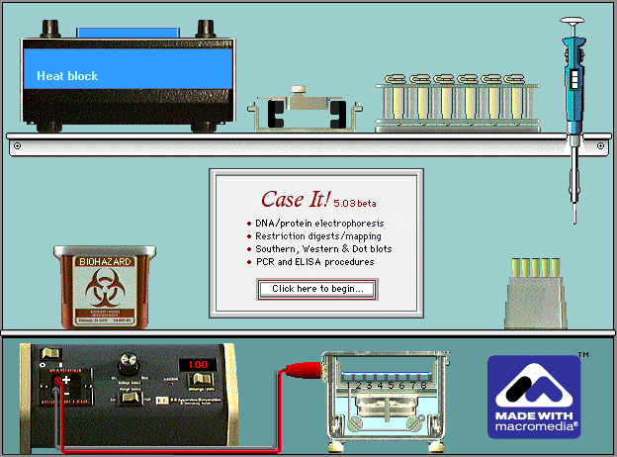
Case It: Integrating molecular biology computer simulations and bioinformatics into case-based learning and research projects
Mark Bergland and Karen Klyczek, University of Wisconsin-River Falls
HHMI Quantitative Biology/BioQUEST Workshop, Emory University, 2013

Slide 2
Session overview
Introduction to the Case It! project and ScienceCaseNet
Microarray cases
breast cancer gene expression
prostate cancer SNP analysis
Bioinformatics applications
Honey bee virus diversity
Freshmen research application: HHMI SEA-PHAGES
Case It Mobile as an alternative to the Case It simulation
How to develop your own Case It cases

Slide 3
Case It! Project
Case It! Home Page: www.caseitproject.org
Includes tutorials, downloads, case descriptions, forums, suggestions for class use, and workshop links
Case It is part of ScienceCaseNet.org network for case and problem-based learning, funded by RCN-UBE program of NSF
Contact: mark.s.bergland@uwrf.edu
Case It funding was provided by the TUES program
of the National Science Foundation

Slide 4
Case It! Project
Additional Collaborators
Mary Lundeberg, Biology Department, University of
Wisconsin-River Falls
Chi-Cheng Lin, Computer Science Department,
Winona State University
Arlin Toro, Biology Department, Inter American
University of Puerto Rico-San German campus
Rafael Tosado, Medical Technology Program,
Inter American University of Puerto Rico-Metropolitan
Campus
C. Dinitra White, Biology Department, North Carolina
A&T State University

Slide 5
Overview of Case It Project
Electronic framework for analyzing and discussing case studies in molecular biology
Genetic and infectious diseases and associated ethical issues
Students gather background information on cases
Analyze DNA and protein sequences using the Case It simulation (v6.06)
Can extend case analysis using MEGA bioinformatics software (megasoftware.net)
We have used online poster sessions and role-playing, but there are many other ways to use software and cases

Slide 6
Features of Case It v6.06
DNA and protein electrophoresis
Restriction enzyme digestion and mapping
Southern, Dot and Western blotting
Polymerase Chain Reaction (single and multiplex)‏
ELISA
Microarrays (SNP and expression)
BLAST, alignments and tree-building (in conjunction with MEGA software)
Above are used to analyze case studies in genetic and infectious diseases and other biology topics

Slide 7
Session overview
Introduction to the Case It! project and ScienceCaseNet
Microarray cases
breast cancer gene expression
prostate cancer SNP analysis
Bioinformatics applications
Honey bee virus diversity
Freshmen research application: HHMI SEA-PHAGES
Case It Mobile as an alternative to the Case It simulation
How to develop your own Case It cases

Slide 8
Breast cancer case
Woman diagnosed with breast cancer, without prior risk factors
Microarray analysis used to determine potential for aggressive growth and invasiveness of tumor

Slide 9
Breast cancer microarray case
Sarah was devastated when she received a diagnosis of breast cancer. It did not seem to run in her family, so she assumed she did not have to worry about it. She is grateful for the support of her friends, especially Molly, who is a clinical lab pathologist. Molly is helping her think about the difficult decisions regarding how aggressive her treatment should be, in terms of surgery, chemotherapy, etc.

Slide 10
Breast cancer microarray case
Molly explains that the oncologist recommended running a lab test that uses a microarray to measure the expression of specific genes. The pattern of gene expression can predict how quickly the tumor cells will grow and whether they will respond to various treatments. Sarah is meeting with the oncologist to review the results, and she has asked Molly to go with her.

Slide 11
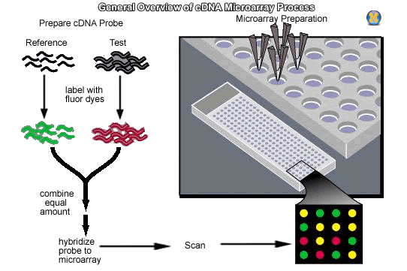
Microarray method
RNA
cDNA

Slide 12
Breast cancer microarray
Genes associated with increased cell proliferation (or rapid growth) in breast cancer tumors:
Ki-67, STK15, Survivin, Cyclin B1, MYLB2
Genes associated with increased tumor cell invasion:
Stromelysin 3, Cathepsin L2
Genes associated with proliferation in response to estrogen:
SCUBE2, PGR, ERBB2

Slide 13
Session overview
Introduction to the Case It! project and ScienceCaseNet
Microarray cases
breast cancer gene expression
prostate cancer SNP analysis
Bioinformatics applications
Honey bee virus diversity
Freshmen research application: HHMI SEA-PHAGES
Case It Mobile as an alternative to the Case It simulation
How to develop your own Case It cases

Slide 14
Prostate cancer case
PSA blood test, link to prostate cancer being questioned
SNPs associated with naturally high blood PSA levels detected by microarray
Should biopsy be done based on high PSA test result?

Slide 15
Session overview
Introduction to the Case It! project and ScienceCaseNet
Microarray cases
breast cancer gene expression
prostate cancer SNP analysis
Bioinformatics applications
Honey bee virus diversity
Freshmen research application: HHMI SEA-PHAGES
Case It Mobile as an alternative to the Case It simulation
How to develop your own Case It cases

Slide 16
Case scenario - honeybees
Honey bees are commonly exposed to pesticides as they forage for pollen and nectar. Some pesticides are known to disorient bees and thus affect their behavior. Sub-lethal exposures of some pesticides are considered possible contributing factors to Colony Collapse Disorder (CCD). Dr. Muskiver was curious if pesticide exposure was linked to virus infection, another possible contributing factor to CCD.
To test this question, Dr. Muskiver set up four test hives, and fed the honey bees either with untreated pollen or pollen treated with sub-lethal doses of the pesticide Imidocloprid, a neonicotinoid. Samples of 20 bees from each hive were collected, RNA was extracted, and cDNA synthesized in order to run PCR. Multiplex PCR was performed using primers specific for 4 viruses, and also for the bee actin gene as a control. PCR products can be identified based on the size of the product:

Slide 17
Primers
Primers PCR product size
Actin 120 bp
Deformed wing virus (DWV) 203 bp
Black queen cell virus (BQCV) 322 bp
Sac brood virus (SBV) 487 bp
Israeli acute paralysis virus (IAPV) 719 bp

Slide 18
DNA samples
DNA samples for testing:
Negative control – bee sample with no viruses present Positive control – bee sample containing all four viruses Hive 1 – exposed to pesticides Hive 2 – exposed to pesticides Hive 3 – no pesticides exposure Hive 4 – no pesticide exposure

Slide 19
Procedure
Open DNA seqences and primer
Run multiplex PCR
Load and run gel
Click fragment and blast associated DNA sequence

Slide 20
Case scenario - bioinformatics
Recent declines in honey bee populations have given rise to the syndrome named Colony Collapse Disorder (CCD). Several potential stressors have been identified. A team of research scientists, funded by the North American Honey Bee Council, decide to survey colonies from around North America for two of the notable stressors – Deformed Wing Virus (DWV), a virus that causes wing deformation, and Varroa destructor, a parasitic mite that feeds on the bee.
It has recently been reported that V. destructor transmits certain strains of DWV more effectively, and that long-term mite infection reduces virus diversity and leads to the prevalence of more pathogenic viruses. The scientists are interested in testing the relationship between DWV strains and the Varroa mite in North America.

Slide 21
Case scenario - bioinformatics
Bees tested from:
Central Ontario - low mite levels
Northwestern Washington - low mite levels
Southeast Florida - high mite levels
Oahu, Hawaii - high mite levels
Northern Arizona - moderate mite levels
Southern British Columbia - moderate mite levels

Slide 22
DNA sequence analysis

Slide 23
Authentic research for first-year students: HHMI SEA-PHAGES Project
Fall semester
Isolate mycobacteriophages from soil
Isolate phage DNA and analyze by restriction enzyme digestion
Select one phage to send for sequencing
Spring semester – phage genomics (www.phagesdb.org)
Annotate genes
Comparative genomics
Research projects on phage biology

Slide 24
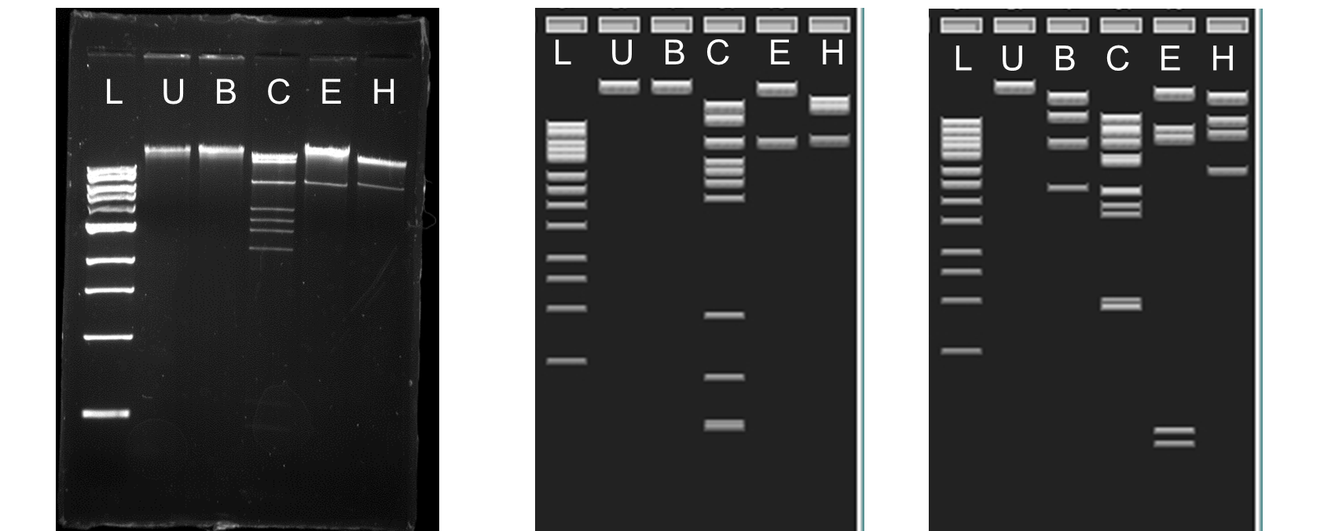
Abrogate lab gel Abrogate virtual gel Bxb1 virtual gel
L=1 kb ladder; U=undigested; B=BamHI; C=ClaI; E=EcoRI H=HindIII

Slide 25
Cluster A phages, listed by subcluster
A1 Perseus
A1 Abrogate
A2 SemperFi
A3 JHC117
A3 Rockstar
A4 MeeZee
A4 Dhanush
A5 Cuco
A6 McFly
A7 Timshel
A8 Astro
A9 Packman
A10 Rebeuca
A10 Trike
Left to right: 1 kb ladder, undigested, BamHI, ClaI, EcoRI, HindIII

Slide 26
Phage genetic analysis
Choose phages from the A3, A4, A7 or A10 subcluster
Download sequences from www.phagesdb.org
Digest with restriction enzymes
Which enzymes distinguish these groups of phages?
What else can you learn about the relationship between these phage
BLAST sequence of unique bands
Align sequences from common bands

Slide 27
Case It Mobile
Case It v6.06 is a PC application that can also be run on Macs running Windows, via Parallels or Bootcamp
Case It Mobile is a collection of screen-capture videos of the Case It simulation in action, that can be run using a web browser on a laptop, smart phone, or tablet
Useful when either time is not available to run the actual simulation, or PCs (or Macs running Windows) are not available
Example: http://www.caseitproject.org/mobile/

