Slide 1
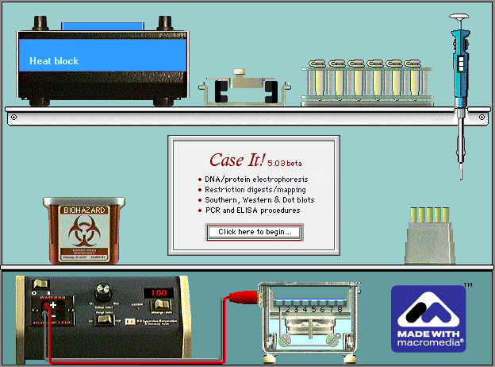
Case It: Integrating molecular biology computer simulations and bioinformatics into case-based learning
Mark Bergland and Karen Klyczek, University of Wisconsin-River Falls
American Society for Microbiology Conference for Undergraduate Educators, Denver 2013

Slide 2
Session overview
Introduction to the Case It! project and ScienceCaseNet
Connecting NCCSTS cases to Case It
Antibiotic resistance in bacteria
Immune evasion and virus multiplication
Freshmen research application: HHMI SEA-PHAGES
Case It Mobile as an alternative to the Case It simulation
How to develop your own Case It cases
Strategies for implementation and assessment

Slide 3
Case It! Project
Case It! Home Page: www.caseitproject.org
Includes tutorials, downloads, case descriptions, forums, suggestions for class use, and workshop links
Case It is part of ScienceCaseNet.org network for case and problem-based learning, funded by RCN-UBE program of NSF
Contact: mark.s.bergland@uwrf.edu
Case It funding was provided by the TUES program
of the National Science Foundation

Slide 4
Case It! Project
Additional Collaborators
Mary Lundeberg, Biology Department, University of
Wisconsin-River Falls
Chi-Cheng Lin, Computer Science Department,
Winona State University
Arlin Toro, Biology Department, Inter American
University of Puerto Rico-San German campus
Rafael Tosado, Medical Technology Program,
Inter American University of Puerto Rico-Metropolitan
Campus
C. Dinitra White, Biology Department, North Carolina
A&T State University

Slide 5
Overview of Case It Project
Electronic framework for analyzing and discussing case studies in molecular biology
Genetic and infectious diseases and associated ethical issues
Students gather background information on cases
Analyze DNA and protein sequences using the Case It simulation (v6.06)
Can extend case analysis using Case It and MEGA bioinformatics software (megasoftware.net)
We have used online poster sessions and role-playing, but there are many other ways to use software and cases

Slide 6
Features of Case It v6.06
DNA and protein electrophoresis
Restriction enzyme digestion and mapping
Southern, Dot and Western blotting
Polymerase Chain Reaction (single and multiplex)‏
ELISA
Microarrays (SNP and expression)
BLAST, alignments and tree-building (in conjunction with MEGA software)
Above are used to analyze case studies in genetic and infectious diseases and other biology topics

Slide 7
Session overview
Introduction to the Case It! project and ScienceCaseNet
Connecting NCCSTS cases to Case It
Antibiotic resistance in bacteria
Freshmen research application: HHMI SEA-PHAGES
Case It Mobile as an alternative to the Case It simulation
How to develop your own Case It cases
Strategies for implementation and assessment

Slide 8
Connection to NCCSTS cases
Case It case: “MRSA” – on Case It web site
“Nelson … grew up in the mountains of Utuado, Puerto Rico. At twelve years of age …he shared the stage with the famous Puerto Rican singer Ednita Nazario. At age 22, he received a call confirming an audition to enter the American Music and Dramatic Academy (AMDA) in New York. Nelson decided to undergo cosmetic surgery to reduce and re-shape his nose before going to New York.
A week after the second surgery, Nelson’s nose and face were quite swollen, bruised, and aching, and his body temperature was 99.5°F. Nelson was suffering an infection, probably a Staph infection. As they waited for the lab results, Nelson did not understand how he could develop an infection since he never missed a single dose of his antibiotic….
[His sister] was looking into the possibility of filing a lawsuit against the hospital and the surgeon on the basis that her brother acquired a nosocomial infection during the surgery.”

Slide 9
DNA Sequences and Primers
DNA has been isolated from the following bacteria samples: - culture of bacteria from Nelson's lesions - an antibiotic-sensitive S. aureus - a hospital-acquired methicillin-resistant S. aureus - a community-acquired methicillin-resistant S. aureus
PCR primers are available for the following: - glp, a housekeeping gene found in all strains of S. aureus (843 bp) - pvl, a toxin gene common in community-acquired MRSA (433 bp) - mec, part of the cassette found in most samples of MRSA (393 bp)

Slide 10
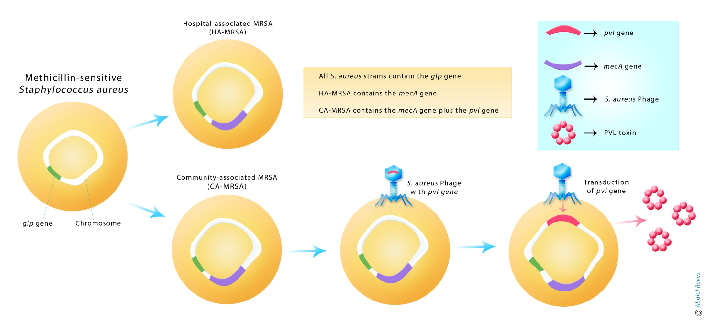
Hospital-associated versus community-associated MRSA

Slide 11
Analysis using Case It and MEGA
Case It procedure: Use these primers to run PCR and gel electrophoresis on the DNA samples, to see if the corresponding sequences are detected. What do the results tell you about Nelson's infection?
Bioinformatics extension: Compare the glp and/or mec PCR products using the sequence alignment/tree building feature. Do the tree results support your initial conclusions about the source of Nelson's infection?

Slide 12
Analysis using Case It and MEGA
Case It procedure: Use these primers to run PCR and gel electrophoresis on the DNA samples, to see if the corresponding sequences are detected. What do the results tell you about Nelson's infection?
Bioinformatics extension: Compare the glp and/or mec PCR products using the sequence alignment/tree building feature. Do the tree results support your initial conclusions about the source of Nelson's infection?
What is a possible alternative to antibiotics?

Slide 13
Authentic research for first-year students: HHMI SEA-PHAGES Project
Fall semester
Isolate mycobacteriophages from soil
Isolate phage DNA and analyze by restriction enzyme digestion
Select one phage to send for sequencing
Spring semester – phage genomics (www.phagesdb.org)
Annotate genes
Comparative genomics
Research projects on phage biology

Slide 14
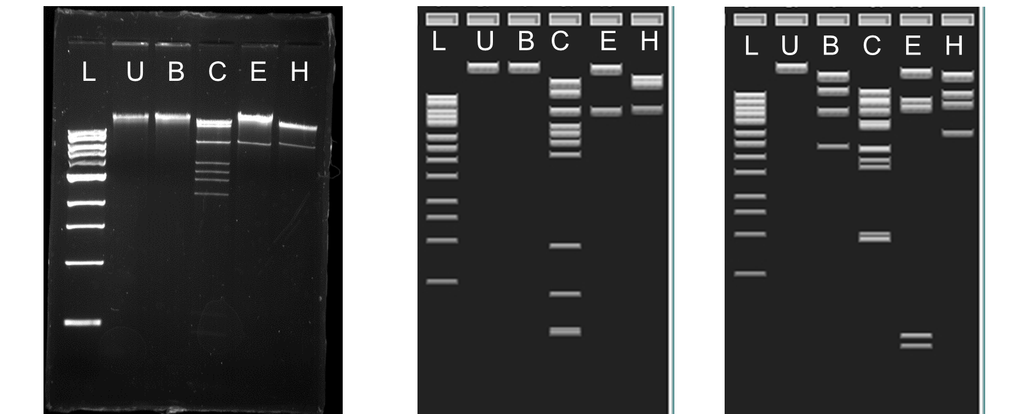
Abrogate lab gel Abrogate virtual gel Bxb1 virtual gel
L=1 kb ladder; U=undigested; B=BamHI; C=ClaI; E=EcoRI H=HindIII

Slide 15
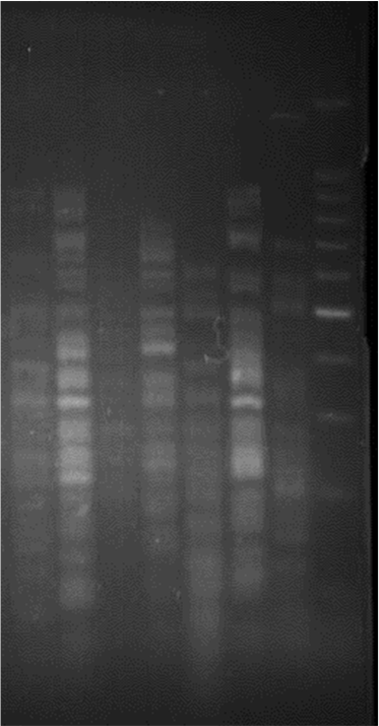
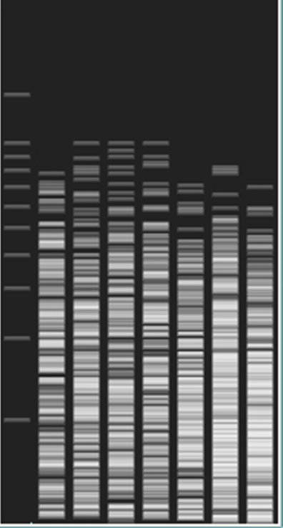
HaeIII Lab Gels
HaeIII Virtual Gel
1 2 3 4 5 6 7 8 9 10 11 12 13 14 15 16
* * * * * * *
* Indicates A1 phages
* Indicates Abrogate

Slide 16
L1 Joe Dirt
L2 Breezona
M Rey
N Butters
O Catdawg
P Fishburne
Q OBUPride
S Marvin
T RonRayGun
F1 Dorothy
F2 Avani
F2 Yoshi

Slide 17
Case It Mobile
Case It v6.06 is a PC application that can also be run on Macs running Windows, via Parallels or Bootcamp
Case It Mobile is a collection of screen-capture videos of the Case It simulation in action, that can be run using a web browser on a laptop, smart phone, or tablet
Useful when either time is not available to run the actual simulation, or PCs (or Macs running Windows) are not available
Example: http://www.caseitproject.org/mobile/

Slide 18
Discussion
Does adding lab simulations increase engagement and/or enhance learning?
Ideas for additional Case It connections to NCCSTS cases or other cases?
Ideas for other original cases?

