Slide 1
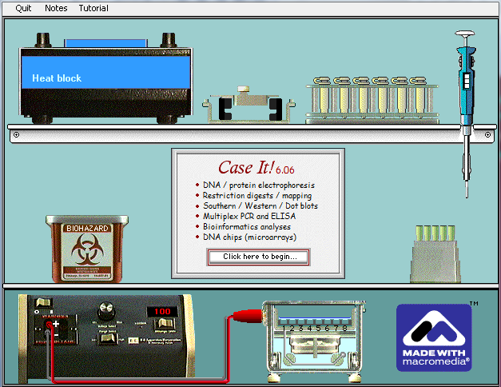
Case It workshop: integrating molecular biology computer simulations and bioinformatics into case-based learning and student research
Mark Bergland and Karen Klyczek University of Wisconsin-River Falls
ACUBE Annual Meeting, Lakeland College, 2012

Slide 2
Case It! Project
URL for Case It! Home Page:
http://caseit.uwrf.edu
Includes tutorials and download links
Access to cases descriptions, problem spaces
Contact: mark.s.bergland@uwrf.edu
Previous support from the TUES program
of the National Science Foundation

Slide 3
Workshop overview
Current application – HHMI SEA-PHAGES
Case examples - Huntington’s disease
Case It Mobile - HIV
Microarray cases - breast cancer gene expression and SNP microarray for prostate cancer
Case development – your ideas

Slide 4
Case It! Project
Electronic framework for analyzing and discussing case studies in molecular biology
Genetic and infectious diseases and associated ethical issues
Students gather background information on cases
Analyze DNA and/or protein sequences using
Case It! simulation
Online poster sessions
Role-playing

Slide 5
Techniques for DNA and protein analysis Case It! simulation
Features of Case It! simulation
DNA and protein electrophoresis
Restriction enzyme digestion and mapping
Southern blotting
Dot blotting
Polymerase Chain Reaction (single and multiplex)‏
ELISA
Western blotting
Microarrays (SNP and expression)
Case studies in genetic and infectious diseases and other biology topics

Slide 6
Case It! Simulation New features in version 6.06
Bioinformatics tools
Open and save FASTA sequences
Connection to BLAST and other NCBI tools
Integration with MEGA software
Alignments
Tree building
Other
Microarray simulation
SNP
Expression

Slide 7
Workshop overview
History of the Case It project
Current application – HHMI SEA-PHAGES
Case examples - Huntington’s disease
Case It Mobile - HIV
Microarray cases - breast cancer gene expression and SNP microarray for prostate cancer
Case development – your ideas

Slide 8
Open-ended research
HHMI SEA-PHAGES project in General Biology course for freshmen
Lab sequence replaced by phage research
Isolate mycobacteriophages from soil
Isolate phage DNA and analyze by restriction enzyme digestion
Select one phage to send for sequencing

Slide 9
Open-ended research
Spring semester – phage genomics
Retrieve complete phage genome sequence
Annotate genes
Comparative genomics
Research projects on phage biology
www.phagesdb.org

Slide 10
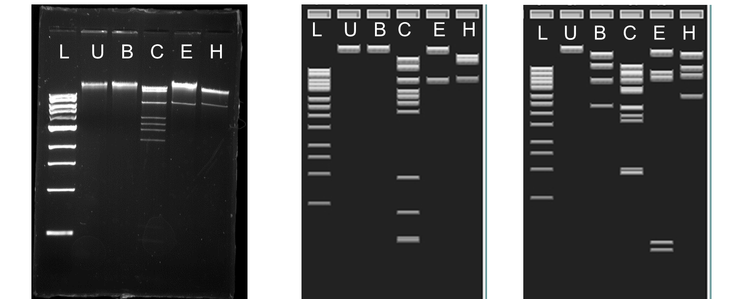
Abrogate lab gel Abrogate virtual gel Bxb1 virtual gel
L=1 kb ladder; U=undigested; B=BamHI; C=ClaI; E=EcoRI
H=HindIII

Slide 11
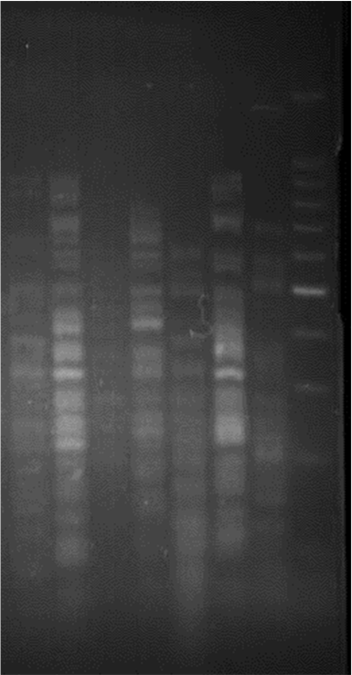
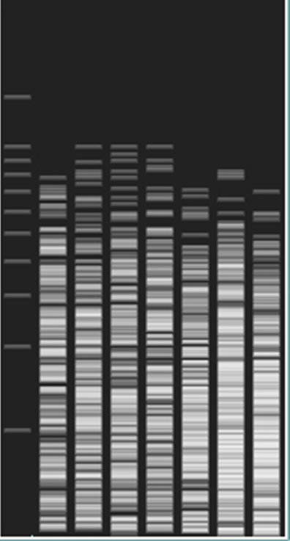
HaeIII Lab Gels
HaeIII Virtual Gel
1 2 3 4 5 6 7 8 9 10 11 12 13 14 15 16
* * * * * * *
Ran separate in 2% agarose gel
* Indicates A1 phages
* Indicates Abrogate
Abrogate significantly different from A1 phages

Slide 12
Phage studies
Obtain phage sequence from Phages Database (www.phagesdb.org)
Digest phage with enzyme set to compare fragment patterns.
BLAST fragment sequences to determine location in phage genome

Slide 13
Workshop overview
History of the Case It project
Current application – HHMI SEA-PHAGES
Case examples - Huntington’s disease
Case It Mobile - HIV
Microarray cases - breast cancer gene expression and SNP microarray for prostate cancer
Case development – your ideas

Slide 14
Huntingon’s disease case
Case scenario - from Case It web site
Restriction enzyme digestion and Southern blot
PCR and gel electrophoresis
Sequence analysis - detect triplet base repeat, sequence alignment and BLAST to identify gene

Slide 15
Workshop overview
History of the Case It project
Current application – HHMI SEA-PHAGES
Case examples - Huntington’s disease
Case It Mobile - HIV
Microarray cases - breast cancer gene expression and SNP microarray for prostate cancer
Case development – your ideas

Slide 16
Workshop overview
History of the Case It project
Current application – HHMI SEA-PHAGES
Case examples - Huntington’s disease
Case It Mobile - HIV
Microarray cases - breast cancer gene expression and SNP microarray for prostate cancer
Case development – your ideas

Slide 17
Breast cancer case
Woman diagnosed with breast cancer, without prior risk factors
Microarray analysis used to determine potential for aggressive growth and invasiveness of tumor

Slide 18
Prostate cancer case
PSA blood test, link to prostate cancer being questioned
SNPs associated with naturally high blood PSA levels detected by microarray
Should biopsy be done based on high PSA test result?

Slide 19
Workshop overview
History of the Case It project
Current application – HHMI SEA-PHAGES
Case examples - Huntington’s disease
Case It Mobile - HIV
Microarray cases - breast cancer gene expression and SNP microarray for prostate cancer
Case development – honey bee example, your ideas on Case It forum page

Slide 20
Case It! Project
Additional Collaborators
Mary Lundeberg, Biology Department, University of
Wisconsin-River Falls
Chi-Cheng Lin, Computer Science Department,
Winona State University
Arlin Toro, Biology Department, Inter American
University of Puerto Rico-San German campus
Rafael Tosado, Medical Technology Program,
Inter American University of Puerto Rico-Metropolitan
Campus
C. Dinitra White, Biology Department, North Carolina
A&T State University

