Slide 1
Tutorial for using Case It for qPCR analyses
Basic procedure for using Case It to display qPCR fluorescence values
Calculating Ct, Delta Ct, and fold change (Delta-Delta Ct method)
Plotting the standard curve and estimating extrapolated copy values

Slide 2
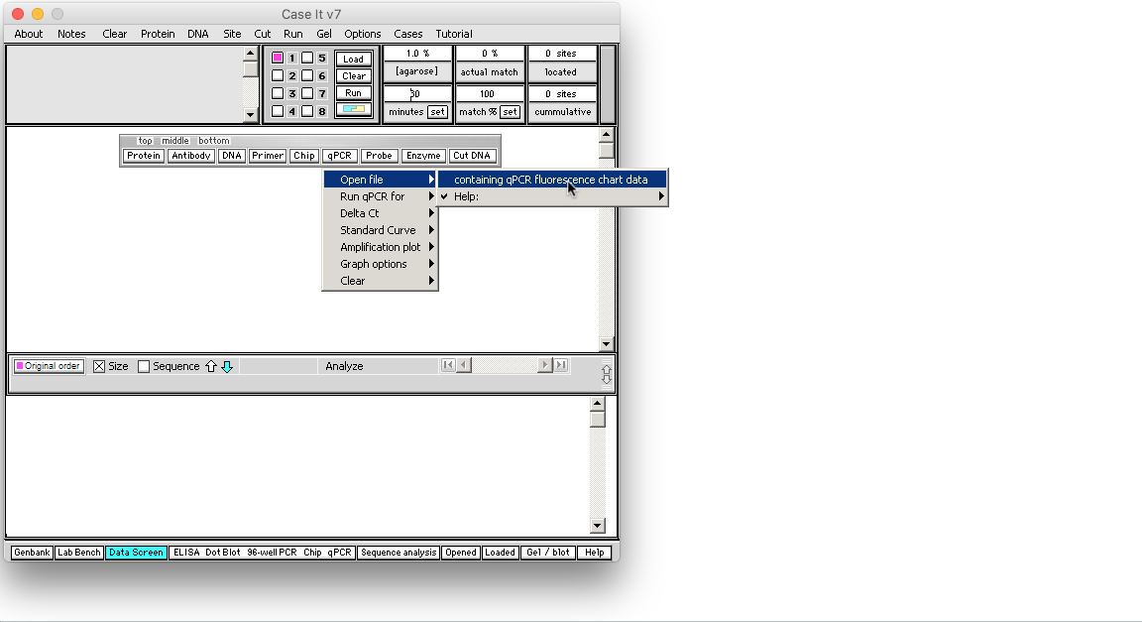
The first part of this tutorial shows how to use Case It v7 to display actual fluorescence data generated by a qPCR thermocycler. Click the qPCR button on the silver button bar, and select Open file -> containing qPCR fluorescence data.
Back to beginning

Slide 3
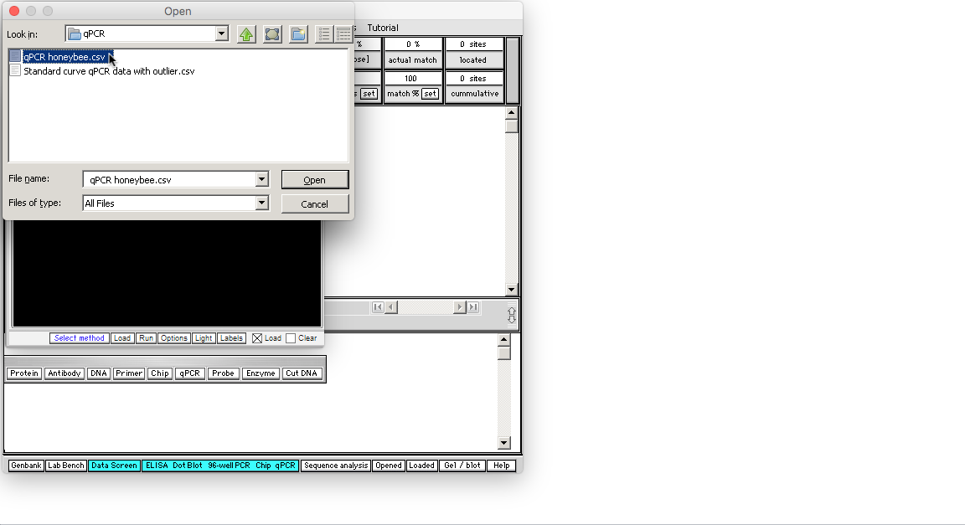
Open the file qPCR honeybee.csv(inside the folders Case It -> Cases -> qPCR -> qPCR honeybee.csv).
Note: The file is inside the qPCR folder, not the Honeybee cases folder.
Back to beginning

Slide 4
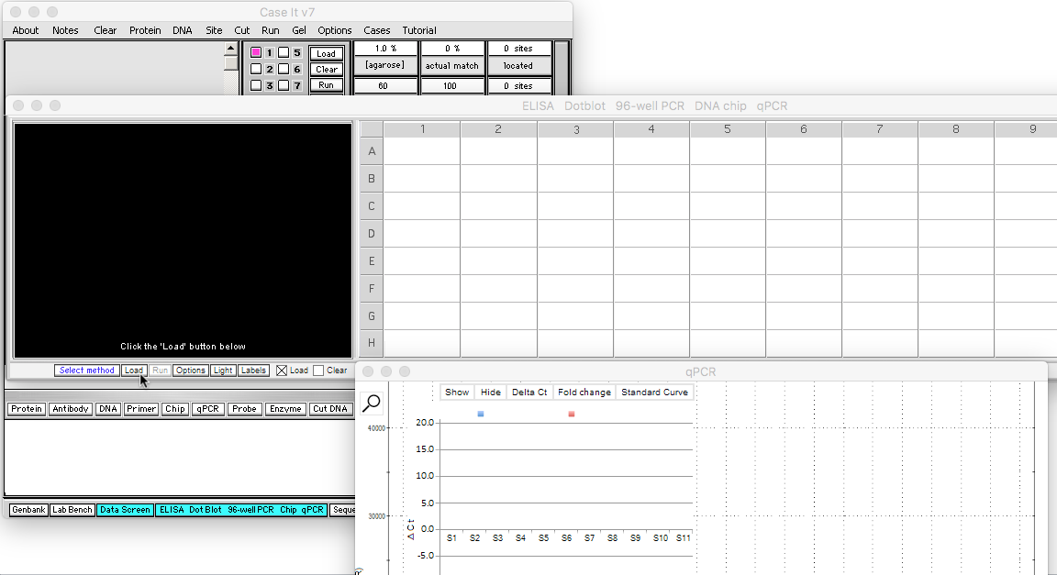
New windows appear when a qPCR file is opened. Click the Load button below the black region of the screen…
Back to beginning

Slide 5
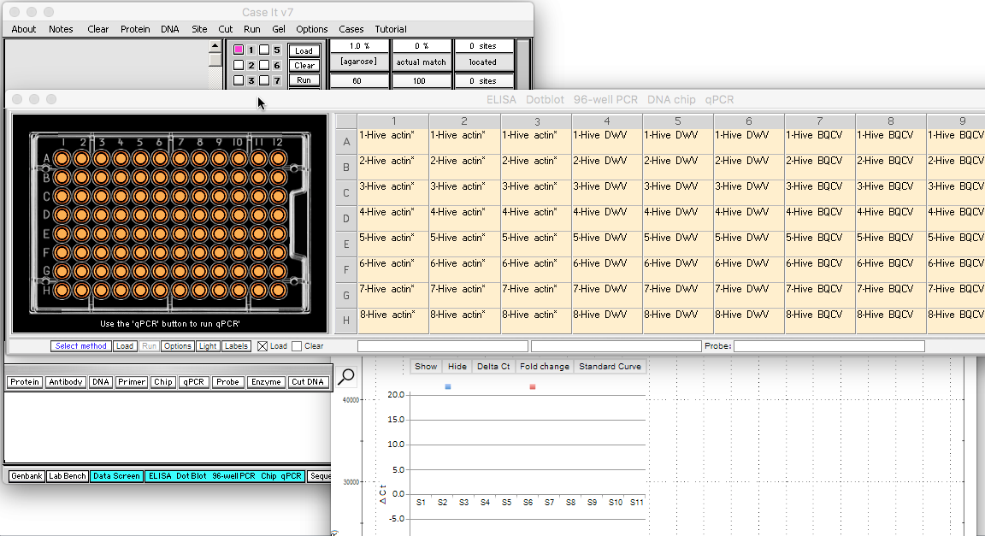
…and the 96 wells turn orange in color, indicating that they have been loaded. Labels indicate names of the samples loaded in each well. To see all the labels we’ll move the window to the left…
Back to beginning

Slide 6
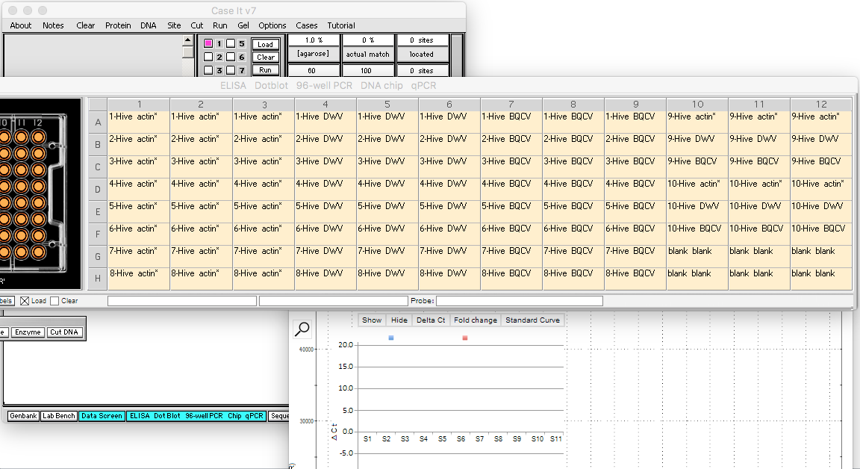
… and all 12 label columns are visible. DWV stands for “Deformed Wing Virus”, and BQCV stands for “Black Queen Cell Virus”. An asterisk following a label name indicates a reference gene (e.g. actin*). Note that for this data set, 10 bee hives have been sampled for DWV and BQCV.
Back to beginning

Slide 7
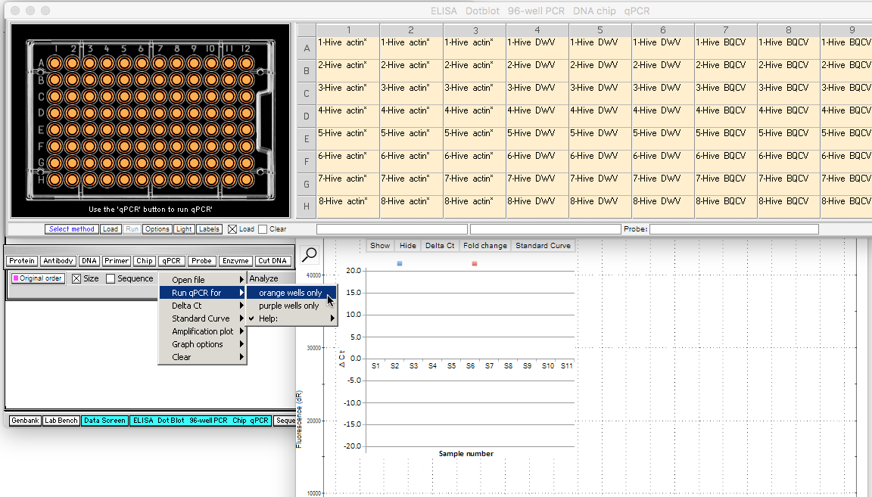
Click the qPCR button and select Run qPCR for -> orange wells only. Note: the Run button next to the Load button has been grayed out, indicating that it is not used to run qPCR (it is used to run other types of analyses involving a 96-well plate, such as ELISA).
Back to beginning

Slide 8
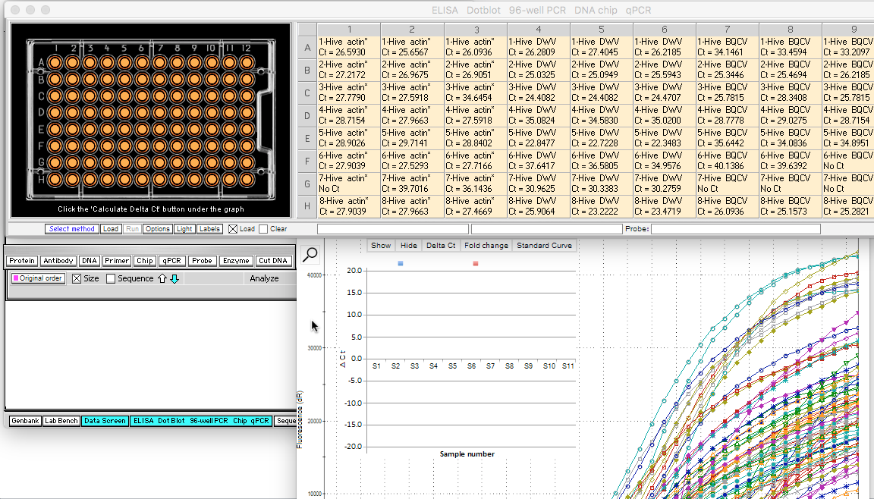
After qPCR runs, Ct values will appear in the labels for each well, for example a Ct value of 24.0337 for well A1. Curves on the graph represent changes in the amount of DNA for each well for 45 qPCR cycles (bottom axis of graph). Click on the graph to bring it forward…
Back to beginning

Slide 9
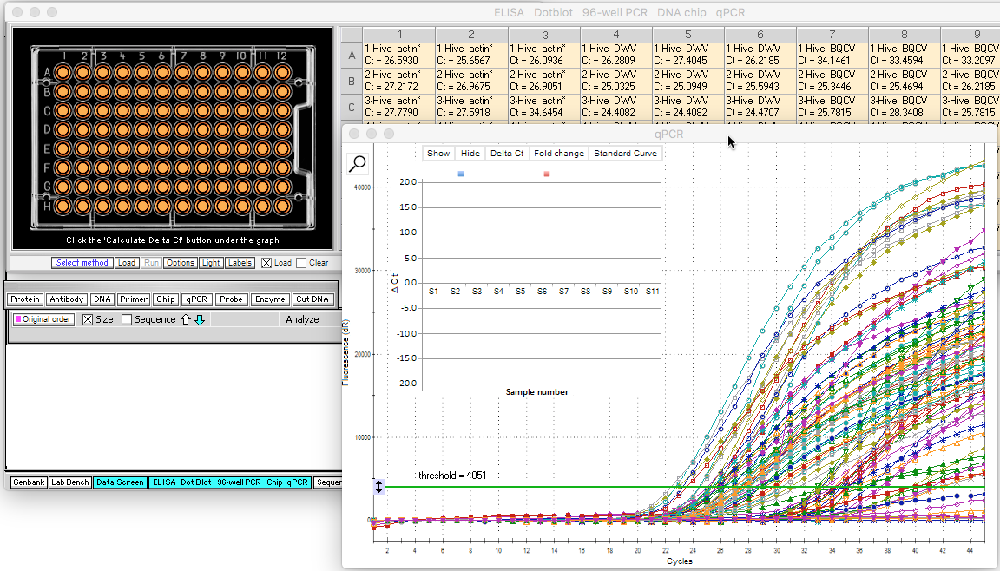
…and all 96 curves can be seen, each with a unique color/symbol combination. The next series of slides will explain how the Ct values were determined from the graph curves.
Back to beginning

Slide 10
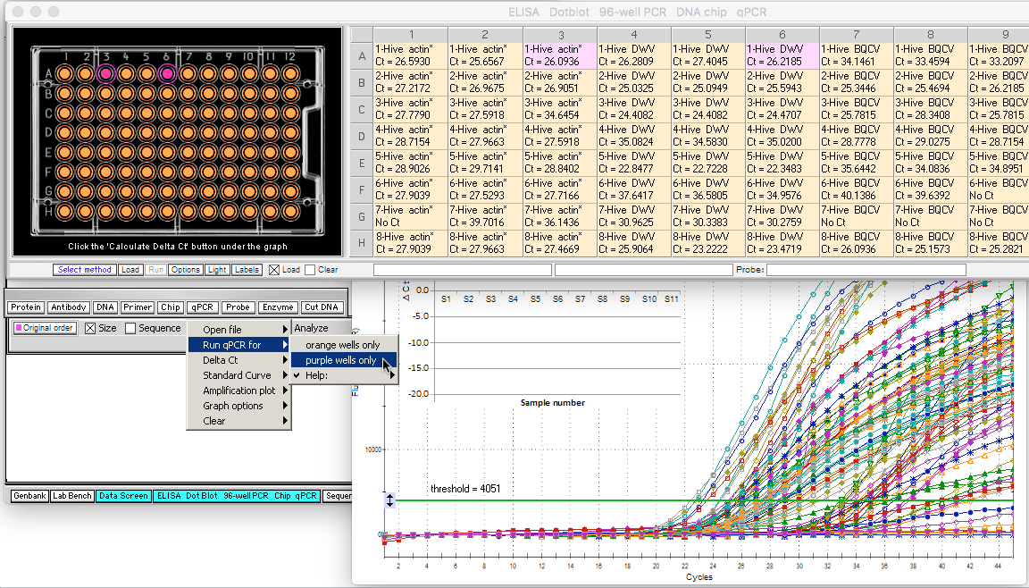
First, click two of the 96 wells (A3 and A6, for example). Note that the wells turn purpose in color, as do the corresponding labels. Then, use the qPCR button and select Run qPCR for -> purple wells only.
Back to beginning

Slide 11
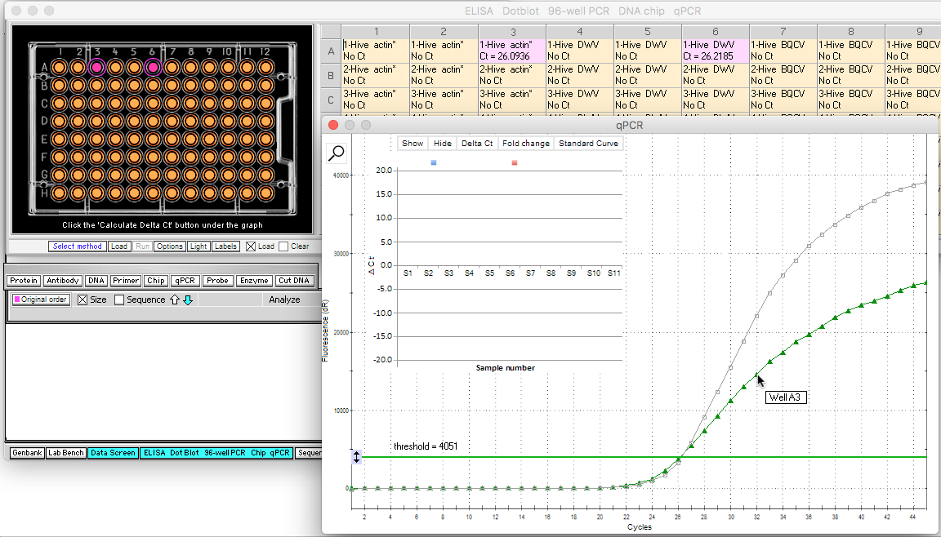
Only two of the 96 curves now appear, along with corresponding Ct values for wells A3 and A6. If the cursor is held over any point on a curve, a box pops up indicating which well the curve is associated with (A3 green, A6 gray).
Back to beginning

Slide 12
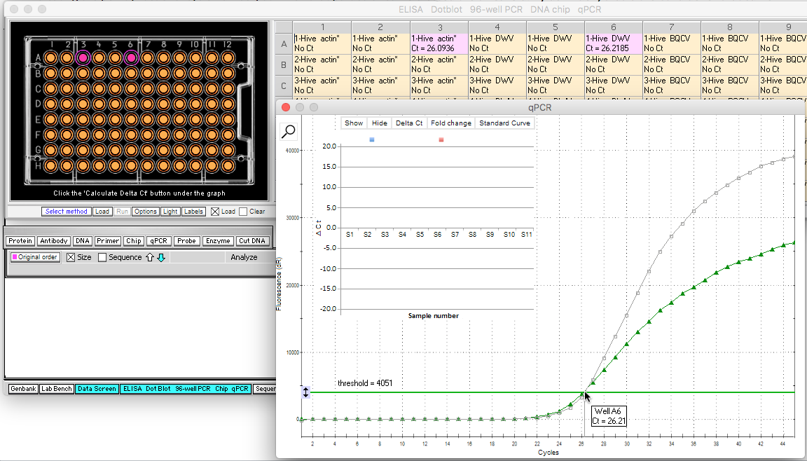
If the cursor is held over the area where a curve intersects the green threshold line, a vertical line is drawn from that point to the bottom axis, indicating the point at which that particular curve crossed the threshold. By definition, that is the Ct value for that curve (26.21 in this case). For this example, both curves have similar Ct values.
Back to beginning

Slide 13

For easier viewing, the graph can be magnified by clicking the magnifying glass icon in the upper left-hand corner of the graph...
Back to beginning

Slide 14
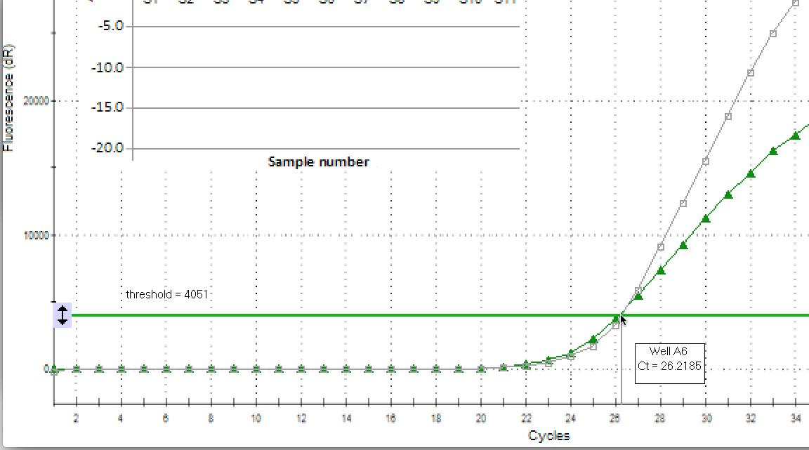
…which makes the intersection of the threshold and curve easier to see. Clicking the magnifying glass icon repeatedly cycles between small, medium, and large views of the graph (note that the icon is not shown in this screen shot).
Back to beginning

Slide 15
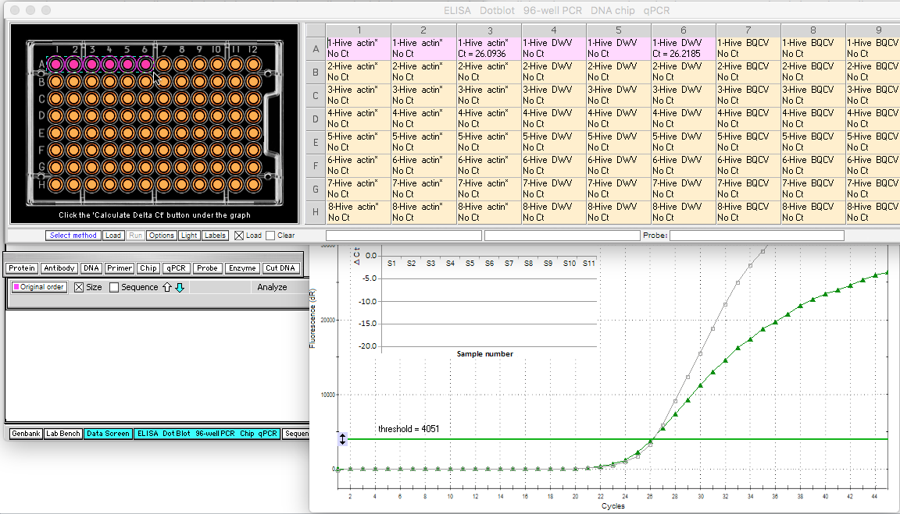
To increase accuracy, qPCR samples are usually loaded in triplicates. Drag over or click wells as shown below so that wells A1 through A6 are purple.
Note that you can make wells purple be clicking either the well or the label associated with that well, but that you can only make them orange again by clicking the well, or by reloading the file.
Back to beginning

Slide 16
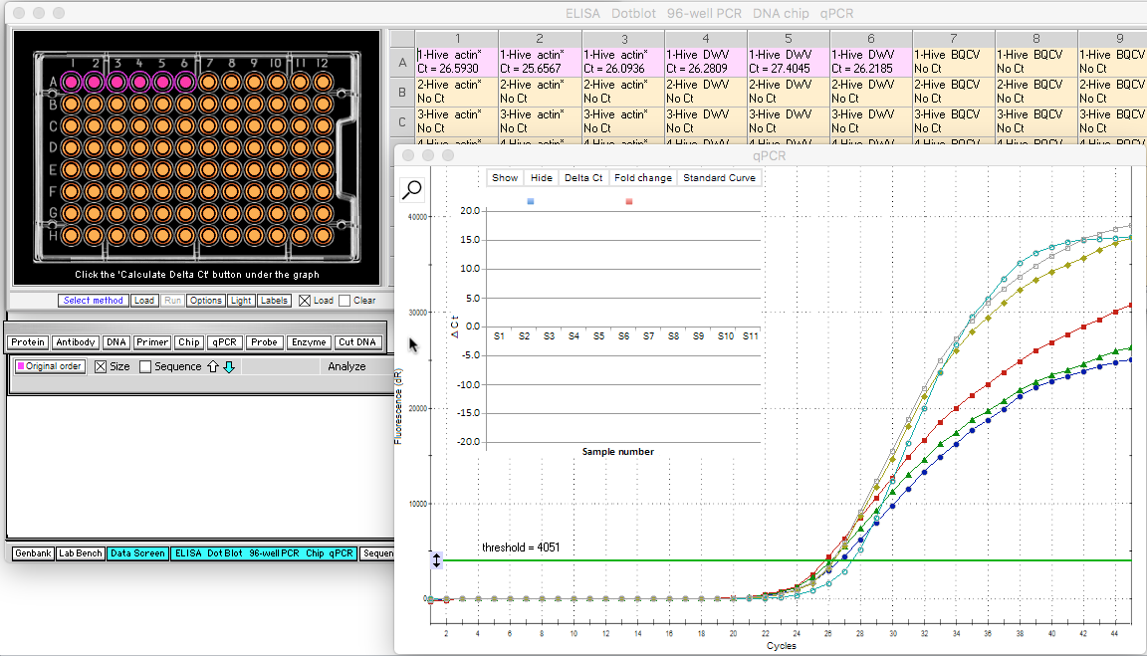
Run qPCR for purple wells only, using qPCR button -> Purple wells only. Note that for this example, the three actin curves and the three DWV curves cross the threshold at similar locations, resulting in similar Ct values for samples associated with wells A1 through A6.
Back to beginning

Slide 17
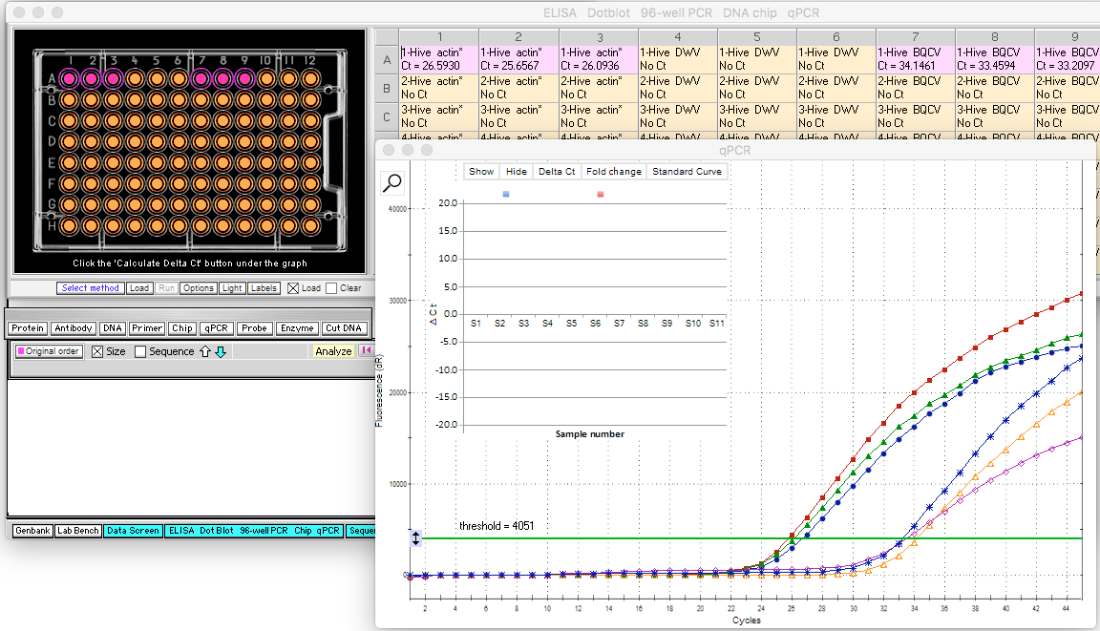
Now click wells A3, A4 and A5 to make them orange again, and click or drag wells A7, A8 and A9 to make them purple. Re-run qPCR for purple wells only, using the same menu commands as before, and note that the three BQCV curves are separated from the three actin curves.
Back to beginning

Slide 18
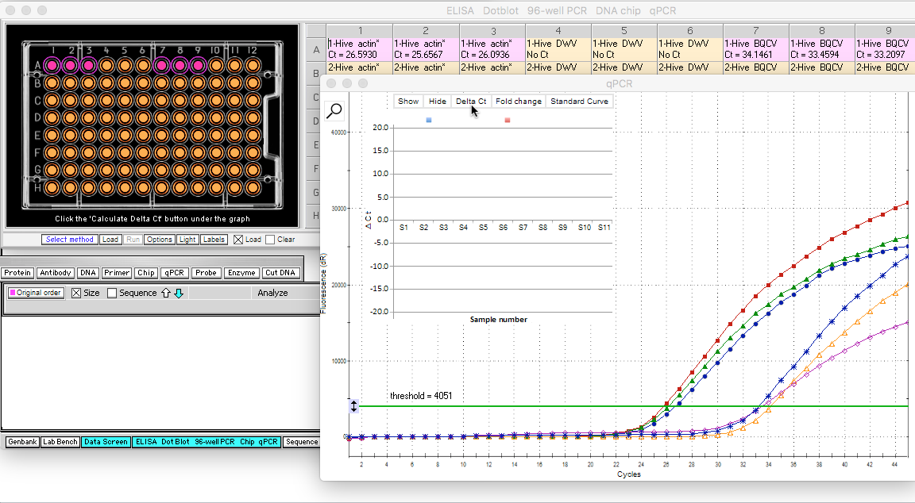
Subtracting the average of the three BQCV Ct values from the average of the three actin Ct values gives the Delta Ct value for this comparison. If you do this by hand for the six purple values below, the average for the actin values is 26.11, and the average for the BQCV values is 33.61, for a Delta Ct value of -7.49. To have the simulation make the calculation, click the Delta Ct button on the graph…
Back to beginning

Slide 19
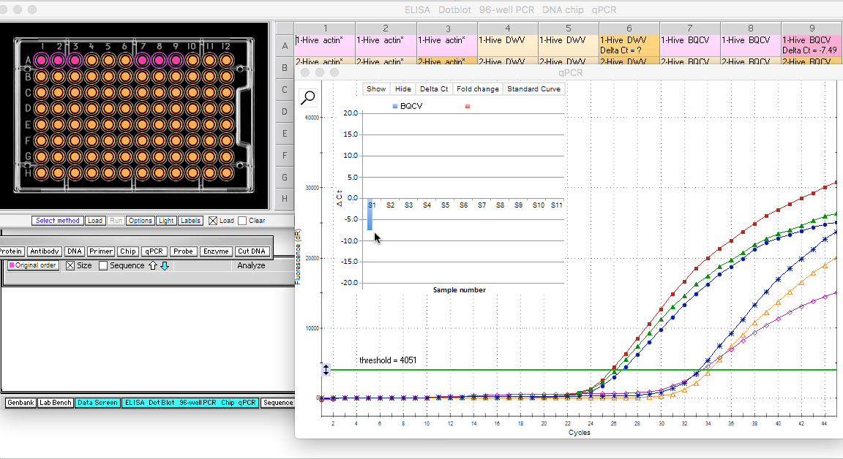
…and the Delta Ct value of -7.49 appears in label A9. Note that a blue bar appears representing this value, pointing downwards because it is represented by a “negative” number.
Note: The threshold is crossed more quickly when initial cDNA amounts are greater, so relatively small Ct values represent relatively large initial cDNA amounts. Thus, an average actin value of 26.11 represents relatively more initial cDNA than an average BQCV value of 33.61. That is why the BQCV value is subtracted from the actin value, resulting in a negative number.
Back to beginning

Slide 20
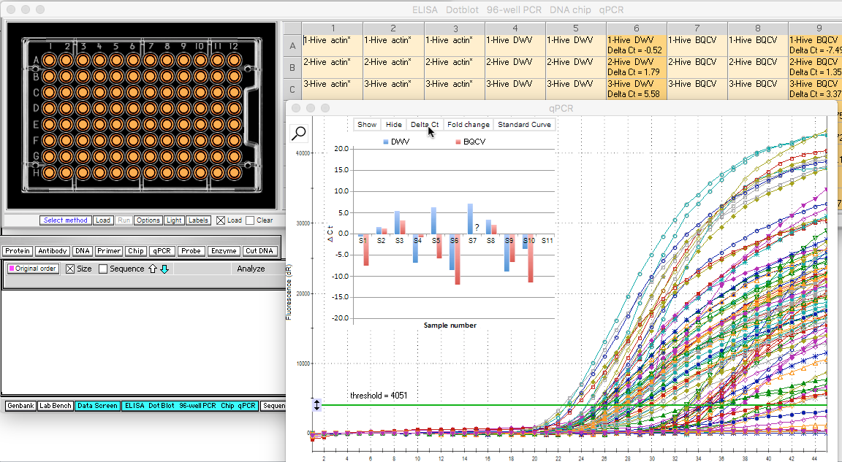
To see the complete set of Delta Ct values, first make all wells orange (either by clicking on the purple wells or by re-opening the re-loading the file). Then re-run the qPCR procedure and click the Delta Ct button. The BQCV bars are now colored red, and the DWV bars are colored blue. Bars that point upwards represent relatively more initial DNA than the reference gene (actin), whereas bars that point downwards represent relatively less initial DNA than the reference gene. Not all columns are shown.
Back to beginning

Slide 21
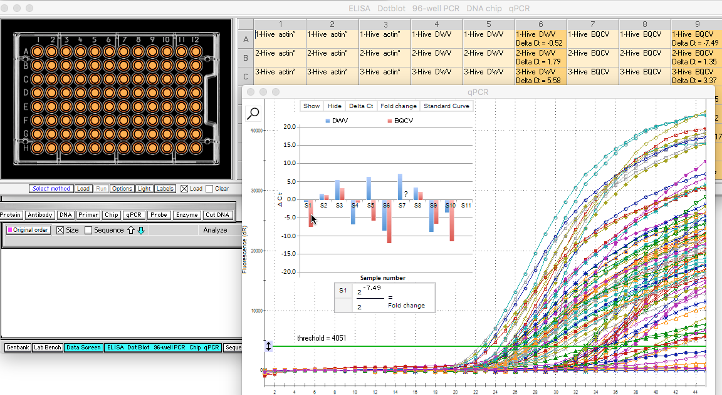
To calculate the fold change (Delta-Delta Ct method) between any two bars on the graph, first single-click on a bar (e.g. the red bar for S1) to put the associated Delta Ct value in the numerator. Note that the numerator of the formula for Delta-Delta Ct is 2 raised to the Ct value, or 2 raised to -7.49 in this case.
Back to beginning

Slide 22
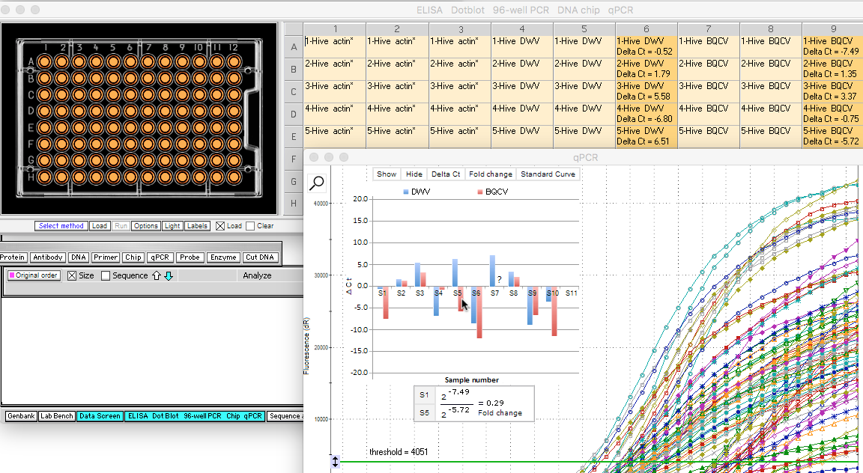
Double-click on any bar to put that bar’s associated Delta Ct value in the denominator of the formula. In this example, double-clicking on the red bar for S5 would put -5.72 in the denominator of the formula, with a resulting fold change of 0.29 between Hives 1 and 5 for BQCV cDNA levels.
Back to beginning

Slide 23
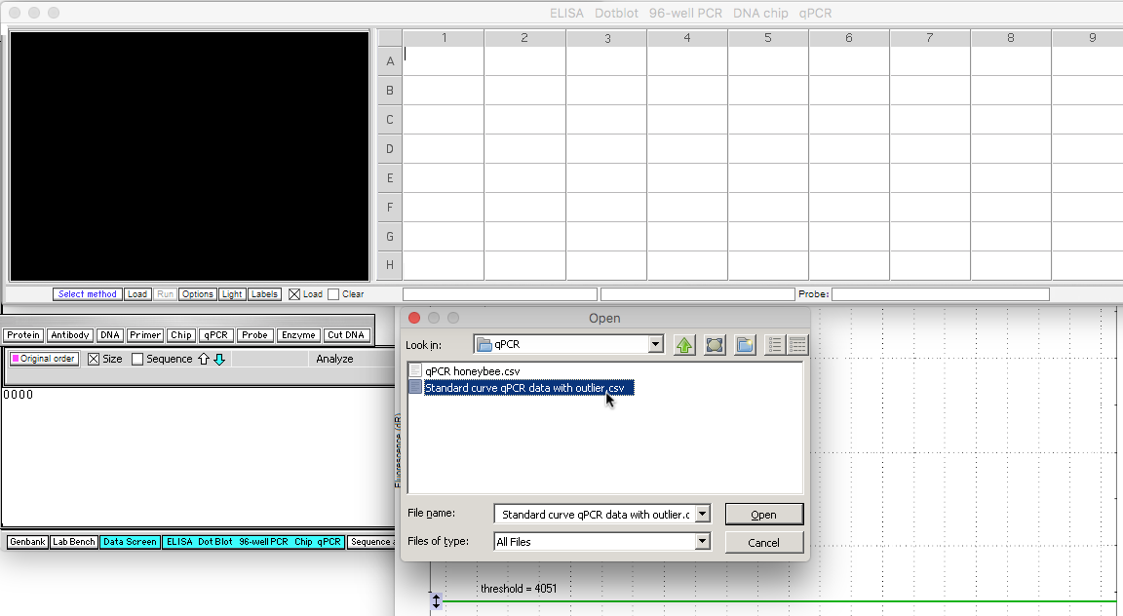
Another feature of the simulation allows the user to determine standard curve values, used for absolute quantification of DNA quantities. To demonstrate this, open the file Standard curve qPCR data with outlier.csv, located inside Cases->qPCR.
Back to beginning

Slide 24
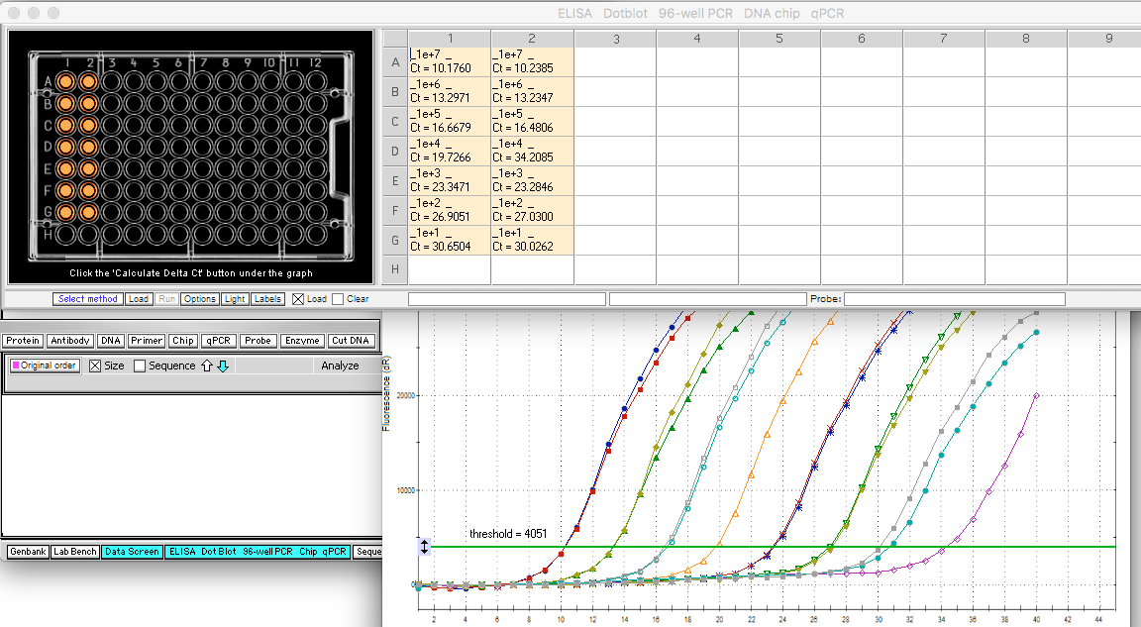
Click the Load button under the 96-well plate, then use the qPCR button and Run qPCR for -> Orange wells only. Standard curve data will appear as shown below. To create a standard curve, known quantities of DNA are amplified and Ct values determined. Note that due to the large numbers involved, e notation is used to display the results (for example, 1e+7 = 1.0*10⁷=10000000 DNA copies.
Back to beginning

Slide 25
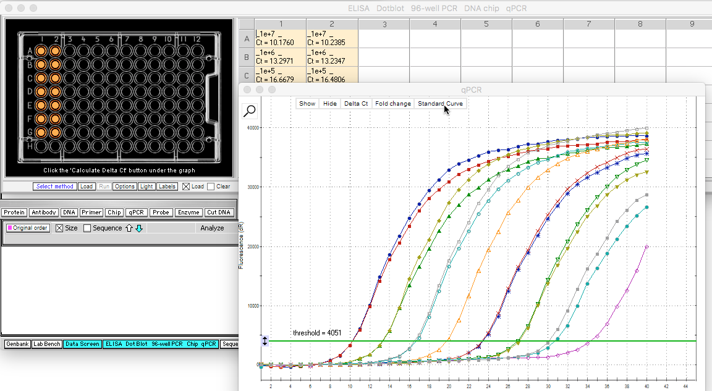
To generate the standard curve from these data, click the Standard Curve button at the top of the graph…
Back to beginning

Slide 26
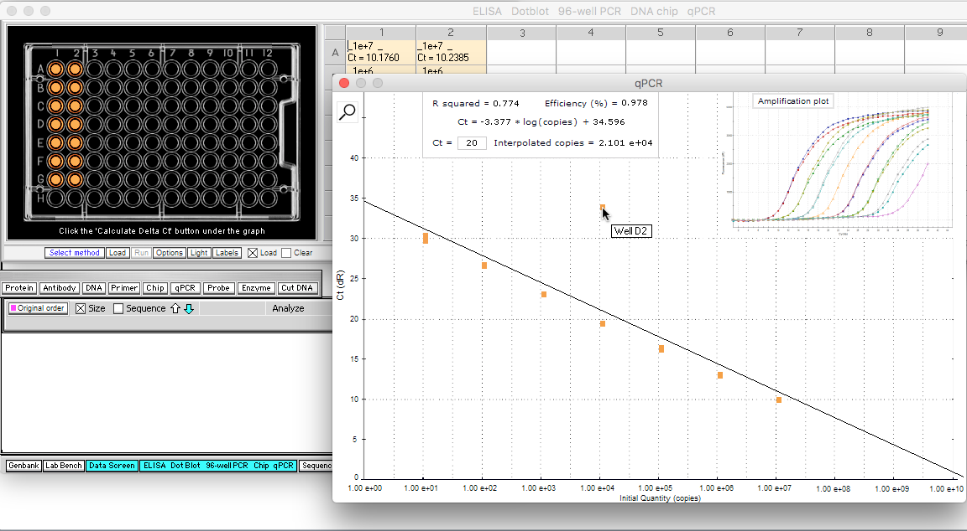
The standard curve plot appears, with a regression line for Ct plotted against initial quantity (copies). Note that an outlier is present in the data set, because a standard curve data points should fall close to the regression line. The outlier can be removed from the data set. First, hold the mouse cursor over the outlier; a box will pop up indicating that it is associated with Well D2, then click the Amplification plot button at upper left.
Back to beginning

Slide 27
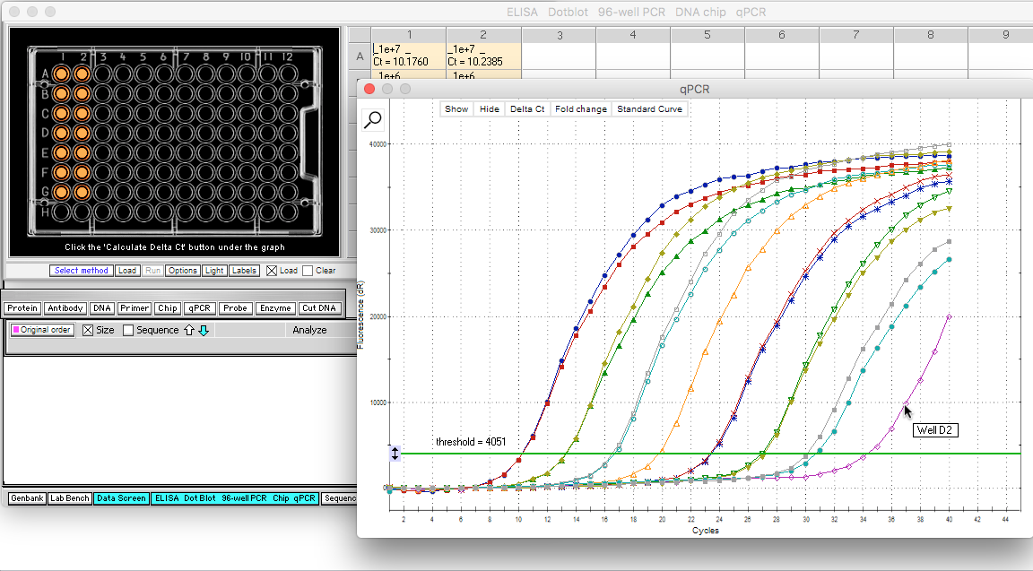
Hold the mouse cursor over the purple curve on the far right, and a box pops up indicating that the curve is for Well D2, the outlier identified on the standard curve.
Back to beginning

Slide 28
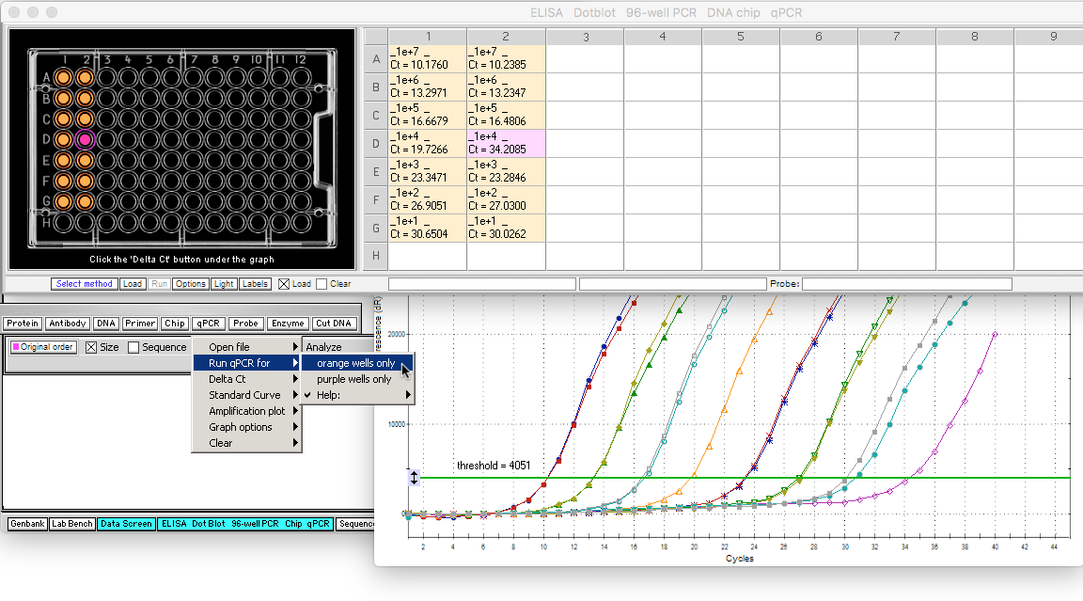
Click well D2 to make it purple, then re-run the standard curve for orange wells only, to exclude the outlier well data.
Back to beginning

Slide 29
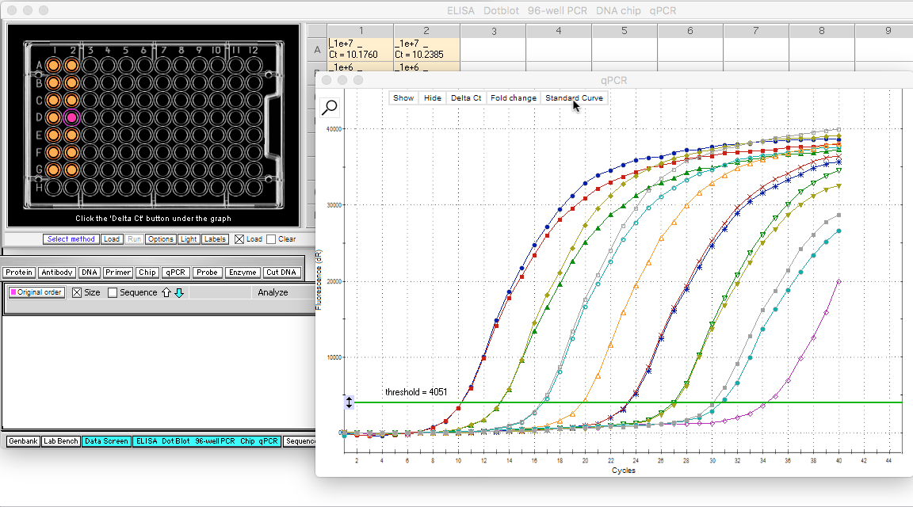
Next, click the Standard Curve button to recalculate the standard curve with the outlier deleted.
Back to beginning

Slide 30
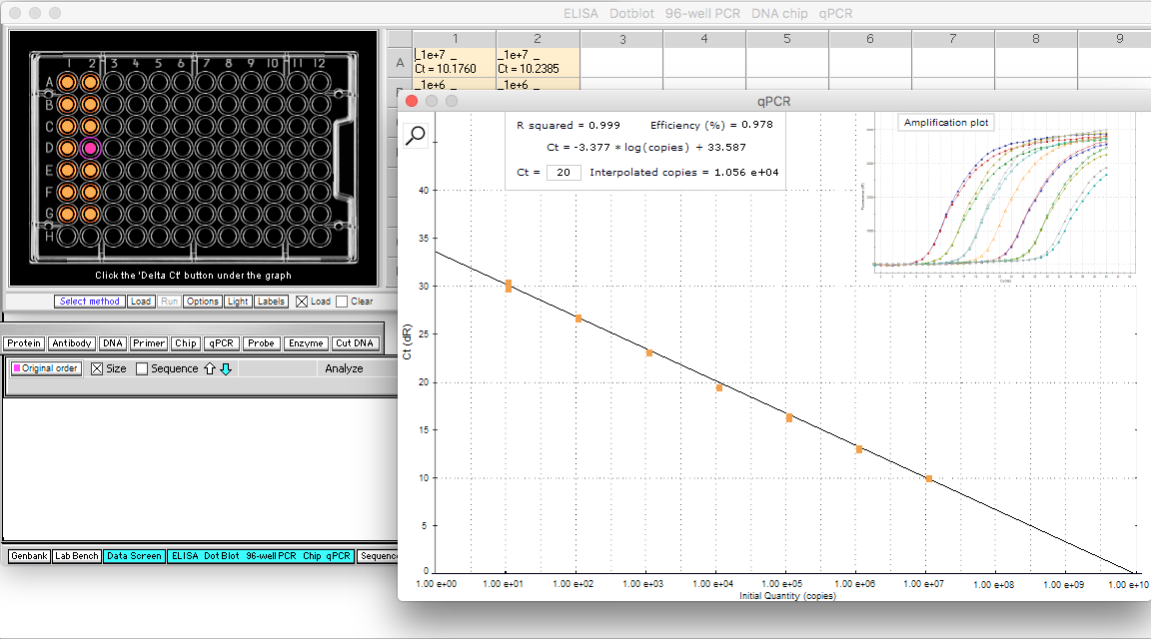
Data points now fall very close to the regression line, as verified by an R squared value of 0.999 (it was 0.774 with the outlier included). Normally you should be very careful about removing outliers from a data set, but for standard curve data we know that the points should fall on the regression line, if the experiment is done correctly. So for standard curve data, outliers definitely mean that something is wrong with the experimental setup.
Back to beginning

Slide 31
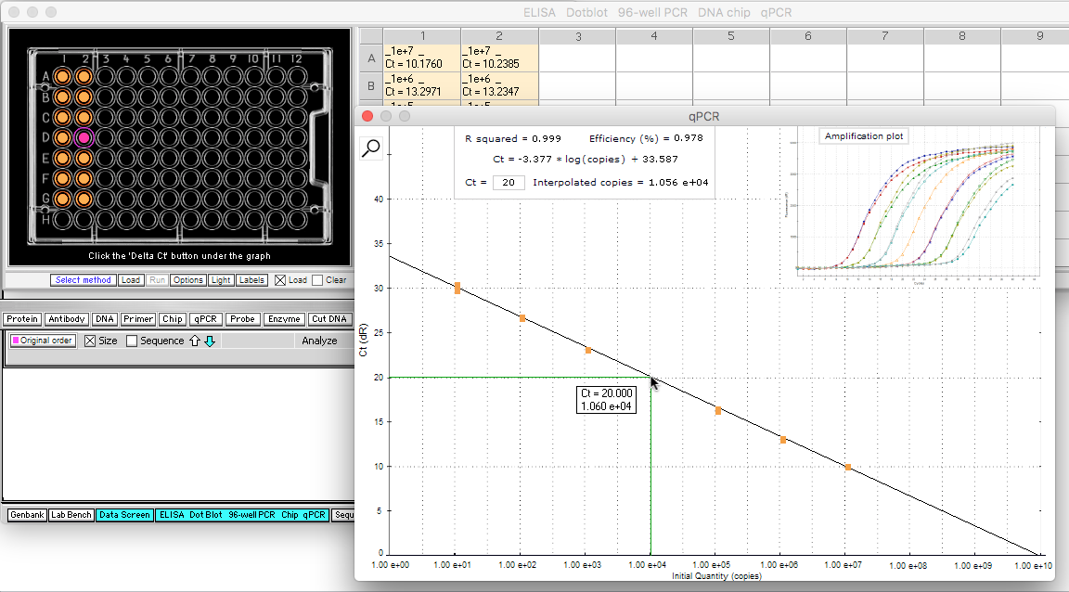
The equation for the regression line is shown in the box on the graph, so that the line can be used to estimate the number of copies present for experimental Ct values. For example, if 20 is entered in the box (the default value), then the number of copies interpolated from the line is 1.056 e+04, or 1056 copies (1.056*10⁴). You can also hold the mouse cursor over any point on the line to generate an interpolated copy number. Note that the number in the pop-up box will be slightly different (1.060 e+04 in this case), depending on where the mouse cursor is positioned on the line.
Back to beginning

