Slide 1
Tutorial for using Case It to search DNA sequences
General sequence searching
Setting search parameters for the PCR procedure
Setting search parameters for Southern and dot blots
Obtaining sequences for research purposes

Slide 2
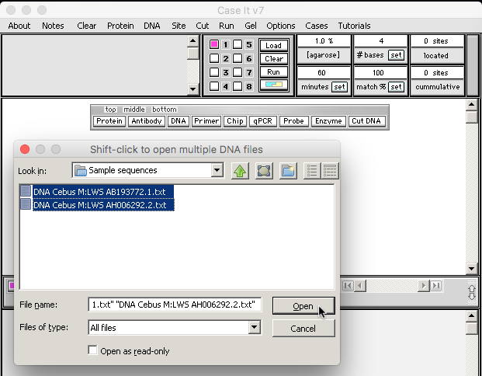
The first part of this tutorial shows the basic procedure for using Case It v7 to search DNA sequences. Click the DNA button on the silver button bar, and double-click on these folders: Case It V7 PC -> Cases -> Color Vision -> Sample Sequences. Shift-click on the two sequences inside the Sample Sequences folder to highlight them, and then click the Open button:
Back to beginning

Slide 3
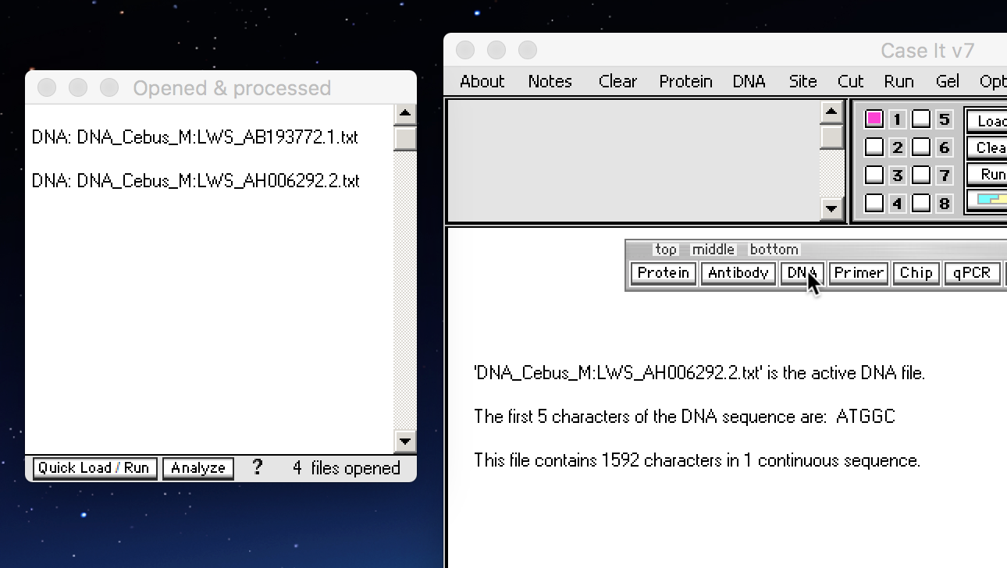
The two open files appear in the Opened & processed window. Click the DNA button again…
Back to beginning

Slide 4
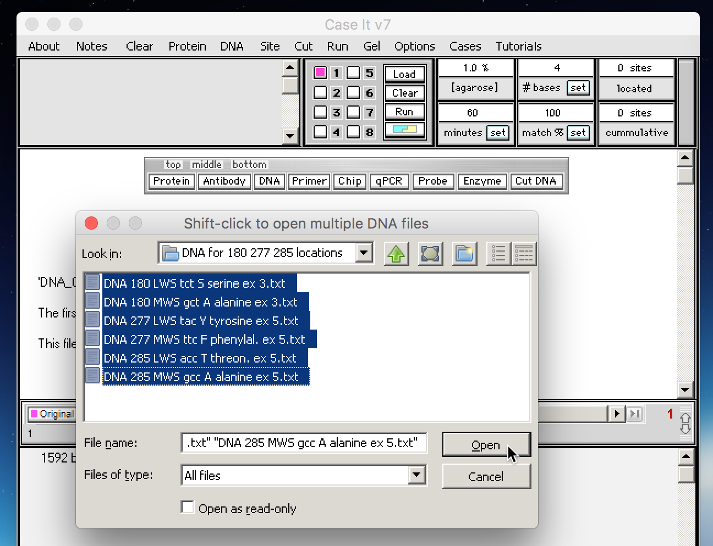
…and double-click through these folders: Case It v7 PC -> Cases -> Color Vision -> DNA for 180 277 285 locations. Shift-click to open all of the files in the DNA for 180 277 285 locations folder.
Back to beginning

Slide 5
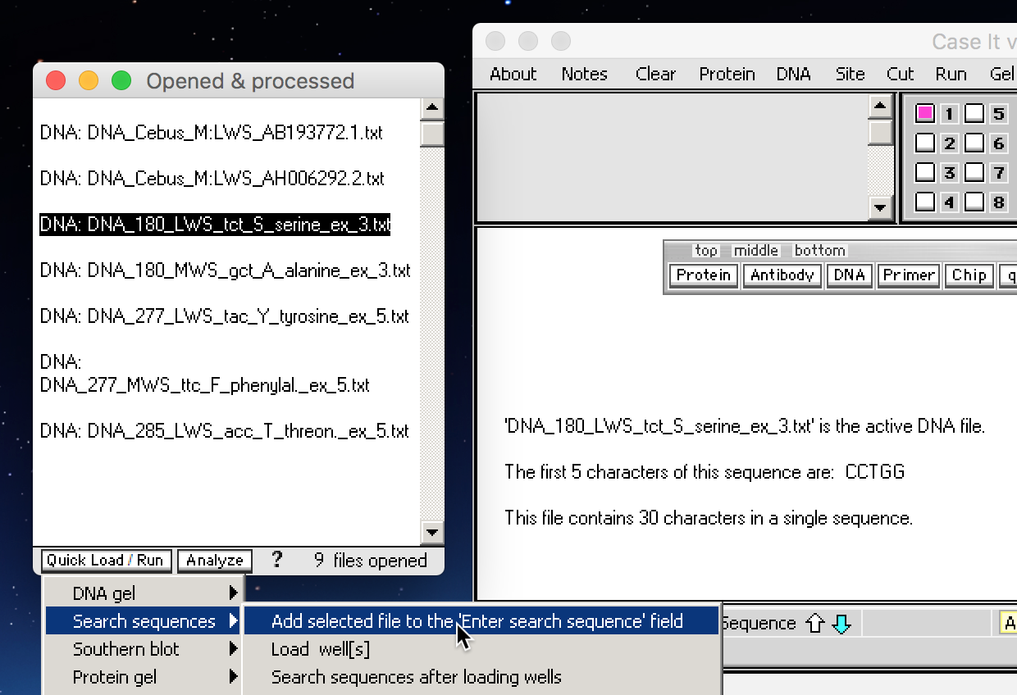
Click on the line DNA: DNA_180_LWS_tct_S_serine_ex_3.txt, and then click the Quick Load / Run button and select Search sequences -> Add selected file to the ‘Enter search sequence’ field.
Note: The explanation of the filename is as follows: In Case It, DNA files must begin with the characters DNA. The number 180 refers to a location on Exon 3 (designated here as_ex_3) of the opsin gene, and the characters tct refer to the DNA codon associated with the amino acid serine (S). One of these three characters would be at position 180 on exon 3 of the opsin gene. Color vision in primates and many other animals depend on which amino acid is associated with this and other positions on the opsin gene. For more information, visit the Evo-Ed site at http://www.evo-ed.org and click on Monkey Opsins.
Back to beginning

Slide 6
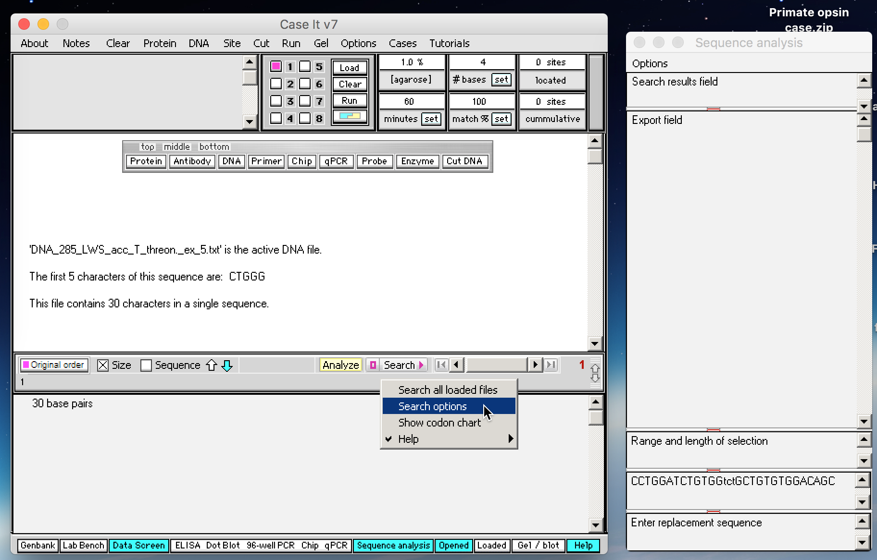
The 30-character sequence in this file appears in the second field from bottom of the Sequence Analysis window (lower right in the screen shot below). Click the Search button and select Search options (or click the purple button to the left of the Search button).
Back to beginning

Slide 7
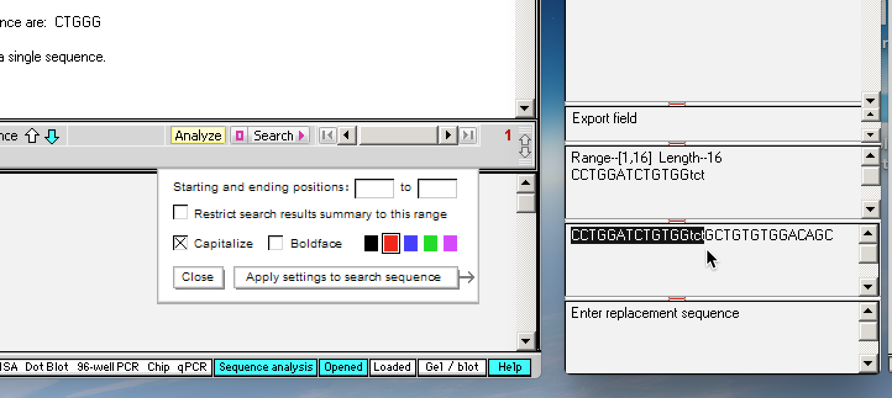
Drag over the search sequence to determine the position of the three lowercase characters. As you do so, the length is updated in the Range field just above the search string field, and the highlighted characters appear there. Note that the three lowercase letters are in positions 14 through 16, so enter those numbers in the Search Options box, as shown on the next slide...
Back to beginning

Slide 8
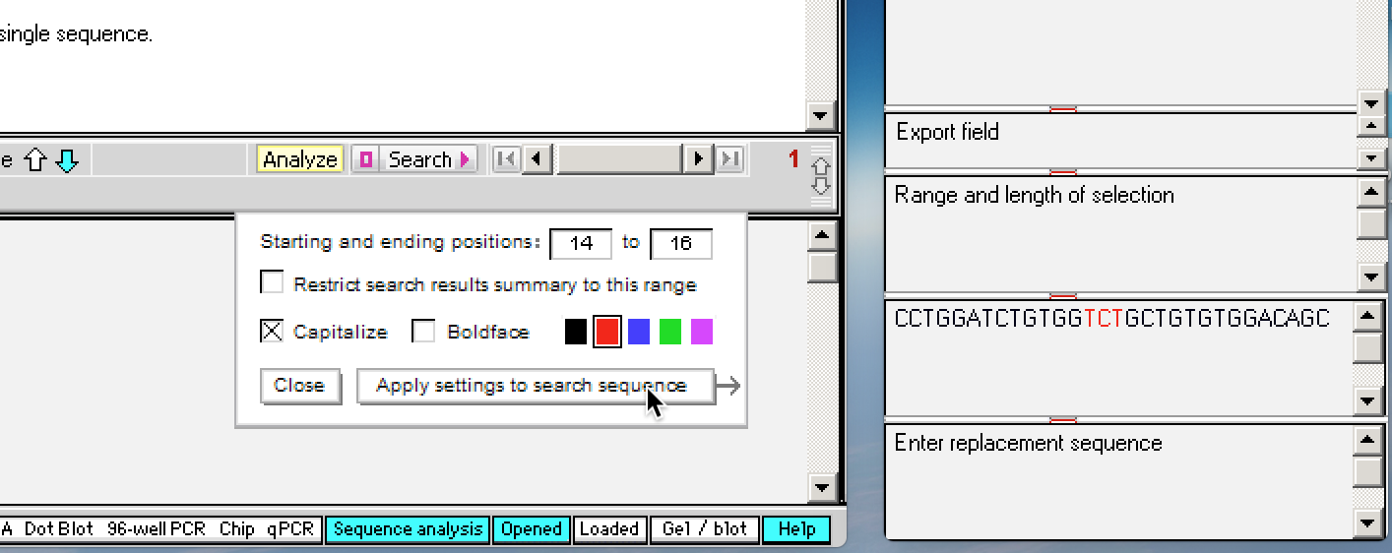
After entering 14 and 16 as the starting and ending positions, click the Apply settings to search sequence button. The default is to highlight the starting and ending characters in red, and capitalize any lowercase letters, but these settings can be changed as shown below.
Back to beginning

Slide 9
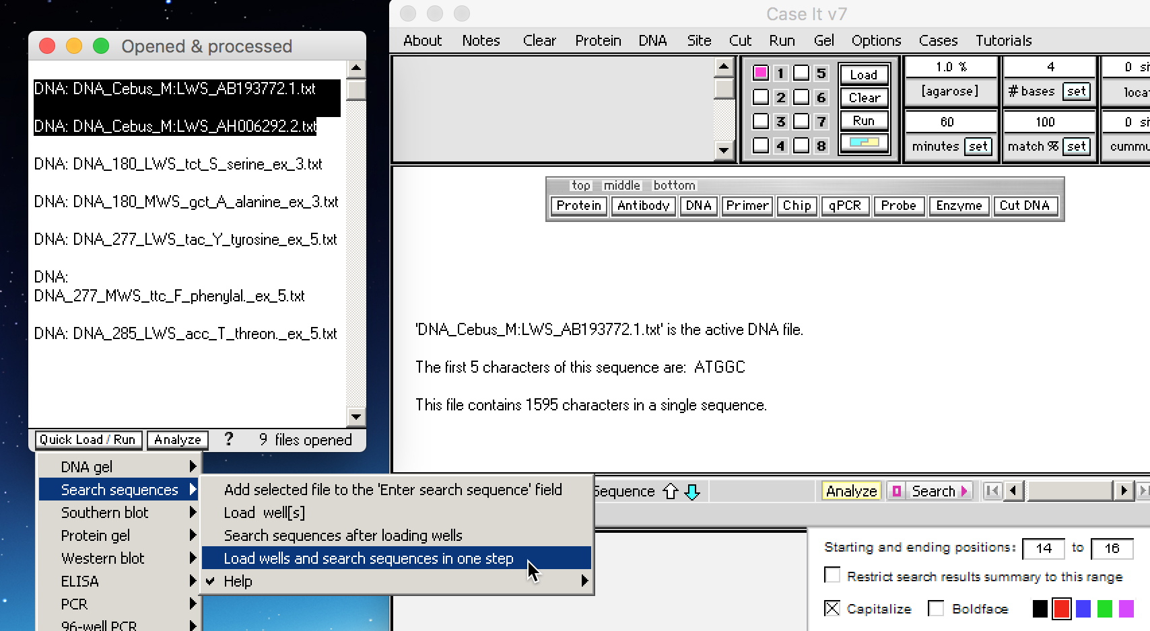
Highlight the two DNA sequences at the top of the Opened & processed window, then click the Quick Load / Run button of that window and select Search sequences -> Load wells and search sequences in one step as shown below. These sequences are from the Capuchin (genus Cebus), a New World monkey known for its tool use.
Note: For present purposes loading wells is not associated with running gels, but rather is a necessary step for the search procedure to work.
Back to beginning

Slide 10
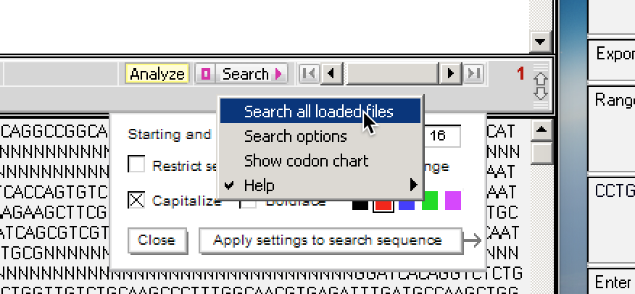
A message appears that the ‘search sequence was not found in any of the DNA files that were searched. Try lowering the match % setting.’ Type 60 into the match % box and click the set button…
…and then click the Search button on the gray divider bar, and select Search all loaded files to research the files at this new match % setting.
Back to beginning

Slide 11
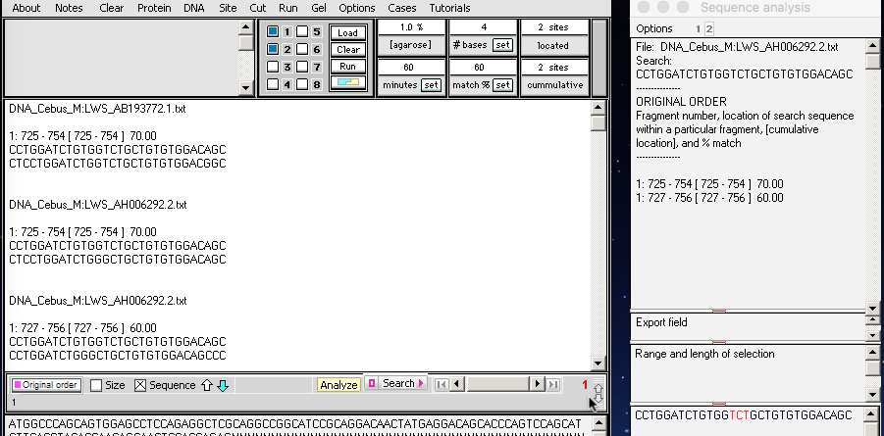
Results appear both in the white field of the Data Screen (as a summary of all results), and also in the Search results field of the Sequence analysis window (showing results for each file separately) Clicking the 1 or 2 at the top of the Sequence analysis window shows search results for the files loaded in either well 1 or well 2. There was one 70% match for the first file searched (AB193772.1), and both 70% and 60% matches for the second file searched (AH006292.2). Note that the gray divider bar has been dragged down to show all results – the ‘drag handle’ for the divider bar is on its extreme right at the cursor location in the screen shot below.
Back to beginning

Slide 12
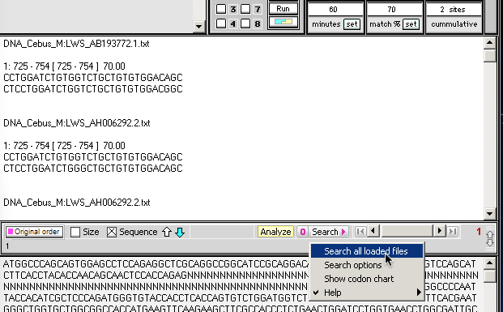
Change the value in the match% box from 60 to 70, then click the set button. Use the Search button as shown below to select Search all loaded files. This command can also be given from the Quick Load / Run button of the Opened & processed window.
Note: The gray divider bar has been returned to its default position in the screenshot below. You can do this either by dragging the bar up by its drag handle, or by using the Analyze button and select Divider->Return gray divider bar to its default position (this step not shown here). You would now need to scroll to see all of the contents of the white field, but to activate the scrollbar you would need to first click in the white field, otherwise the scrollbar may pop up to its top position when released.
Back to beginning

Slide 13
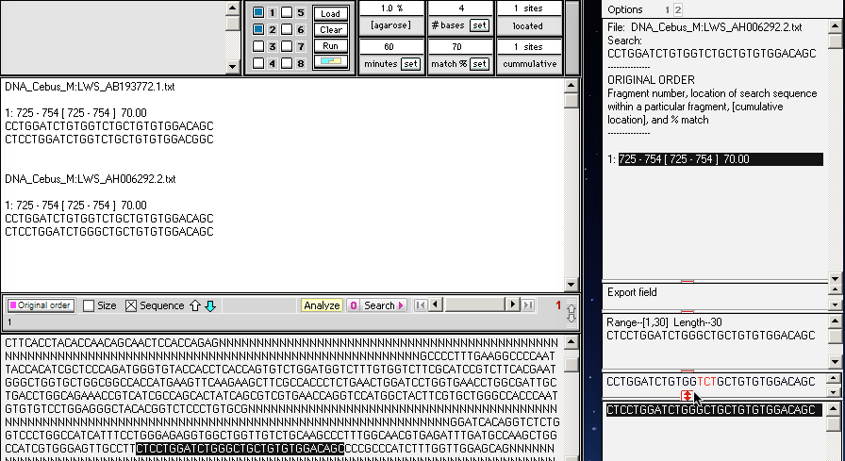
The files are searched again at the new setting of 70%, meaning that only hits with at least a 70% match are shown. Lines in the upper field of the Sequence analysis window represent hits, so if you click on one of these lines then the corresponding characters are highlighted in the file being searched, at the bottom of the Data Screen. In addition, those characters appear in the field at the bottom of the Sequence analysis window, so that you can compare them with the search string just above it. Note that in this case, the characters GCT were present in the file, whereas the characters in red just above it are TCT. What does this mean? Before explaining this, we’ll use another Search Options feature to make it easier to see…
Back to beginning

Slide 14
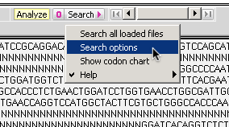
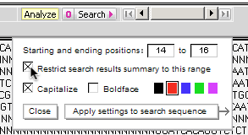
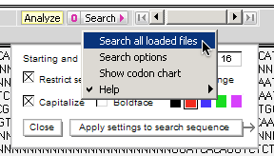
Since the Search Options box had been closed in the preceding slide, open it again using the Search button (or by clicking the button with a purple O to the left of the Search button).
Click the checkbox next to Restrict search results summary to this range, so that an X appears in this checkbox.
Then use the Search button and select Search all loaded files. This will re-search the files with this additional option checked.
Back to beginning

Slide 15
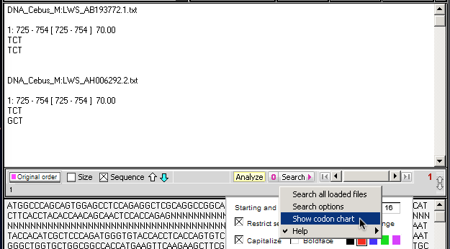
The summary of search results now shows only the three characters in the selected range (14 through 16), making it easier to see that TCT is present in the first file and GCT is present in the second file at location 180 in exon 3 of the opsin gene associated with color vision. Each of these triplets of letters represents a codon, so to determine which amino acids are associated with them we need a codon chart. Click the Search button and select Show codon chart as shown below.
Back to beginning

Slide 16
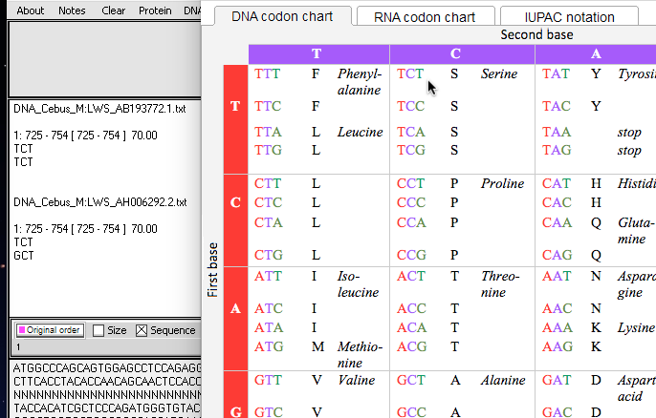
The codon chart indicates that TCT is the codon associated with the amino acid Serine (S), whereas GCT is associated with Alanine (A), so the individual monkeys from which these samples were taken had S and A, respectively, at the 180 position on exon 3 of the opsin gene. This has significance in terms of the wavelengths of colors that these two individuals could detect (see See Color Vision Polymorphism in Wild Capuchins and Spider Monkeys in Costa Rica, also referenced on Slide 18).
Back to beginning

Slide 17
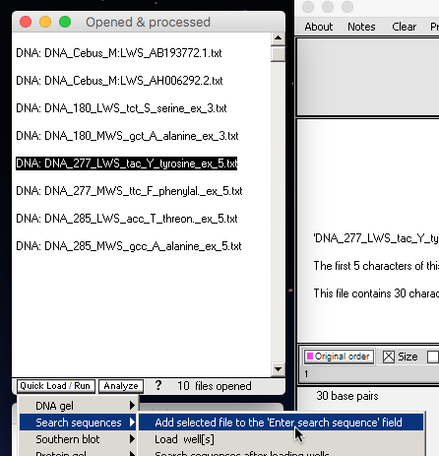
In the Opened & processed window, click on the line DNA: DNA_277_LWS_tac_Y_tyrosine_ex_5.txt and use the Quick Load/Run button to select Search sequences -> Add selected file to the ‘Enter search sequence’ field. The search sequence associated with that file will appear in the second field from the bottom in the Sequence analysis window, as shown at right. Drag to determine the position of the lowercase letters tac (13 through 15), open the Search options box, enter these numbers as the starting and ending positions, and finally click Apply settings to search sequence.
Back to beginning

Slide 18
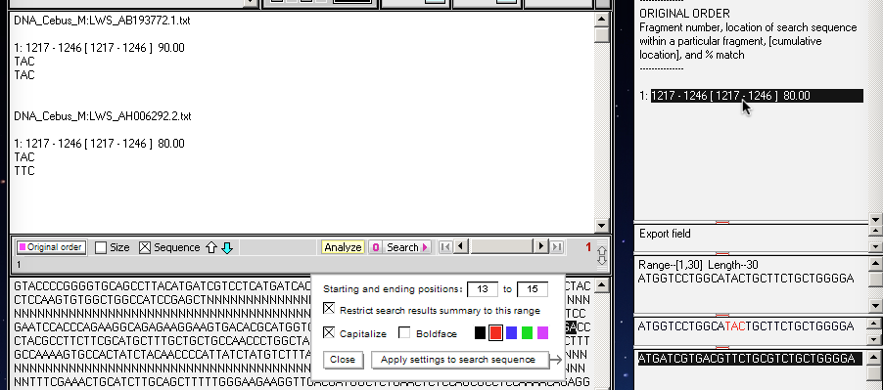
There were 90% and 80% matches, respectively, for the two files. An examination of the codon chart (not shown here) reveals that TAC is the codon for tyrosine (Y), and TTC is the codon for phenylalanine (F). These represent the amino acids at location 277 of exon 5 of the opsin gene, another important location for color vision in primates and other animals. If you repeat this procedure for location 285 on exon 5, using the search string for DNA; DNA_285_LWS_acc_T_threon_ex_5.txt, the amino acids present at this location can be determined for both files.
Verify that for the monkey associated with AB193772.1, the amino acids at positions 180, 277, and 285 are S Y, and T, respectively. See Color Vision Polymorphism in Wild Capuchins and Spider Monkeys in Costa Rica, the source of this data, for information relating to its significance. Question: What are the comparable amino acids at these positions in humans with full color vision, and humans that are colorblind?
Back to beginning

Slide 19
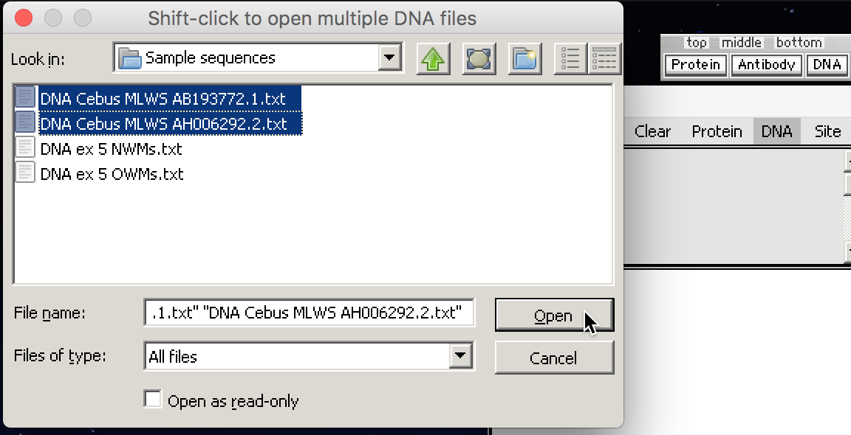
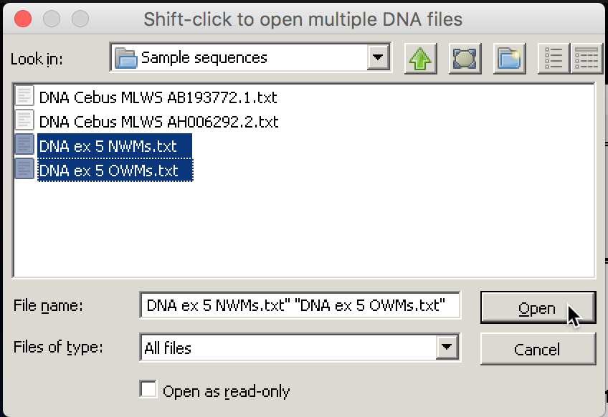
Next, we’ll demonstrate the enhanced PCR feature of Case It v7. Earlier versions of Case It required a 100% match of forward and reverse primers, but Version 7 allows you to set the match percent at any level. As an example, we’ll use DNA sequences from a variety of New World and Old World monkeys, obtained from GenBank. Before beginning, use the Clear menu to clear all existing data from Case It v7.
Click the DNA button and navigate through the folders Case It v7 PC -> Cases -> Color Vision -> Sample sequences. Shift-click to select the two DNA Cebus files used earlier, and click the Open button. Then click the DNA button again, select the other two files in the folder, and click the Open button. Note that you cannot shift click to open all four files simultaneously, since the second two files contain multiple DNA sequences each.
Back to beginning

Slide 20
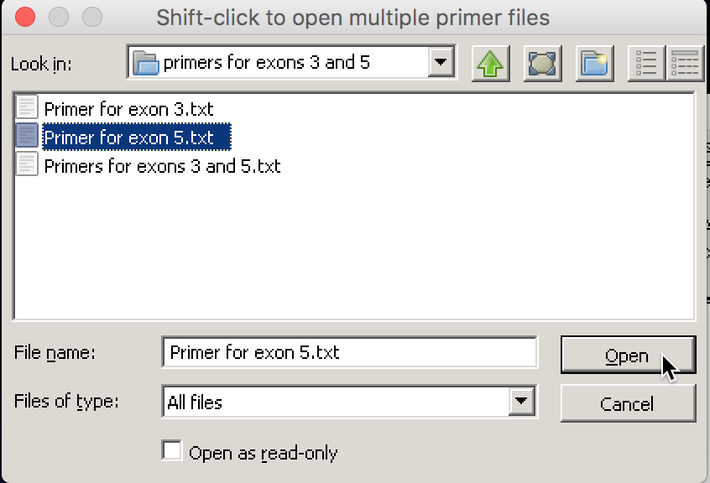
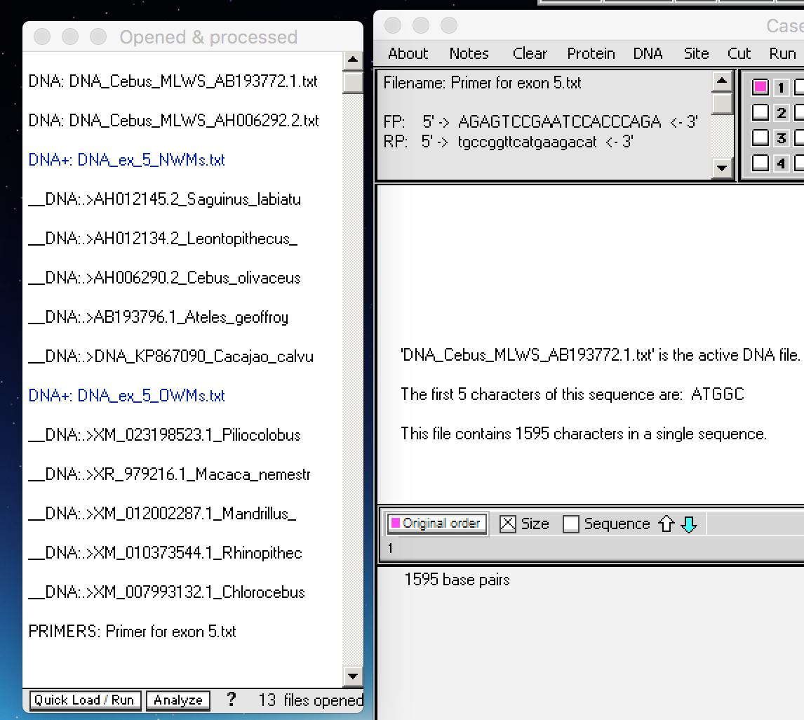
Navigate to the primers for exons 3 and 5 folder and open Primer for exon 5.txt. It will appear as a line at the bottom of the Opened & processed window after the DNA sequences opened previously. The blue lines indicate files that contain multiple DNA sequences, indicated by the underscore preceding each filename. The Cebus files contain one sequence per file.
Back to beginning

Slide 21
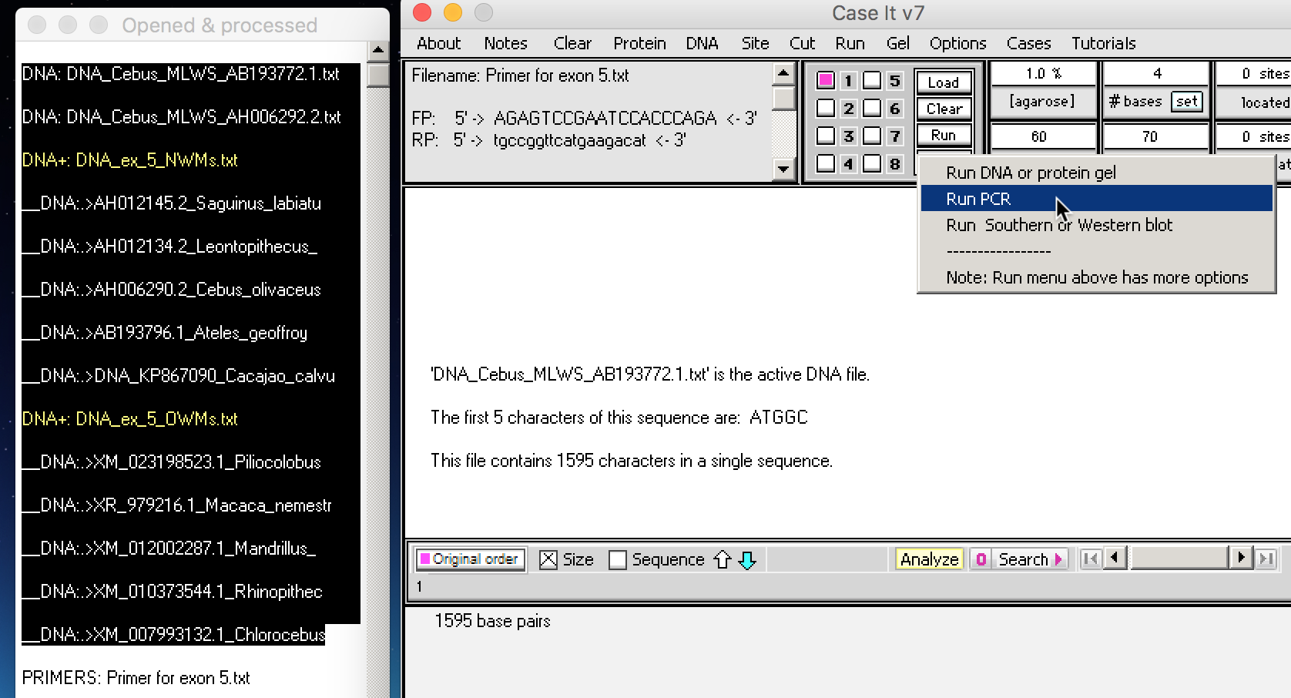
Set the match % setting to 70, meaning that hits will occur for any match of 70% or higher (for both forward and reverse primers).
Shift click to select all the DNA files, making sure not to select the Primers file at the bottom, and then use the Run button and select Run PCR.
Back to beginning

Slide 22
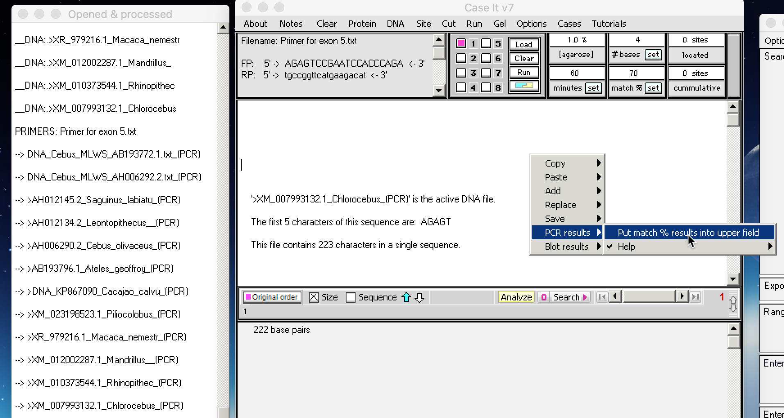
New lines appear in the Opened & processed window, each representing a PCR product (designated by the arrow preceding the filename). To see a summary of results shown the percentage for each hit, right-click on the white upper field and select PCR results -> Put match % in the upper field.
Note: most fields in Case It have associated pop-up menus, activated by right-clicking.
Back to beginning

Slide 23
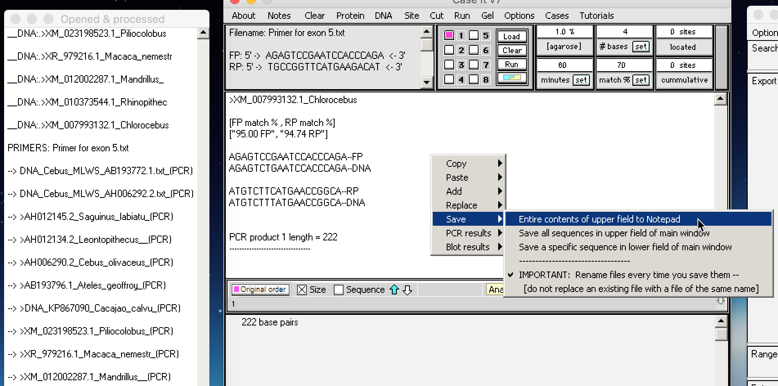
One of the matches is shown below, with a 95% match for the forward primer and a 94.74 match for the reverse primer. You would need to scroll in the field to see all of the results, so right-click to Save them to the Notepad of Case It. You can also Copy the results to the clipboard, for pasting into another application.
Back to beginning

Slide 24
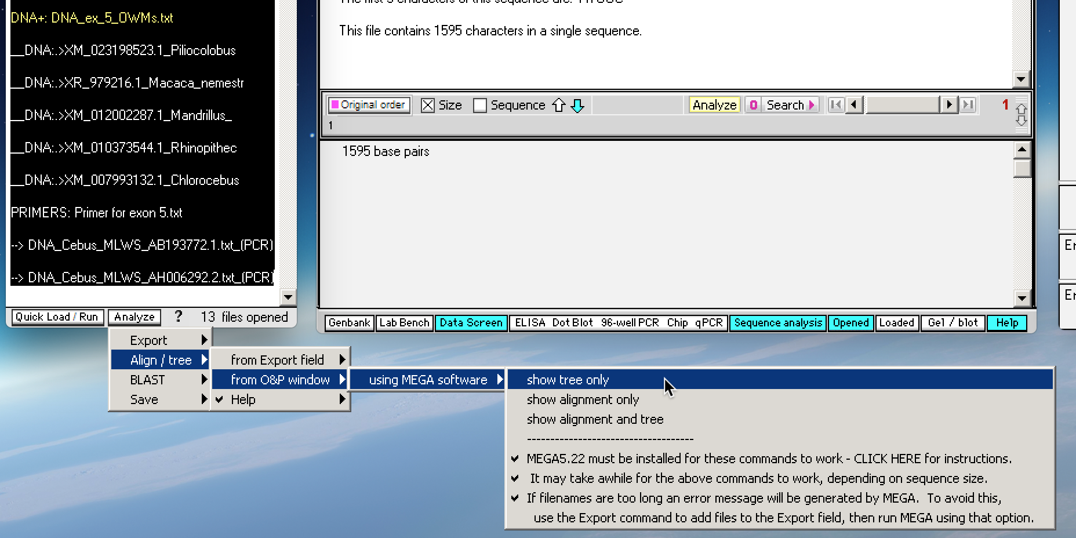
To create a phylogenetic tree of this data with one click, shift-click to highlight all of the PCR products, then use the Analyze button and select Align/tree -> from O&P window -> using MEGA software -> show tree only…
Note: This assumes that you have separately downloaded the MEGA executable and put it in the MEGA folder of Case It – for details, see the tutorial Installing MEBA software for use with Case It.
Back to beginning

Slide 25
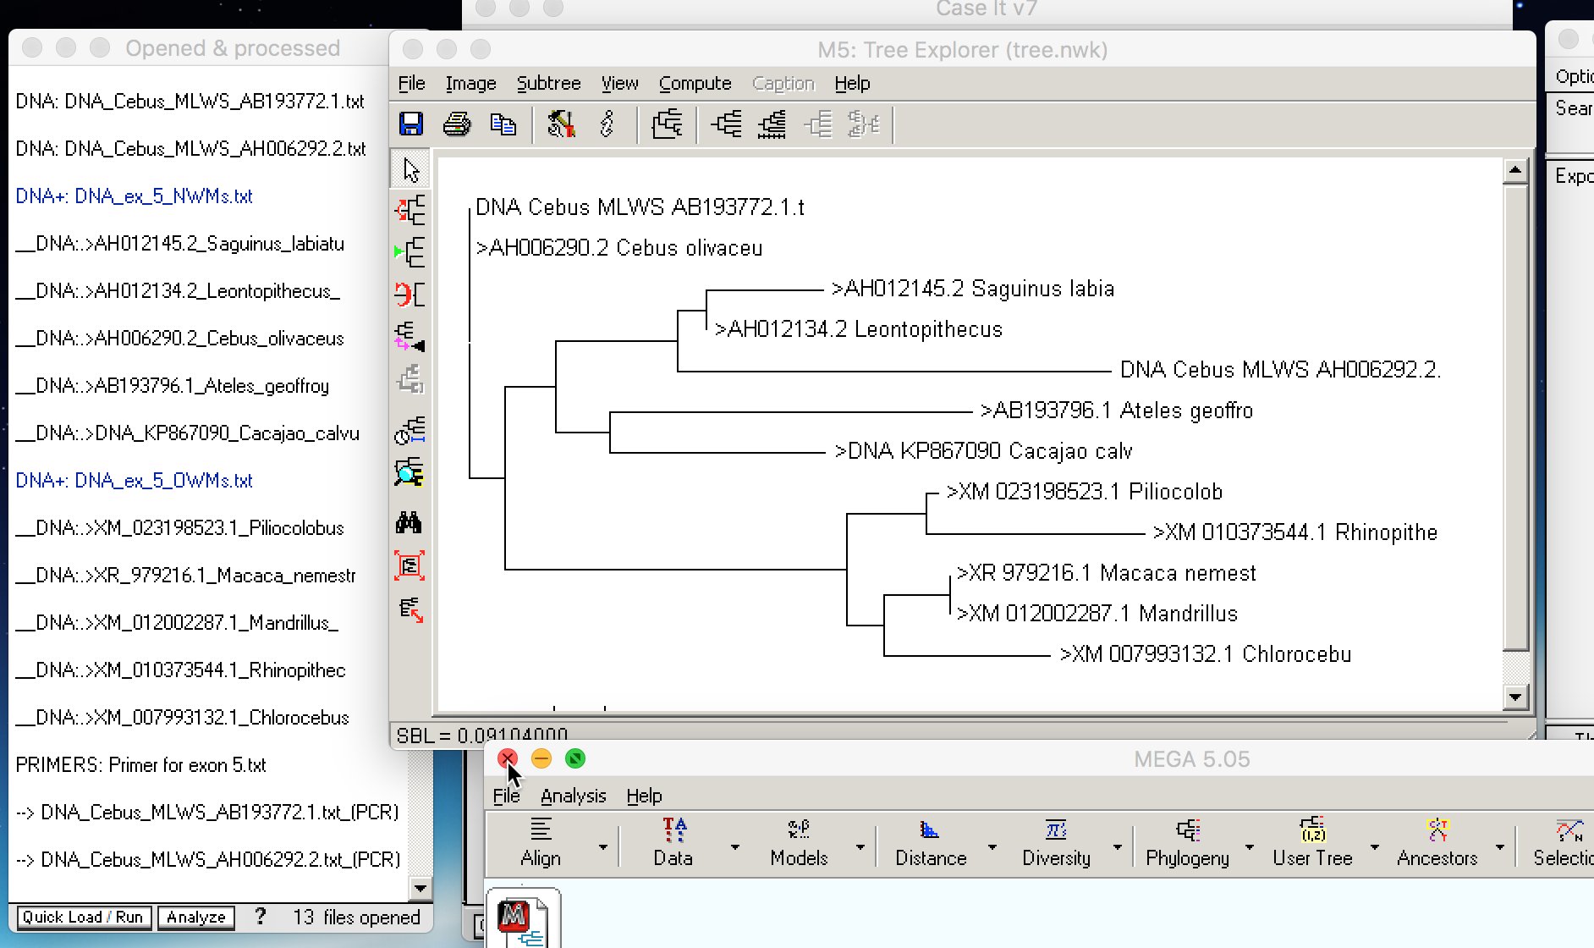
…and in a few seconds the tree appears. Case It also copy selected PCR products to the the clipboard and open two web-based sites for aligning sequences and building trees, the MABL site and the MAFFT site. See the Bioinformatics tutorial for details.
Back to beginning

Slide 26
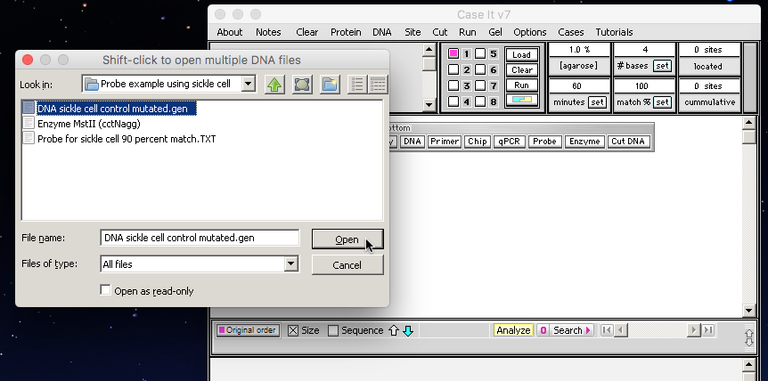
Before demonstrating set search parameters for Southern and dot blots, use the Clear menu and select Clear everything? -> Yes.
Click on the DNA button of the silver button bar, then navigate through the folders Case It v7 PC -> Cases -> Test sequences -> DNA for digestion -> Probe example using sickle cell and open the file DNA sickle cell control mutated.gen.
Back to beginning

Slide 27
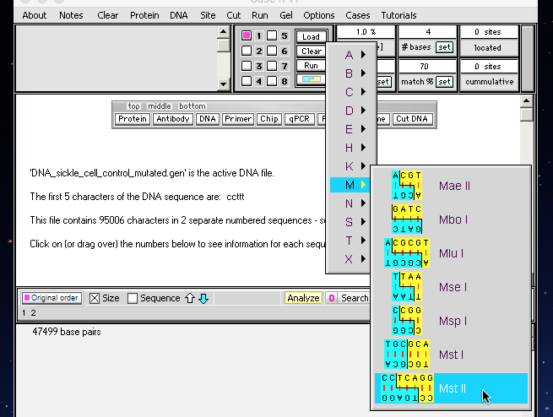
Before running a Southern blot, we need the restriction enzyme Mst II to digest the DNA sequence. Click the button with the blue/yellow symbol (located under the Run button) and select M -> Mst II.
Note: This file could also be accessed by clicking the Enzyme button, then selecting that file from the currently active folder.
Back to beginning

Slide 28
Click the Cut DNA button on the silver button bar and select with a single enzyme.
The digested file appears as a new line in the Opened & processed window, designated by a *** prefix and a + Mst II suffix. Click this line and then click the Load button to load the digested sequence into well one.
Back to beginning

Slide 29
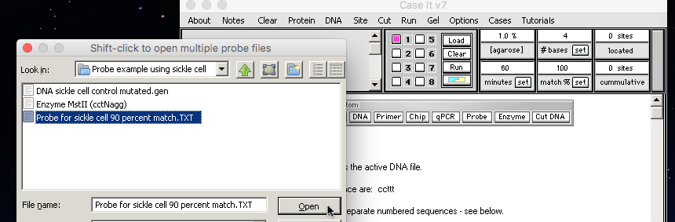
Click on the Probe button of the silver button bar and open the file Probe for sickle cell 90 percent match.
Change the number in the match% field to 70, then click the Set match % button.
Note: Settings below 50% can cause the program to temporarily freeze and may give unpredictable results.
Back to beginning

Slide 30
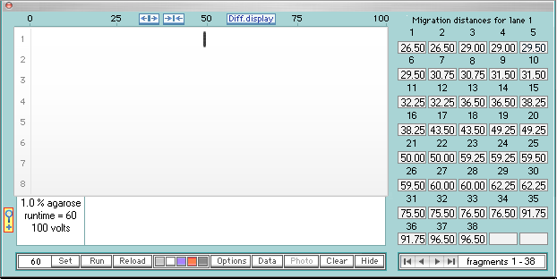
Click the Run button and select Run Southern or Western blot.
A Southern blot will appear with a single fragment showing, representing a fragment that bound to the probe at this match % setting. Note that there are 38 migration distances showing in the table to the right, indicating that other fragments are not visible since they did not bind to the probe.
Back to beginning

Slide 31
Click on the fragment to turn it from black to red, and note that the fragment was the 20th one on the gel prior to running the blot procedure.
To see the original gel upon which the blot is based, click on the Run button and select Timed run.
“Ghost fragments” will appear on the gel, that would not be visible in reality without staining.
To stain the fragments, click the blue button (or the orange or black buttons).
Back to beginning

Slide 32
All fragments in the lane will turn blue, indicating that they have been stained.
To re-run the blot to see which fragments were bound to the probe, use the Run button and select Southern or Western blot…
…and the fragment bound to the probe appears.
Temporarily hide the blot by clicking the Hide button.
Back to beginning

Slide 33
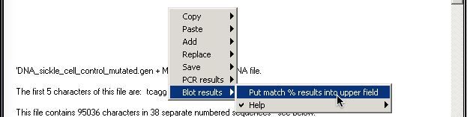
Right-click on the upper field and select Blot results -> Put match % results into upper field.
Actual match percentages (90%) appear in the field, indicating that both fragments 19 and 20 were bound to the probe. Note that the second and fourth lines are duplicates of the first and third lines, so they can be ignored. These results can be copied or saved by right-clicking.
Since only one band appeared after the Southern blot, fragments 19 and 20 must be at the same location, which can be verified by looking at the migration distances and clicking on the boxes associated with fragments 19 and 20.
Back to beginning

Slide 34
To make sure that the probe match routine is working properly, set the match % to 91...
…and no match will occur since 91 is higher than 90, the actual percentage required for a match with this probe and sequence.
Set the match % back to 90…
…and the black band reappears, indicating that the procedure is working properly.
Back to beginning

Slide 35
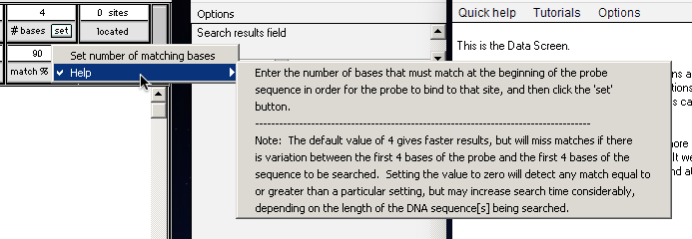
The previous probe searches assumed that there was a perfect match between the first 4 characters of the probe sequence and the hit site on the DNA sequence being searched, as shown in the # bases field below. This was done to speed up searching for existing Case It cases, so that is the default setting for the software. The value can be reduced down to zero, which is more realistic if you are using your own probe for research or case development purposes, but search times may increase substantially as described in the Help message below.
Important: The # bases box only applies to the Southern blot and dot blot routines. Values in this box have no effect on the general search and PCR routines described earlier in this tutorial, as those routines always search from the beginning to the end of sequences one character at a time, for greater realism and usefulness for research purposes. [Lower match % settings will slow down these routines, depending on the size of sequences being searched.]
Back to beginning

Slide 36
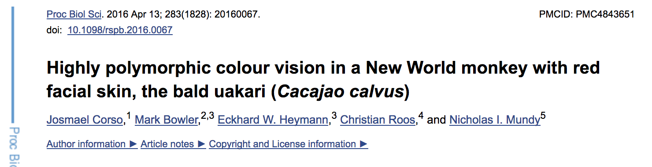
Obtaining sequences for research purposes
A good place to start a research project is to find an article with published forward and reverse primers, for example the one below that analyzed exon 3 and exon 5 of the opsin gene, a gene involved with color vision in primates and many other animals (click here for a link to the full article.)
Scroll down to the Materials and Methods section of the article until you find the section below. The four DNA sequences are:
Primer3CCF2: forward primer for exon 3 Primer3CCR2: reverse primer for exon 3
Primer5CCF2: forward primer for exon 5 Primer5CCR3: reverse primer for exon 5
Nucleotides at position 180 on exon 3 and positions 277 and 285 on exon 5 help determine whether bald uakaris have dichromatic or trichromatic color vision, a characteristic with significant evolutionary and ecological consequences. [See the Monkey Opsin section of the Evo-Ed website for a detailed explanation of the molecular biology of color vision, as it relates to the evolution and ecology of New World and Old World primates.]
Back to beginning

Slide 37
The first step is to create a Primer file that can be read by Case It. Highlight the forward primer sequence for exon 5 and right-click to copy it to your computer’s clipboard. Note: Although Case It v7 is capable of multiplex PCR, we will only use the primers for exon 5 for this example.
Click the Notes menu of Case It v7 and select Show, which causes a simple Notepad text editor to appear.
Right-click in the Notepad and select Paste -> clipboard into Notepad at cursor location.
The forward primer for exon 5 is now the first line in the Notepad.
Back to beginning

Slide 38
Go back to the article and select and copy the reverse primer sequence for exon 5.
Position your cursor at the beginning of the second line of the Notepad, then Paste in the reverse primer sequence so that the forward primer is line 1 of the file, and the reverse primer is line 2.
Additional forward and reverse primers could be pasted in, for example the FP and RP for exon 3, but we will not do this here. The general rule is to add each primer set as additional lines in the file (e.g. lines 3 and 4 for the next set, lines 4 and 5 for the set after that, and so forth.) See the STD case for an example of how multiplex PCR works in Case It v7.
Back to beginning

Slide 39
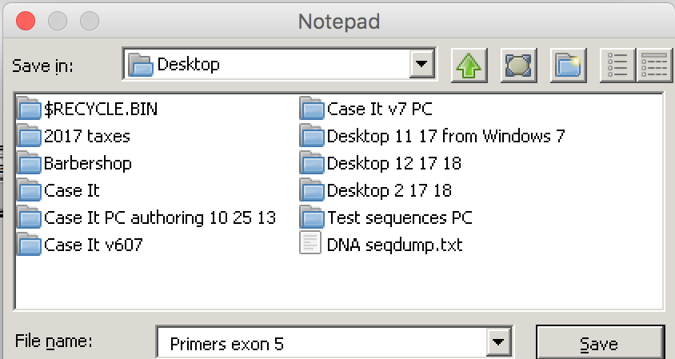
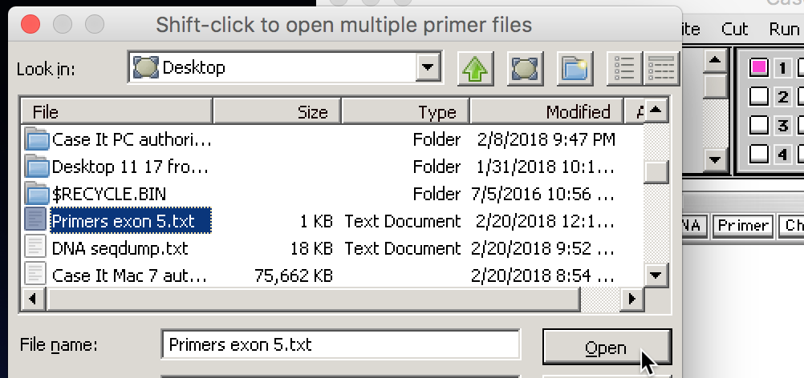
Use the Save command of the Notes menu, and save the file after renaming it Primers exon 5 to the desktop or another location on your computer. Note that files containing primers must always include the word Primers at the beginning of the filename.
Click the Primer button on the silver button bar and open the Primer exon 5.txt file that you just saved. It will appear in the Opened & processed window, and also in the gray field of the main window of Case It.
Back to beginning

Slide 40
We now need to obtain DNA sequences that contain the forward primer sequence for exon 5 of the opsin gene. Double-click on the forward primer in the gray field to highlight it, then right-click in the field and select Copy -> selected text to clipboard and open NCBI Blast site.
Your default web browser will automatically open to the BLASTN page of the NCBI web site. Right-click in the Enter Query Sequence box on this page, then paste the forward primer sequence into the box. You may have to paste more than once for this to work.
Scroll down on the page and click the BLAST button…
Back to beginning

Slide 41
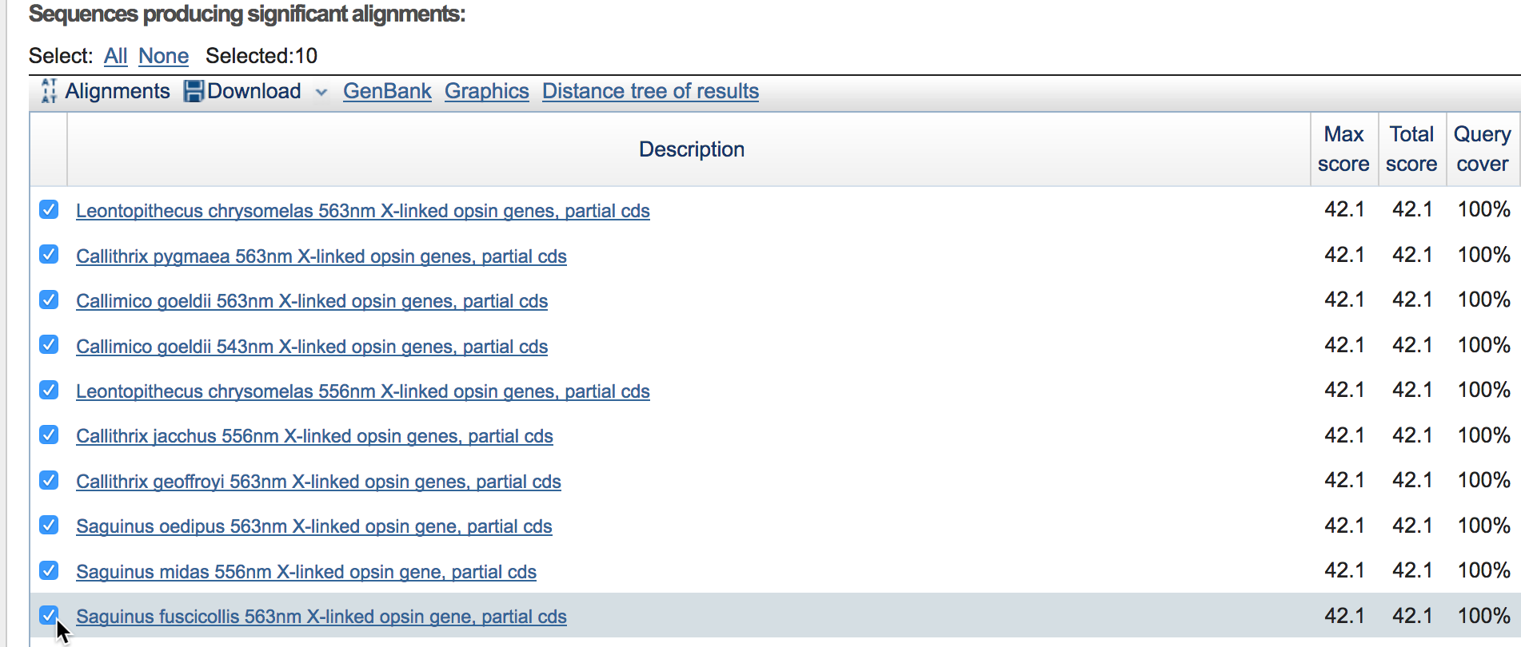
Once the page appears showing results, scroll down on the page and select the first 10 hits (we are doing this strictly to illustrate the procedure; in reality you would want to carefully examine hits and select those most appropriate for the hypothesis you are testing).
Back to beginning

Slide 42
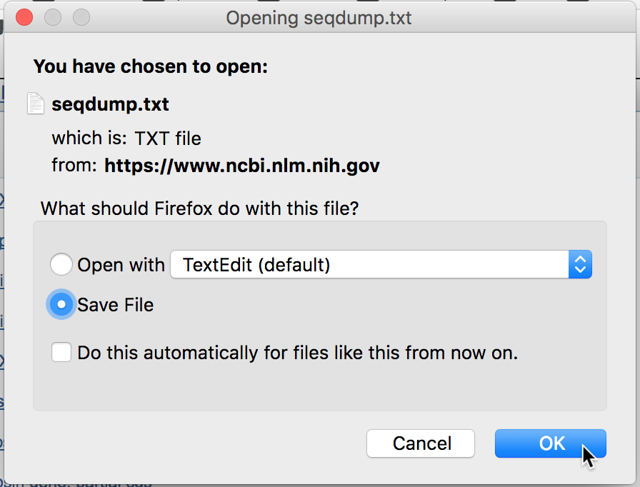
Click the Download button using the default setting (download the complete FASTA sequence). Click the Continue button, select Save File, and click OK. You will then be able to save the file to your desktop or another location on your computer.
The filename will be saved by the NCBI site with the name seqdump.txt. After locating the downloaded file, change the name of the file, making sure to begin the filename with the letters DNA. Otherwise, Case It v7 will not recognize it as a DNA file. In this example, the file has simply been name DNA seqdump.txt, but you should give it a more descriptive name that retains the DNA prefix.
Back to beginning

Slide 43
Use the DNA button on the silver button bar to open the file. Enter 70 in the match % field and click the Set button.
Shift-click in the Opened & processed window to select all 10 lines (only 3 of which are shown here), then click the Run button and select Run PCR.
Back to beginning

Slide 44
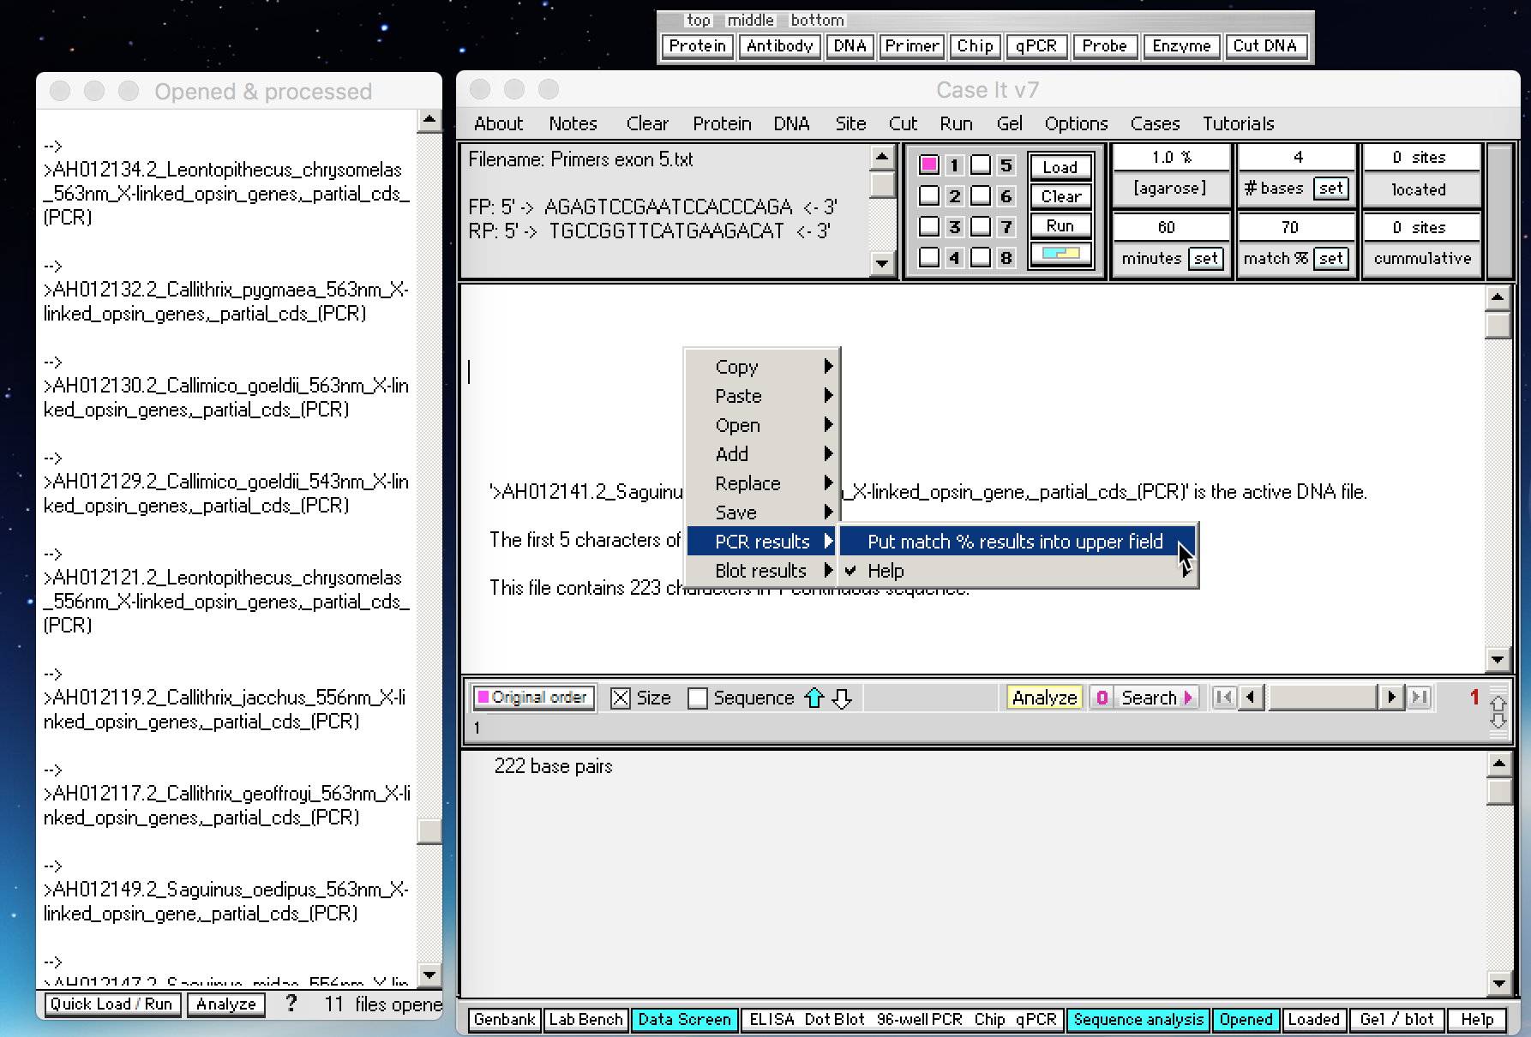
PCR products appear in the O&P windows, designated by arrows at the beginning of each filename. Right-click on the large white field and select PCR results -> Put match % results into upper field.
Back to beginning

Slide 45
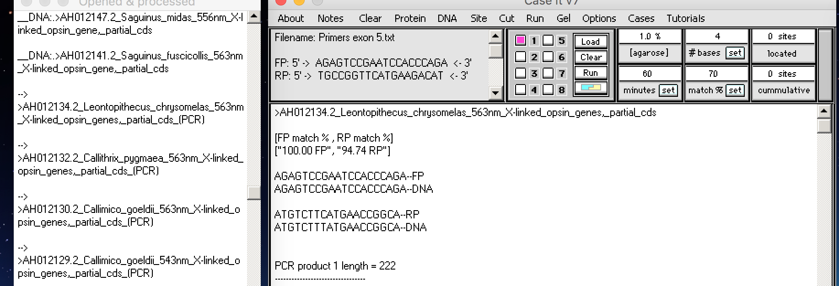
For the first PCR product, there was a 100% match for the forward primer (FP), and a 94.74% match for the reverse primer. Note that the forward primer in the white field is the same as the forward primer in the gray field, whereas the reverse primer (RP) in the white field is the reverse complement of the reverse primer sequence in the gray field. When Case It v7 opens primer files, it automatically converts the reverse primer into its reverse complementary sequence. To see why this is necessary, click the Tutorials menu and watch the video tutorial called Show PCR primer sites.
You can experiment with re-running PCR with different match percent settings, to find an optimal setting for particular combinations of primers and sequences being searched during the PCR procedure. Settings that are too high may miss FP and/or RP sites, whereas settings that are too low may match with spurious FP and RP sites, rendering the results meaningless.
Note: The default match % setting is 100% because existing cases were originally developed with primers that matched exactly, and earlier versions of Case It did not have the capability of finding locations with less than a 100% match. With Version 7, it is now possible to use any % match setting, making the simulation more useful for research purposes.
Back to beginning

Slide 46
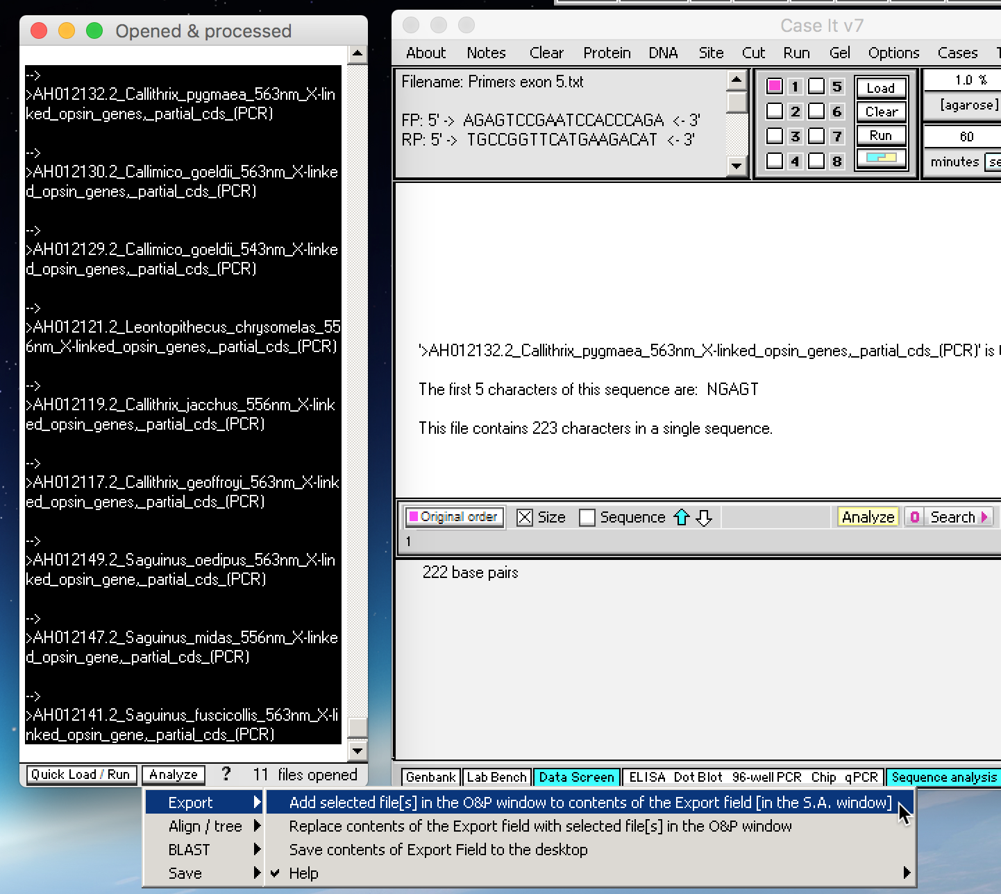
These PCR products can now be analyzed via multiple alignment and tree-building. First, shift-click to highlight all PCR products (lines preceded by arrows) in the Opened & processed window, then click the Analyze button at the bottom of that window and select Export -> Add selected file(s)…
Back to beginning

Slide 47
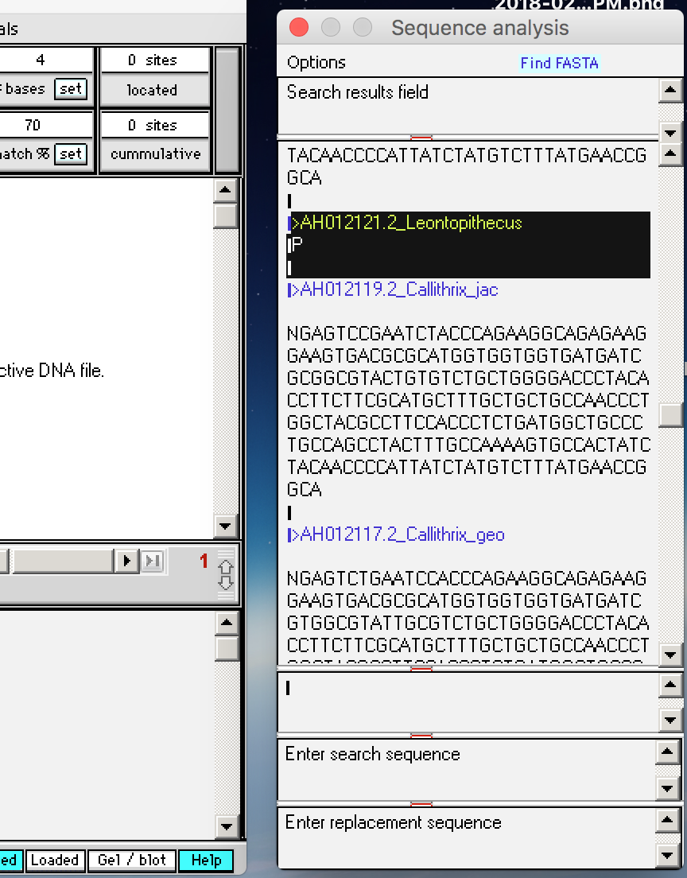
The PCR products have been added to the Export field of the Sequence Analysis window. Scroll through the Export field to verify that PCR products were generated for all files except >AH012134.2_Leontopithecus. Select the lines shown highlighted below and delete them by selecting them and hitting the Delete key of your keyboard.
Delete
Back to beginning

Slide 48
As an aside, it is important to verify that we really have isolated a region associated with exon 5 of the opsin gene. One way to do this is to click on lines in the Opened & processed window representing PCR products (lines preceded by arrows), to see if they are all about the same size.
For this example, all PCR products have 222 characters, suggesting that the match percent setting (70%) was about right for isolating exon 5.
Note: If there is a slight discrepancy in the number of characters in the white field above compared to the gray field below (e.g. 223 vs 222), go by the number in the gray field.
Back to beginning

Slide 49
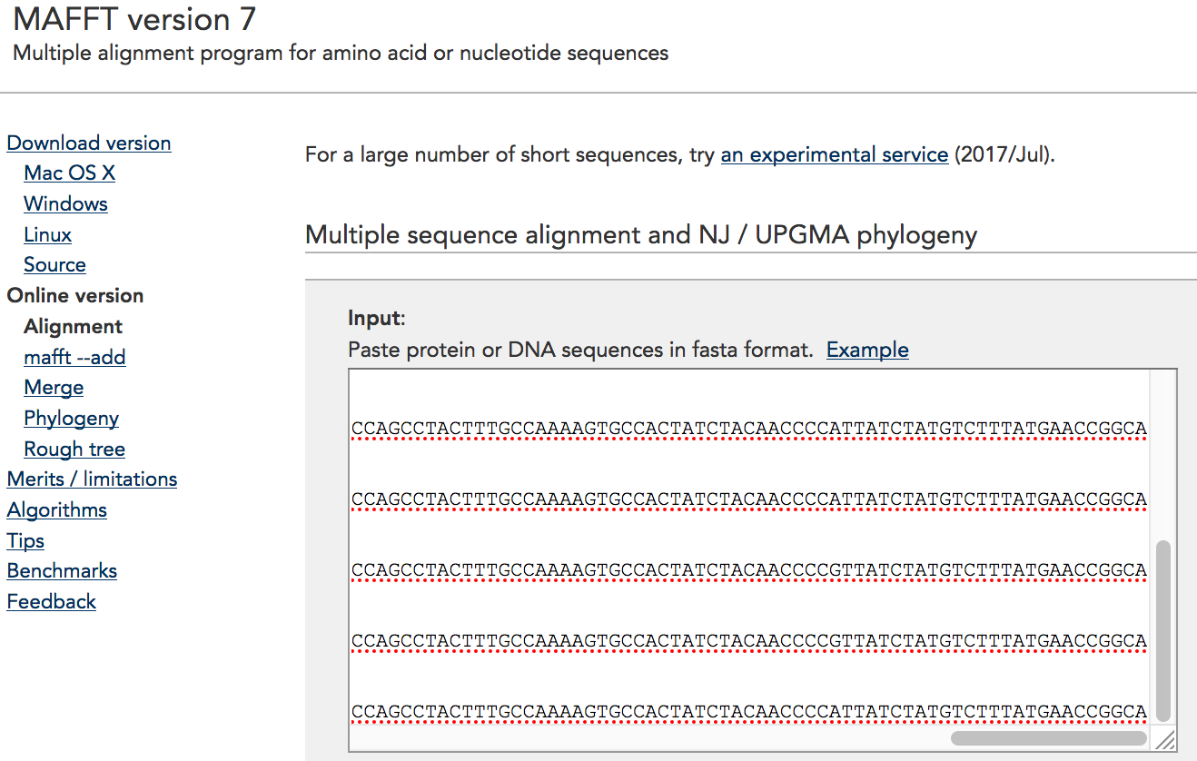
Previously (slides 24 and 25) we used MEGA software to build a tree, but for this example we’ll click on the Analyze button and select Align / tree -> using MAFFT web site -> Copy Export Field to clipboard and open MAFFT web site.
Note: This particular web site is more reliable than the MABL site, which can be unresponsive at times.
Your default browser will automatically open to the first page of the MAFFT site. Paste contents of the clipboard into the Input field.
Back to beginning

Slide 50
Scroll down further on that web page and click the Submit button. Note that we will be using the default settings to build the tree.
On the next page that appears, click Phylogenetic tree.
On the page that appears after that, click Go.
Finally, click View tree on Phylo.io (or one of the other options on that page).
Back to beginning

Slide 51
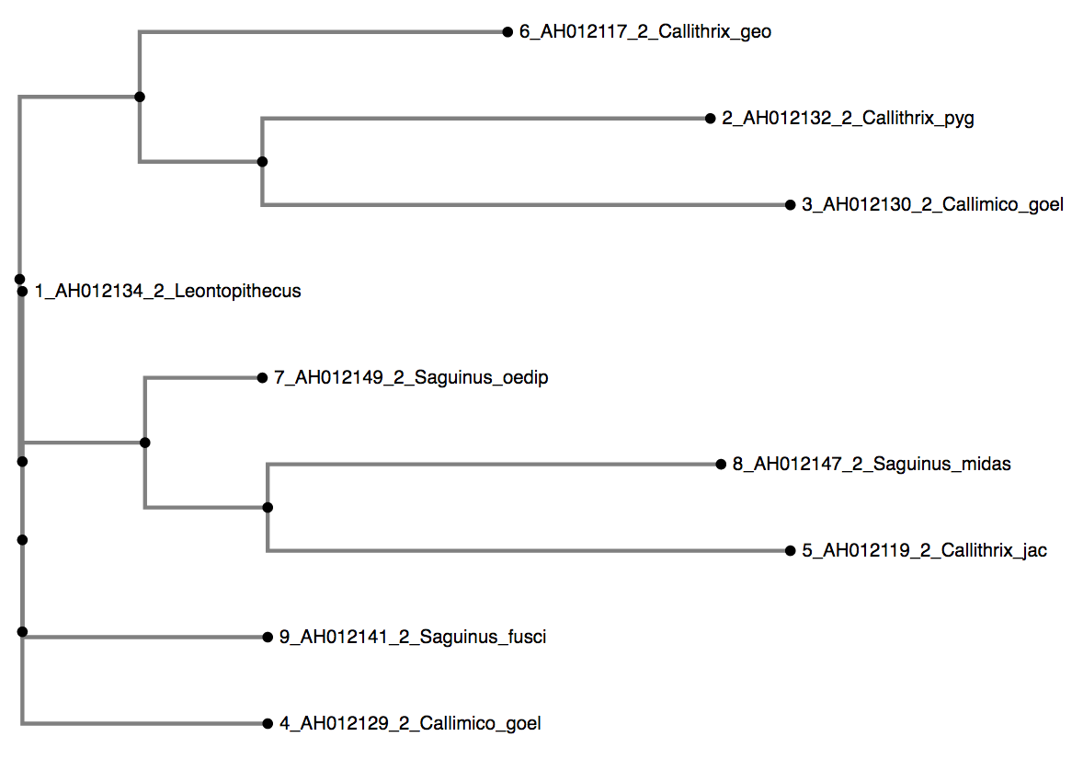
…and the tree appears. Whether or not this particular tree has any significance depends a number of factors, including whether the default settings were appropriate for this analysis and whether the BLAST results selected were appropriate for the hypothesis being tested. The tree is shown here simply to demonstrate the procedure for tree-building using the MAFFT web site.
Back to beginning

Slide 52
There are other features of Case It v7 that are useful for gathering information for research. For example, you can copy text (such as a scientific name) from the large white field of the Data Screen and automatically open the search page of Google or Wikipedia, then paste the scientific name and search. This is a quick way to display information about that species, when gathering information for testing hypotheses on ecological, behavioral, evolutionary, or other topics. This concludes the tutorial.
Back to beginning

