Slide 1
Tutorial for using Case It for bioinformatics analyses
Preparation of sequences for multiple alignment and tree-building, using
the MABL web site,
the MAFFT web site, or
MEGA5 bioinformatics software
Blasting DNA and protein sequences

Slide 2
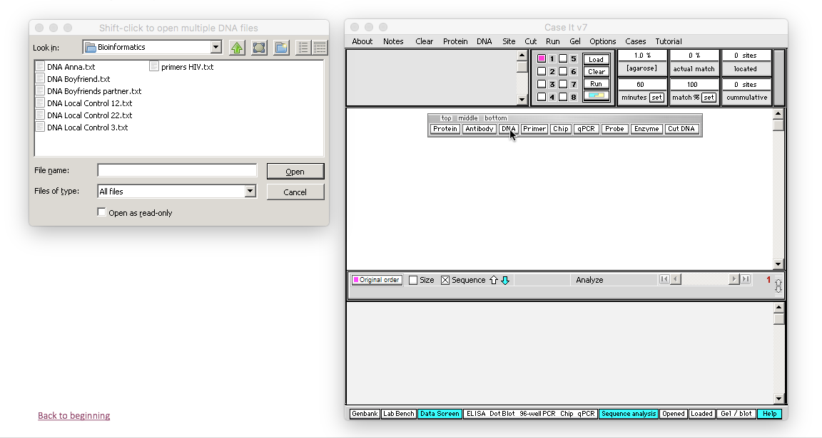
Open Case It v7.exe to the Data Screen, then Click the DNA button on the silver button bar. For this example, we have opened Case It -> Infectious Diseases -> HIV -> U.S.-> Anna-> Bioinformatics. Note that there are files for Anna, her boyfriend, the boyfriend’s partner, and three local controls, along with a primers file.
Back to beginning

Slide 3
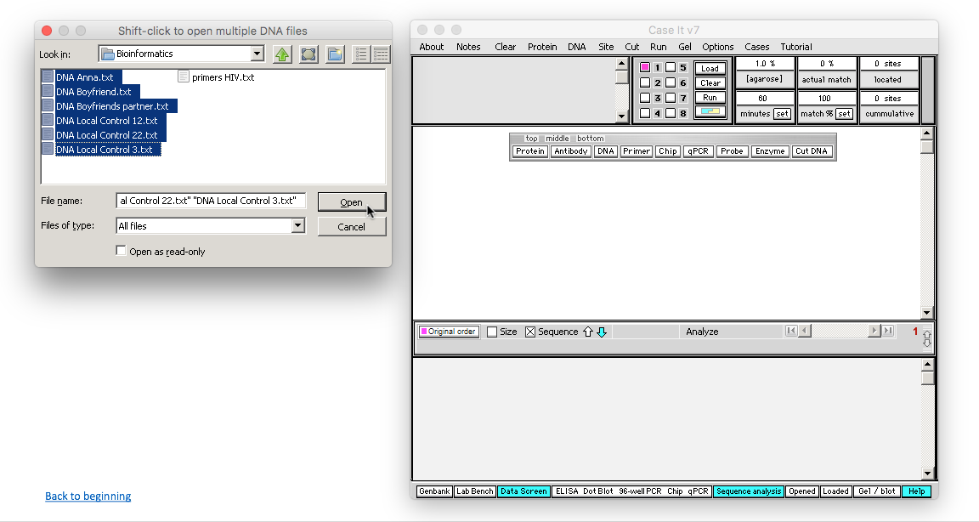
Click on the first DNA file you want to open [DNA Anna.txt in this example], hold down the Shift key, and click on the last DNA file you want to open [e.g. DNA Local Control 3.txt]. Then click the Open button, or double-click on the last file while still holding down the Shift key. Be careful not to include the primers file along with the DNA files.
Back to beginning

Slide 4
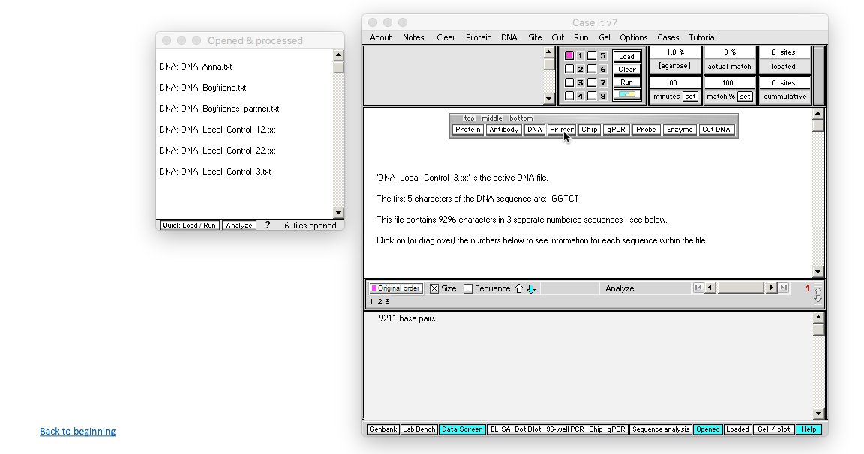
The Opened & Processed window opens, with each file designated by a line in this window. For this particular example, we need to work with PCR products, rather than the original files, to make the sequences shorter [this step may not be necessary, depending on the case being analyzed]. To begin the PCR process, click the Primer button on the silver button bar…
Back to beginning

Slide 5
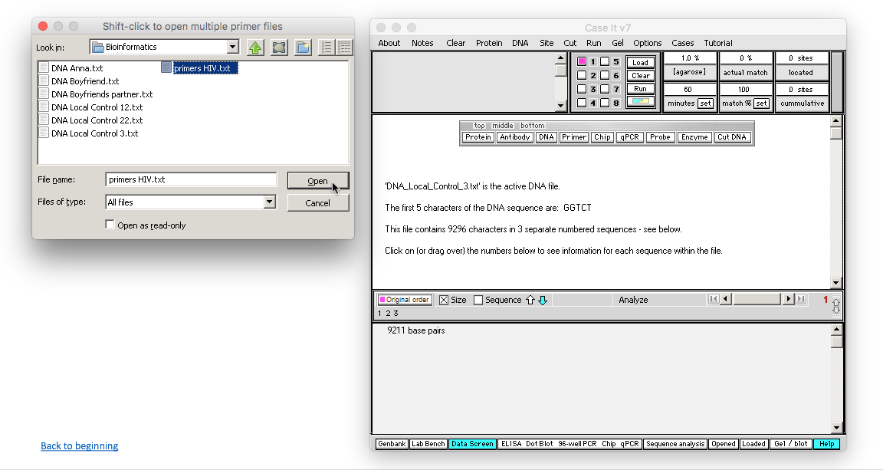
…then select the primers file and click Open [or double-click the file name primers HIV.txt]…
Back to beginning

Slide 6
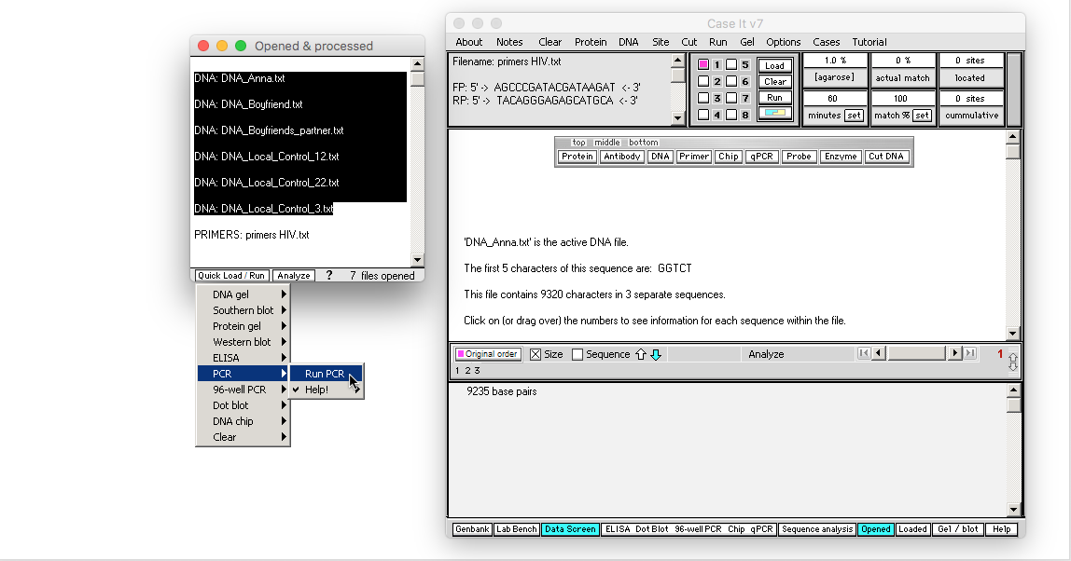
The primers file name appears in the Opened & Processed window, and the forward and reverse primers of this file appear, indicating that this primer file is active. Shift-click to highlight the DNA files, then use the Quick Load /Run button to select PCR -> Run PCR.
Back to beginning

Slide 7
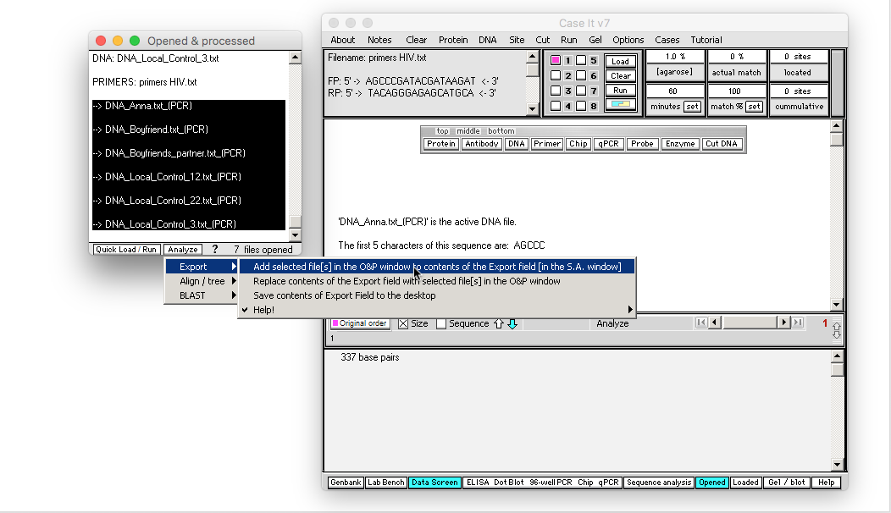
New names appear in the Opened and Processed window, with each name preceded by an arrow symbol. These names represent PCR products. Shift-click to highlight the names, then use the Analyze button and select Export -> Add selected file[s] in the O&P window to contents of the Export field [in the S.A. window].
Back to beginning

Slide 8
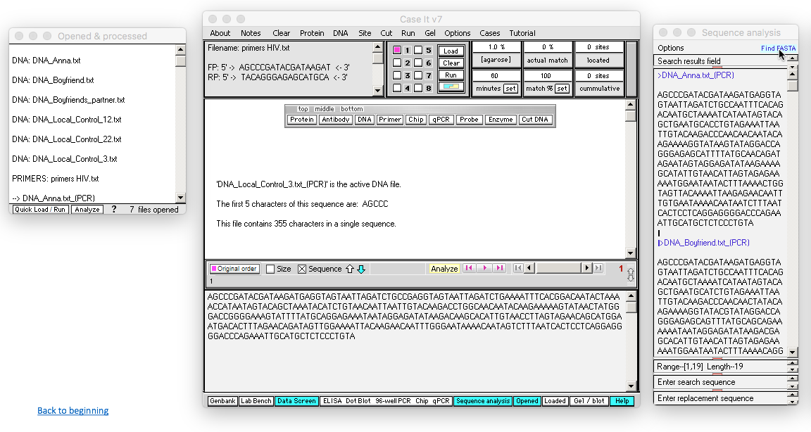
Selected PCR products have been added to the Sequence analysis window to the right of the main screen, in FASTA format. [Note that you can verify that the proper products were added by repeatedly clicking the blue Find FASTA button in the Sequence analysis window, to cycle through the products.]
Back to beginning

Slide 9
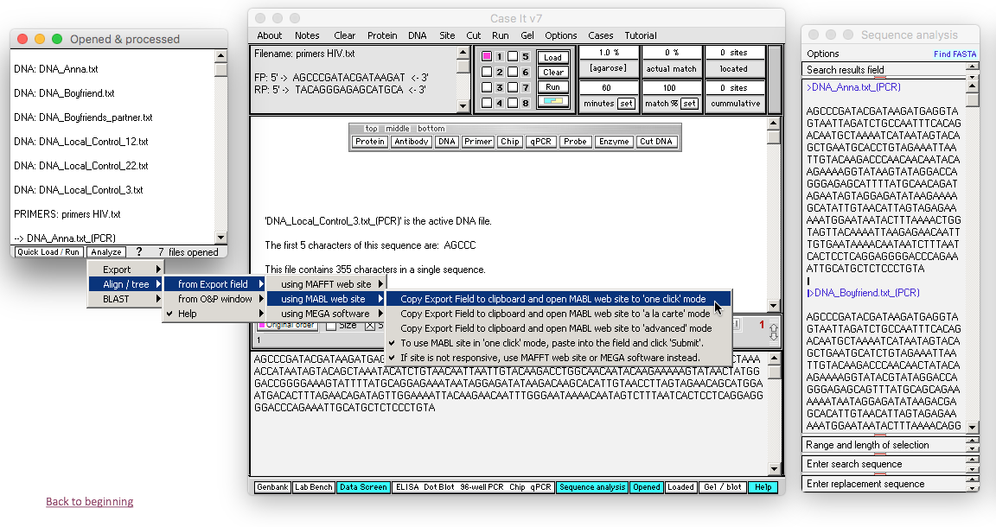
Case It has three options for aligning sequences and building trees [1] MABL web site, [2] MAFFT web site, and [3] MEGA software. The quickest way to build a tree is with the MABL, so we’ll demonstrate that first. To use the MABL website, click the Analyze menu at the bottom of the Opened & processed window, and select the menu choices shown below. We’ll use the ‘one click’ mode of MABL for simplicity.
[Note: the MABL website is not always responsive, so if it doesn’t work it may be necessary to use MAFFT or MEGA instead.]
Back to beginning

Slide 10
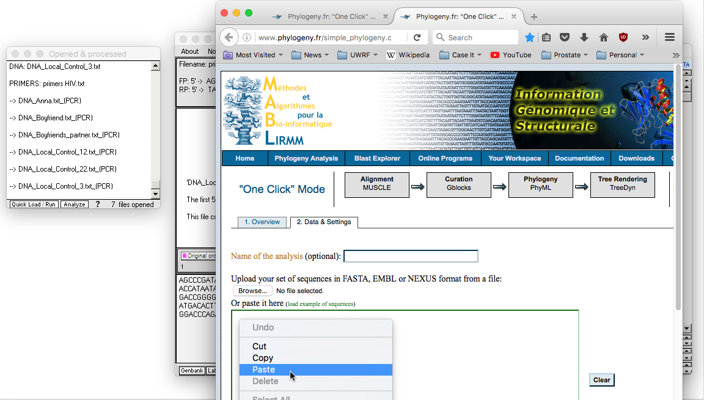
The MABL web site automatically opens to ‘once click’ mode. Right-click on the input field and select Paste…
Back to beginning

Slide 11
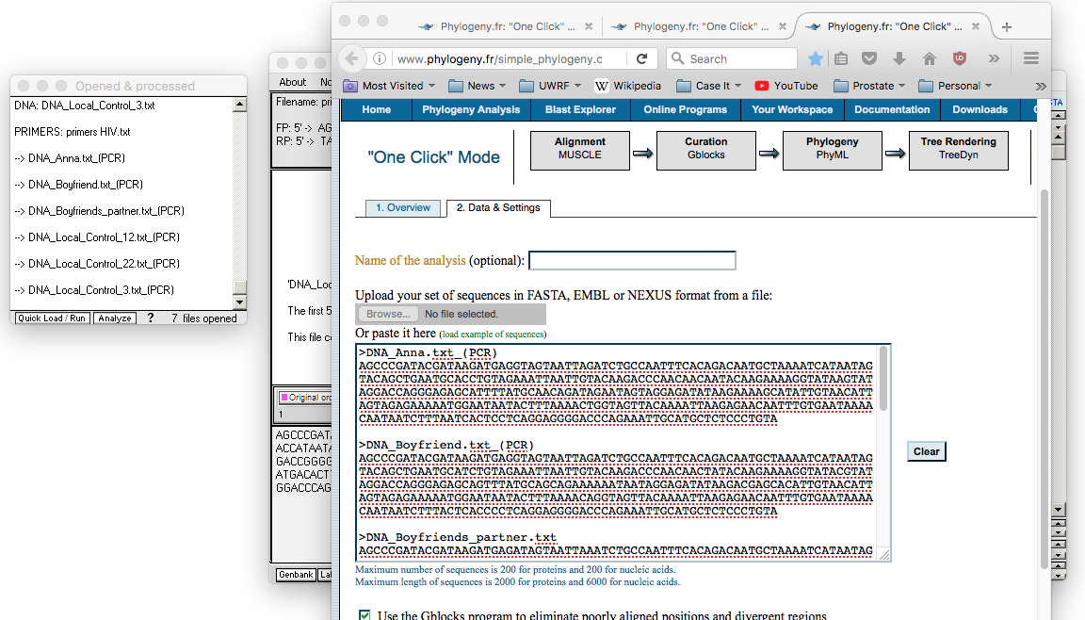
Contents of the Export field of Case It now appear in the input field of the MABL web site.
Back to beginning

Slide 12
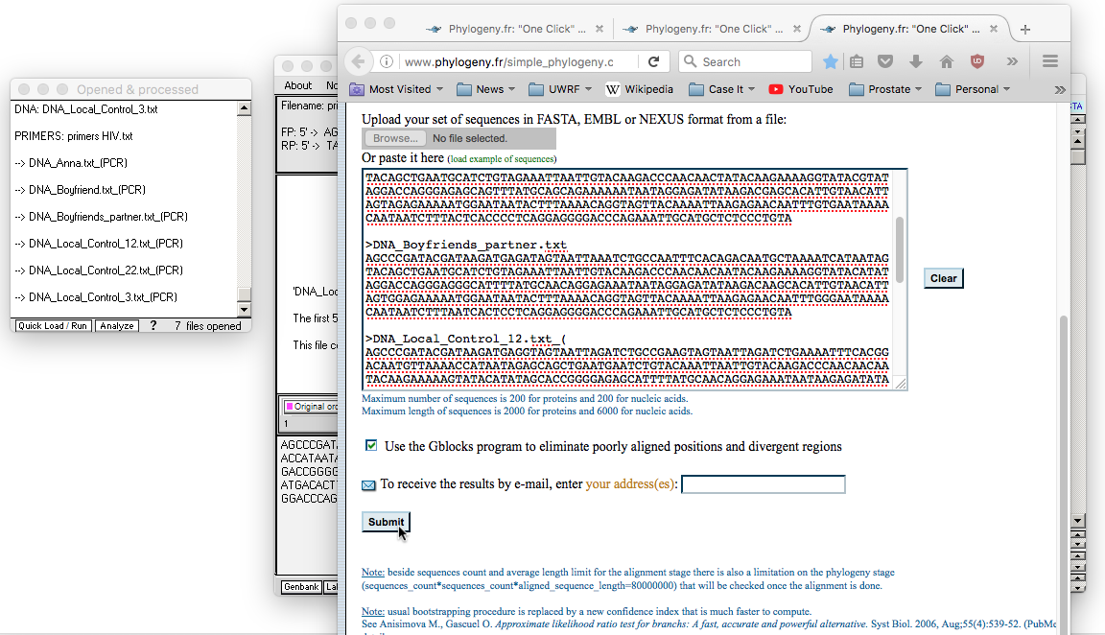
Scroll down on the web page, and click Submit (since this is the ‘one click’ mode of MABL)…
Back to beginning

Slide 13
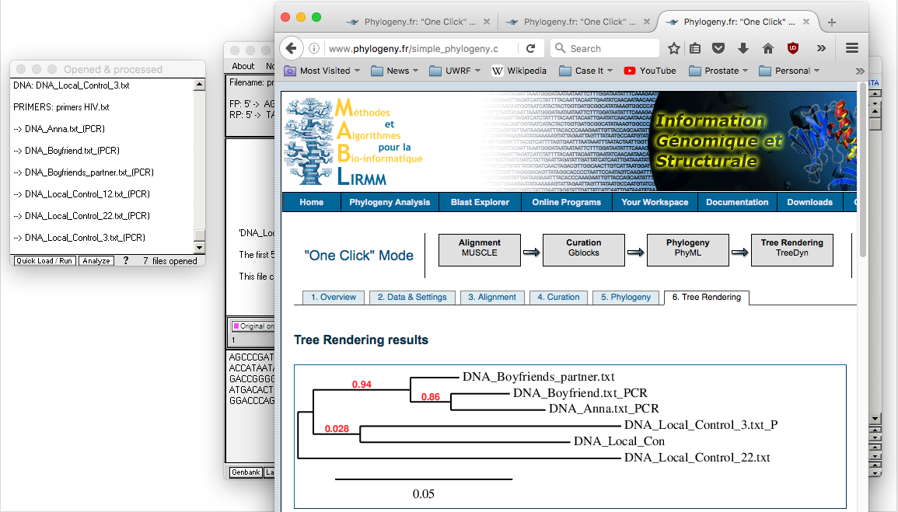
…and wait for the tree to appear. If the website is not responsive, use one of the other options [MAFFT web site, MEGA bioinformatics software].
Back to beginning

Slide 14
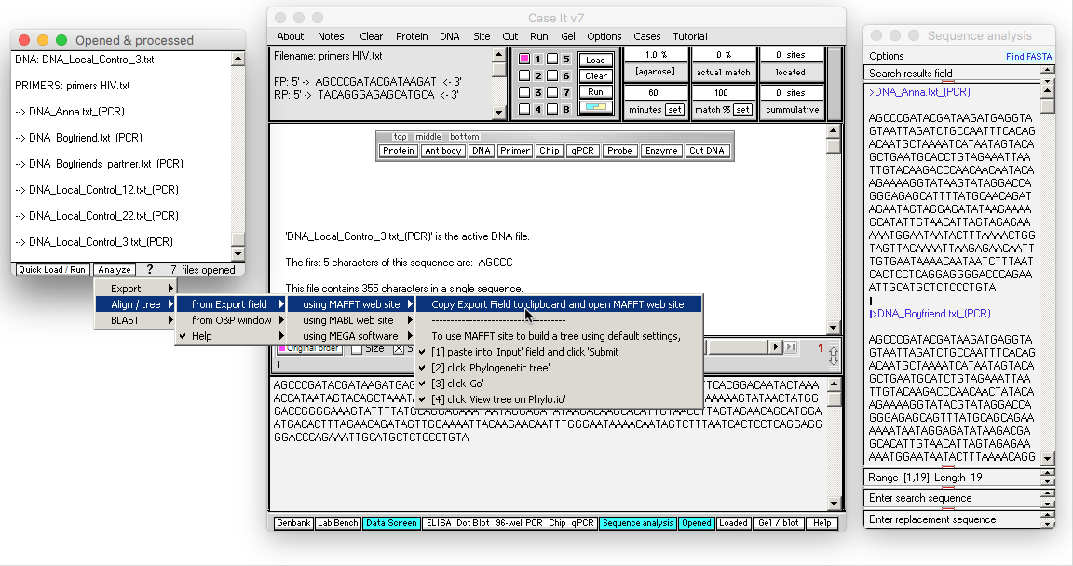
Case It has three options for aligning sequences and building trees [1] MABL web site, [2] MAFFT web site, and [3] MEGA software. Use the Analyze button and select the menu options shown below to copy contents of the Export Field to the clipboard and automatically open the MAFFT site. [Note: Although use of MAFFT requires more mouse clicks then using MABL, the MAFFT site is almost always operable, whereas MABL may not be.]
Back to beginning

Slide 15
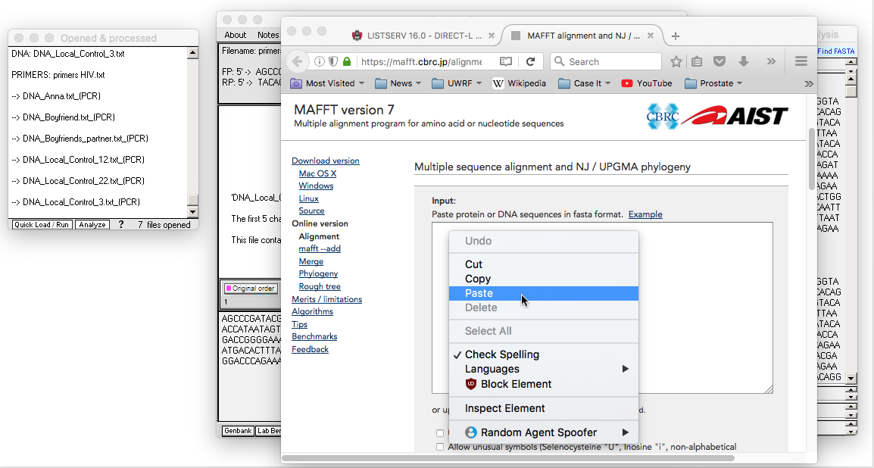
It may take a few seconds for your web browser to open to the MAFFT site. Right-click inside the Input field, and select Paste.
Back to beginning

Slide 16
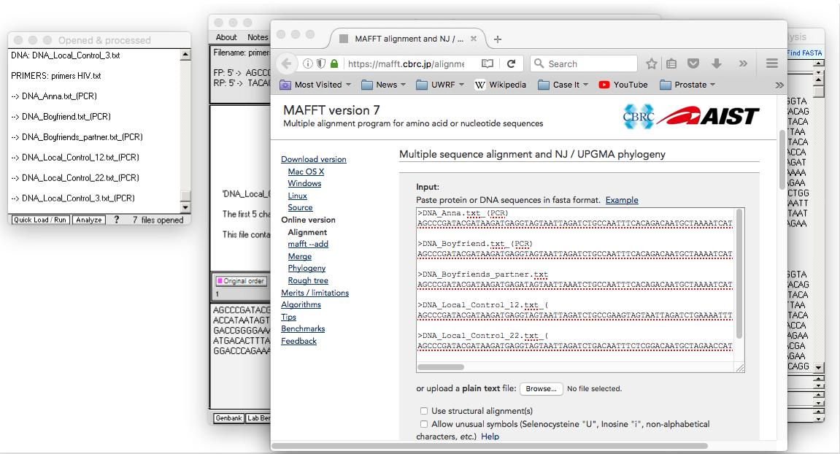
Contents of the Export field of Case It now appear in the Input field of the MAFFT web site.
Back to beginning

Slide 17
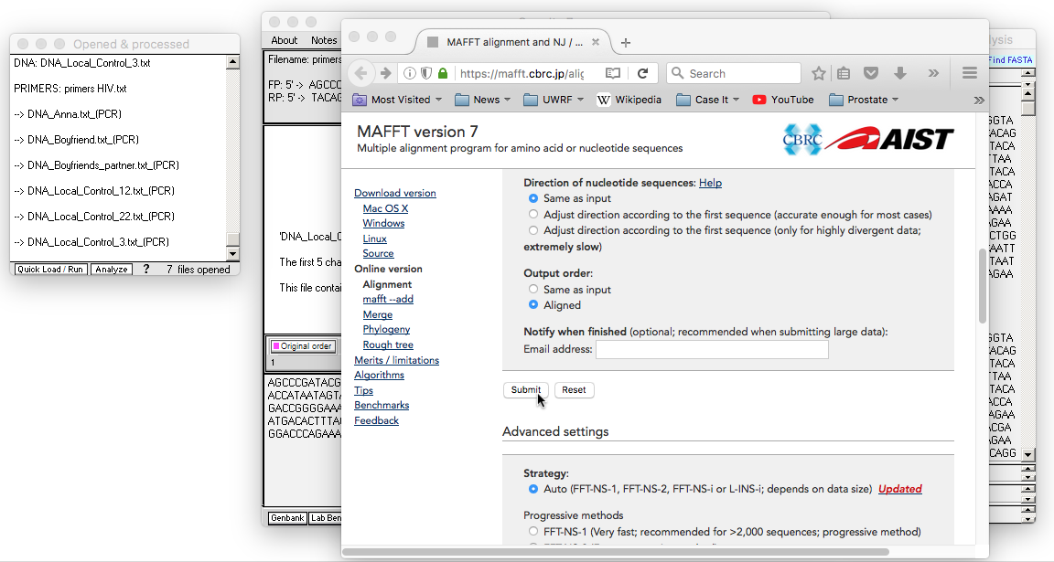
Scroll down on the MAFFT page and click the Submit button [in this example, no options are being changed before clicking Submit].
Back to beginning

Slide 18
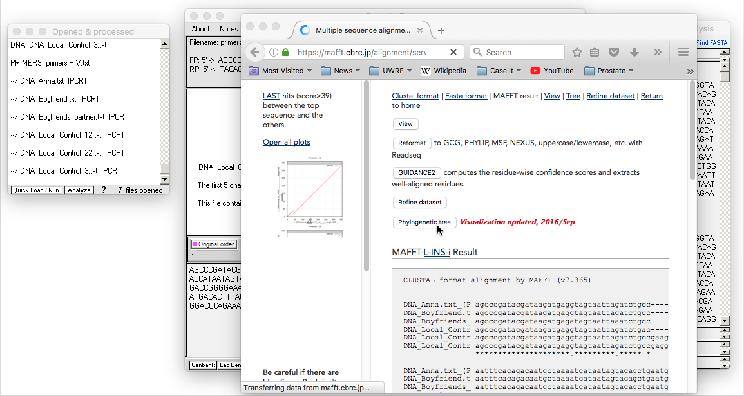
The sequences have been aligned via CLUSTAL. Click the Phylogenetic tree button…
Back to beginning

Slide 19
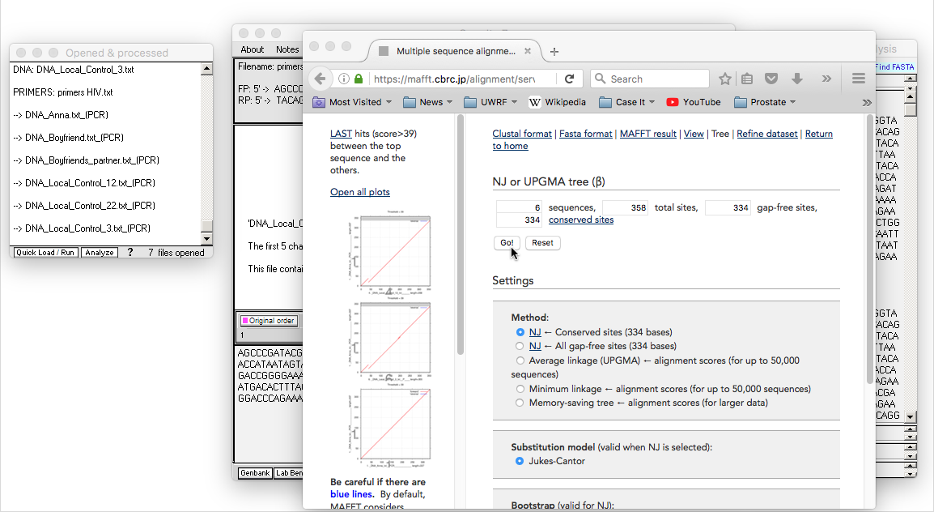
Default settings will be used in this example, so click the Go button…
Back to beginning

Slide 20
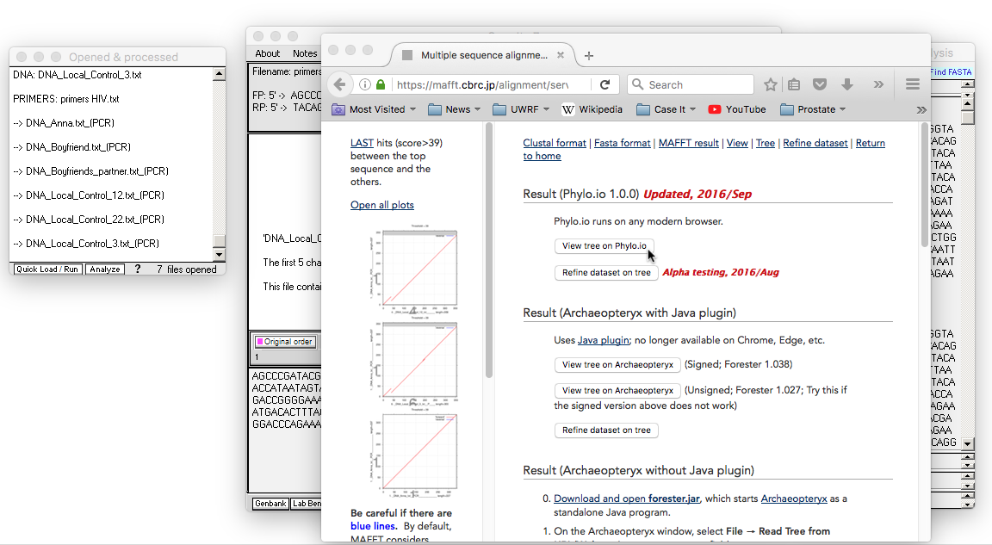
…click View tree on Phylo.io…
Back to beginning

Slide 21
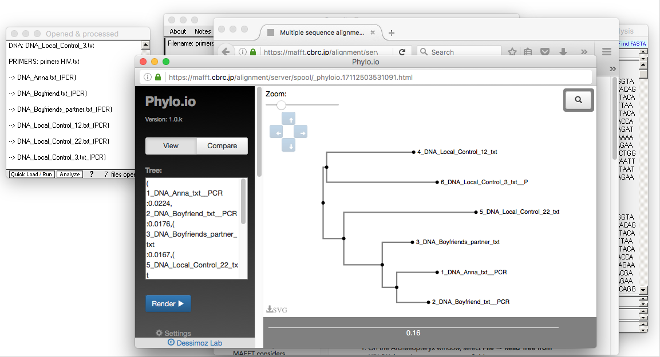
…and the tree will appear. In this example, the directional arrow buttons were used to change the original scale of the tree.
Back to beginning

Slide 22
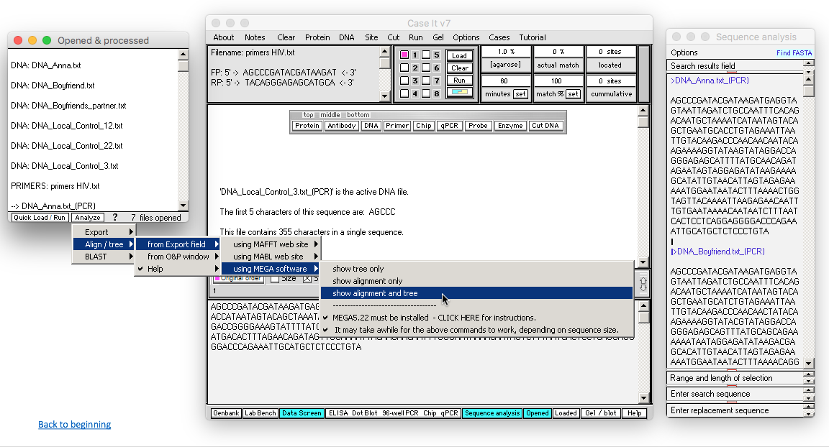
The third option for multiple alignment and tree-building is to have Case It open and control MEGA5 software. If default values for this software are used, then Case It will open MEGA5 and build a tree with one click (MEGA5 is included with the Case It download). Click the Analyze button and select the menu commands below.
Back to beginning

Slide 23
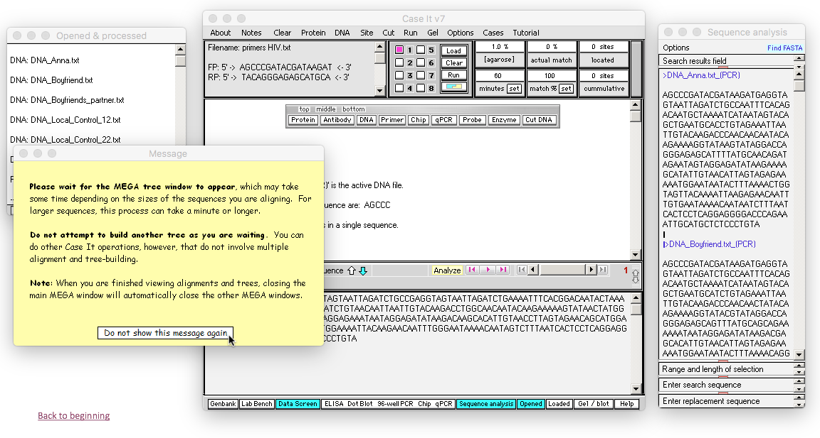
The first time that this command is used, a yellow alert box will appear, indicating that it will take some time for MEGA to appear. This depends on the speed of your computer, and the number and size of sequences being aligned. So the key is to be patient. Note that other Case It operations can be conducted while you are waiting, but that you should not attempt to build another tree until the first one appears.
Back to beginning

Slide 24
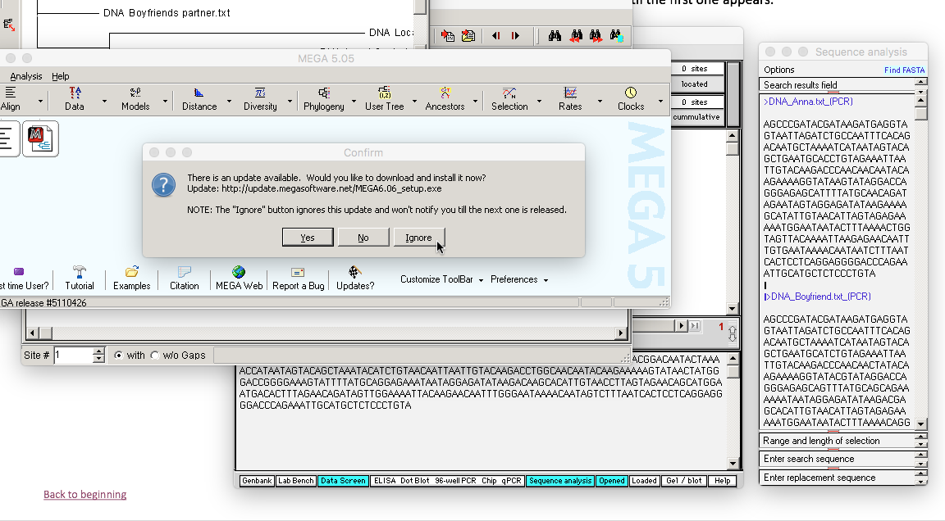
Several windows will open, including the main MEGA5 window (the one with the light blue background). On the Confirm window, click Ignore, as you don’t want updates to MEGA5 since they won’t work with Case It. After clicking Ignore, minimize the light blue window. (Minimize it, don’t close it, as closing this window closes all windows of MEGA5).
Back to beginning

Slide 25
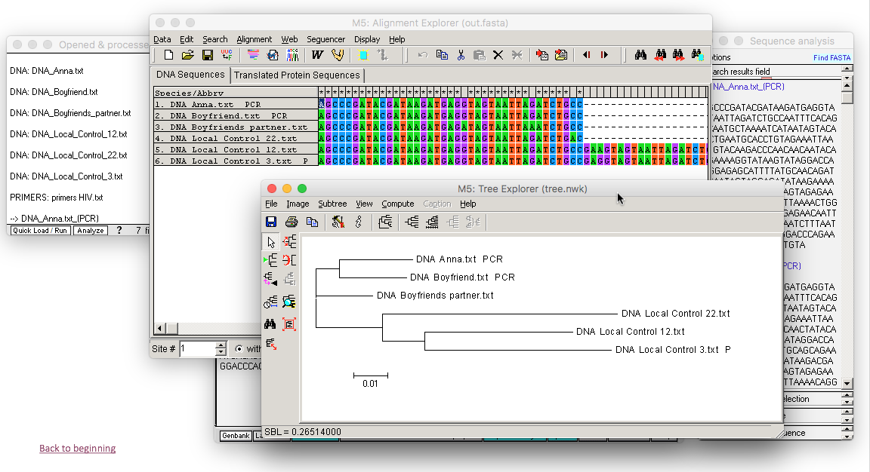
The multiple alignment and tree now appear. The advantage of using MEGA5 over the bioinformatics sites has do do with the many manipulations of the alignment and tree that are possible using MEGA5.
Back to beginning

Slide 26
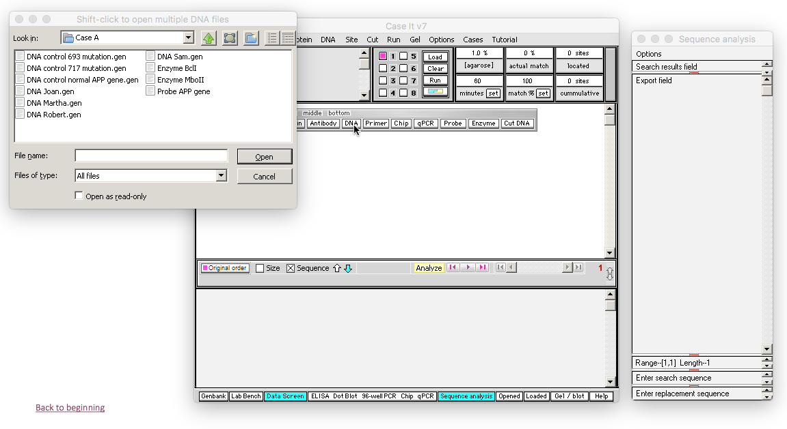
Case It can also be used as a front end for BLASTING DNA and protein sequences. We’ll use one scenario from the Alzheimer’s case as an example. Click the DNA button on the silver button bar, and navigate to Cases -> Genetic disease cases -> Alzheimer's -> Case A.
Back to beginning

Slide 27
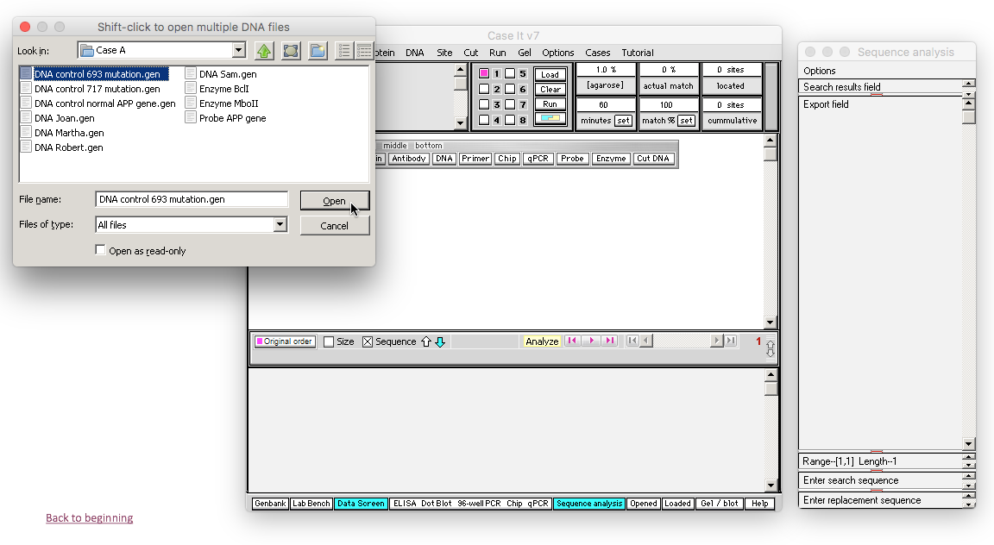
Any of the DNA sequences can be selected, so for this example we’ll select the first one. Double-click on the first file name, or click once and click the Open button…
Back to beginning

Slide 28
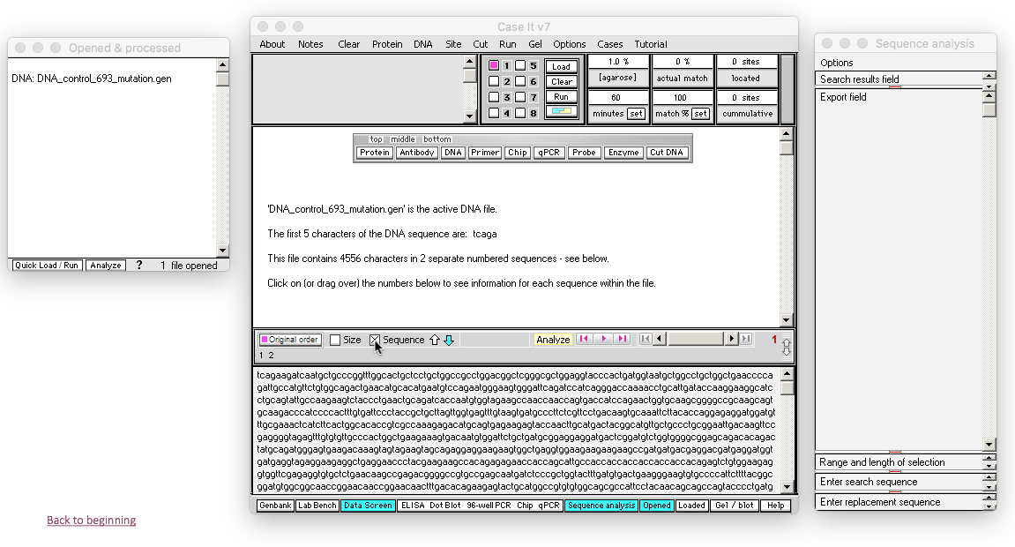
The name of the file appears in the Opened and processed window at the left. To see the sequence associated with this file name, click on the Sequence checkbox on the gray divider bar. By default, the blue arrow to the right of the checkbox points down, indicating that the sequence in the lower field will be shown.
Back to beginning

Slide 29
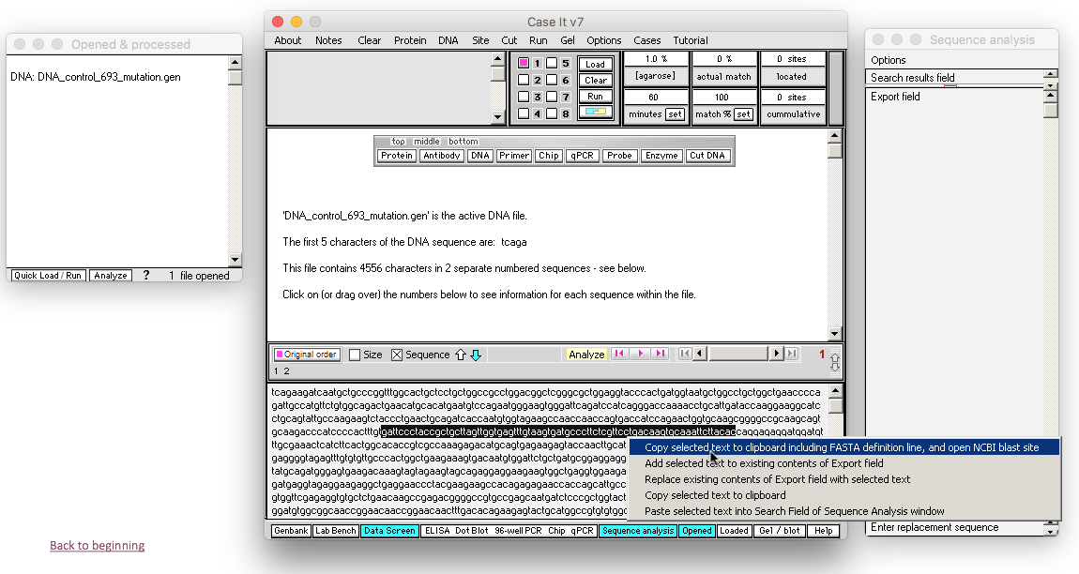
Highlight any part of the sequence and right-click on it. Select the first menu option in the pop-up menu to automatically open your default web browser the the NCBI blast site.
Back to beginning

Slide 30
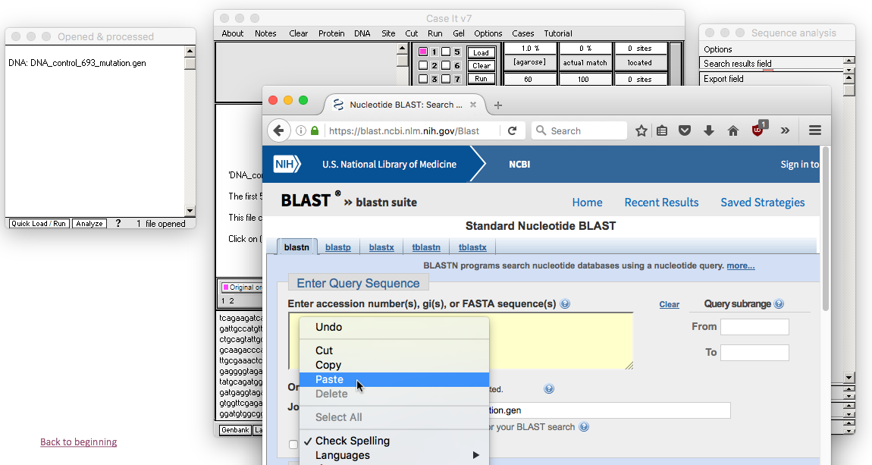
Right-click in the Query Sequence field of the NCBI site, and paste the contents of the clipboard into the field. It may be necessary to click and paste twice for this to work.
Back to beginning

Slide 31
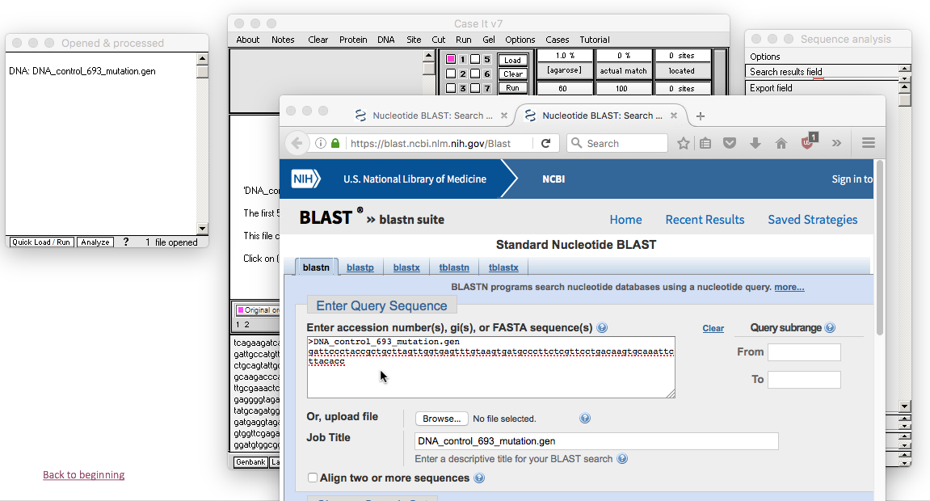
The DNA sequence copied from Case It is not in the Query Sequence field of the NCBI site.
Back to beginning

Slide 32
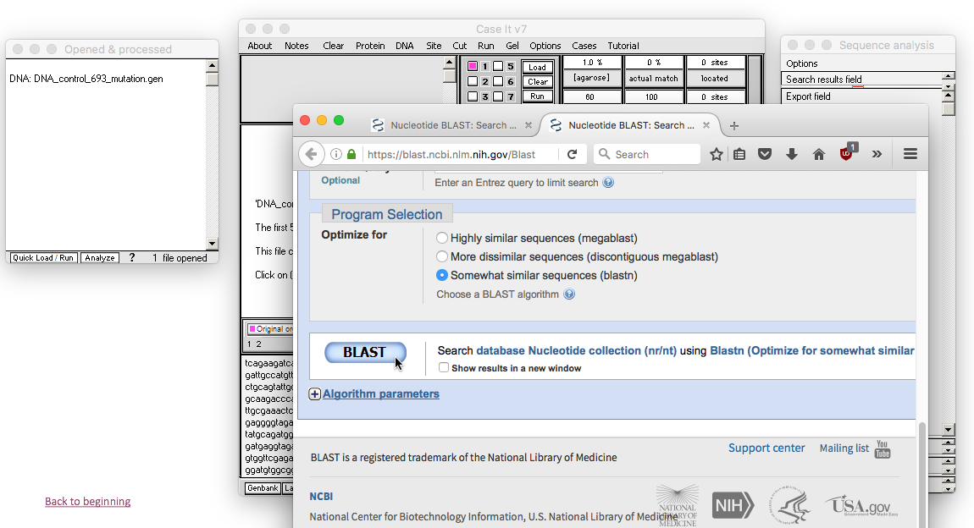
Scroll down on the NCBI page and click the BLAST button.
Back to beginning

Slide 33
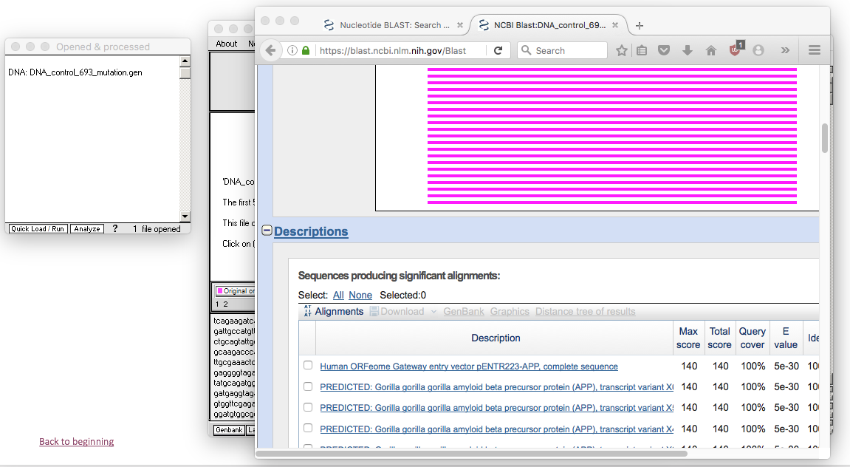
After a few moments the BLAST results will appear.
Back to beginning

Slide 34
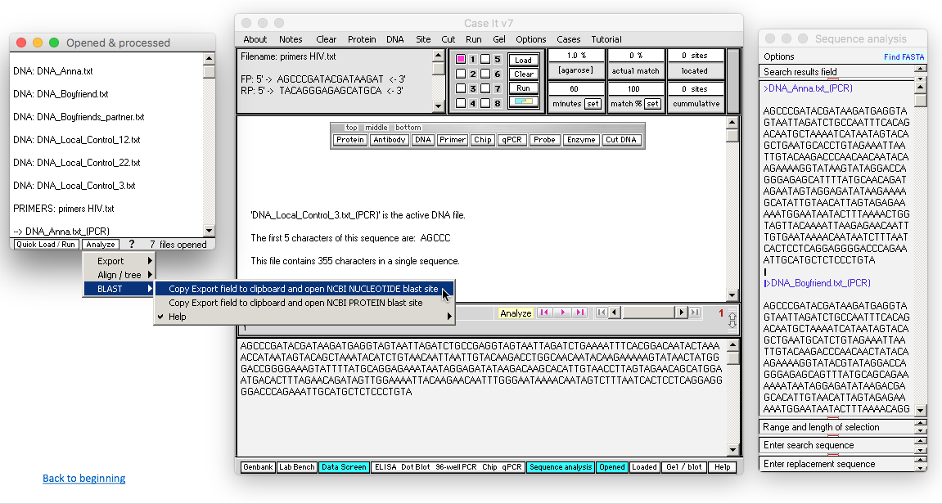
BLAST can also be used to analyze data in the Export field, using several methods. To demonstrate the first method, we’ll use the HIV example described earlier, assuming that sequences have already been added to the Export field (see pp. 2-8 of this tutorial).
Click the Analyze button at the bottom of the Opened & processed window, and make the menu selection shown below.
Back to beginning

Slide 35
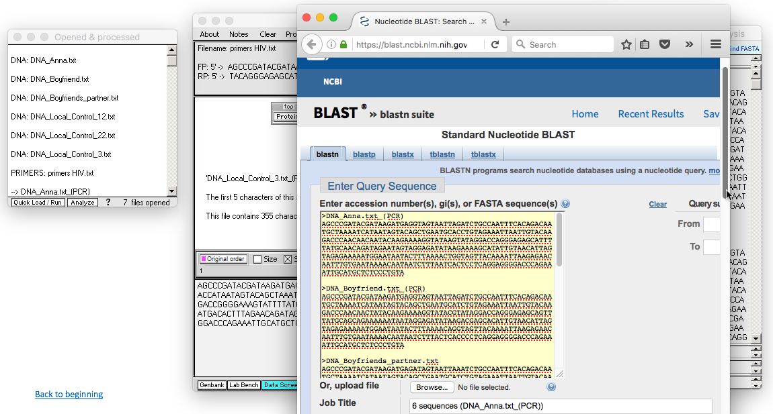
The NCBI web site will automatically open, and you can paste the contents of the clipboard into the Query Sequence field by right-clicking on the field and selecting Paste (you may have to do this twice). Then scroll further down the web page and click the BLAST button (not shown here).
Back to beginning

Slide 36
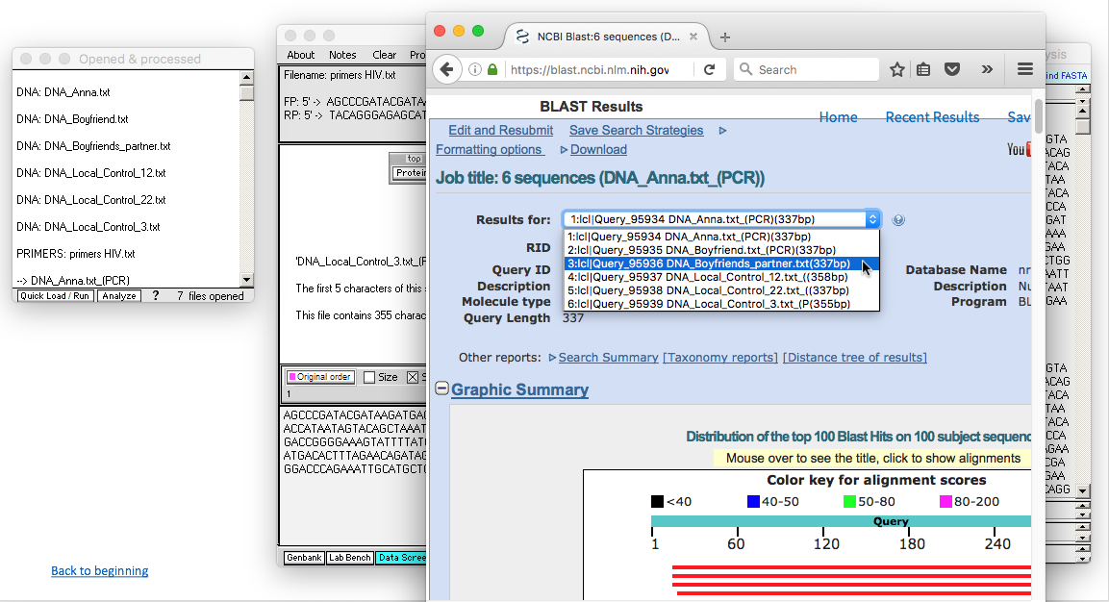
Since multiple sequences were BLASTed, you can select the results you wish to view from the drop-down menu on the BLAST Results page.
Back to beginning

Slide 37
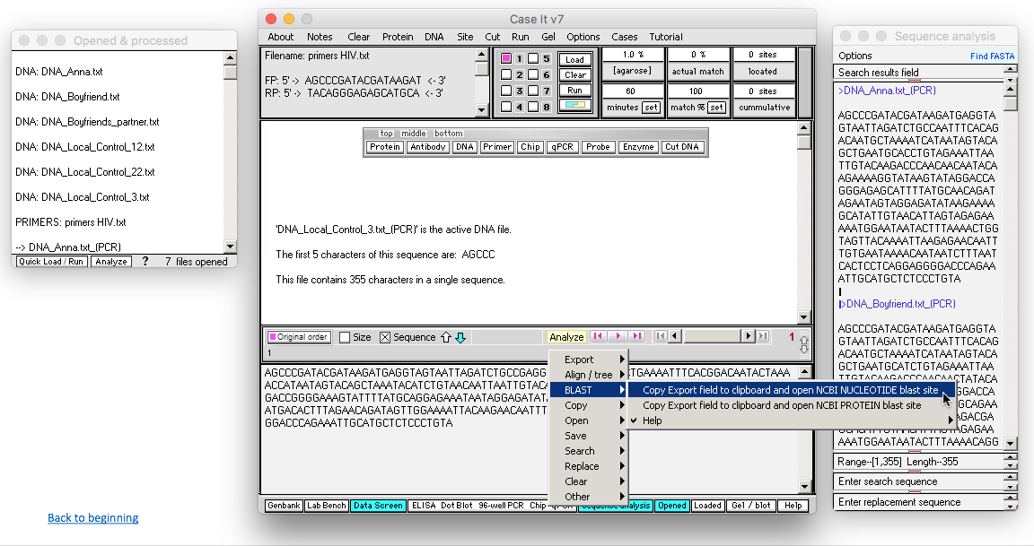
Another way to accomplish the same thing is to use the yellow Analyze button on the main screen. Note that the two Analyze buttons have some commands in common, but some unique commands as well. In this particular case, BLAST results would be identical to those shown on the preceding page of this tutorial, so we won’t show them again.
Back to beginning

Slide 38
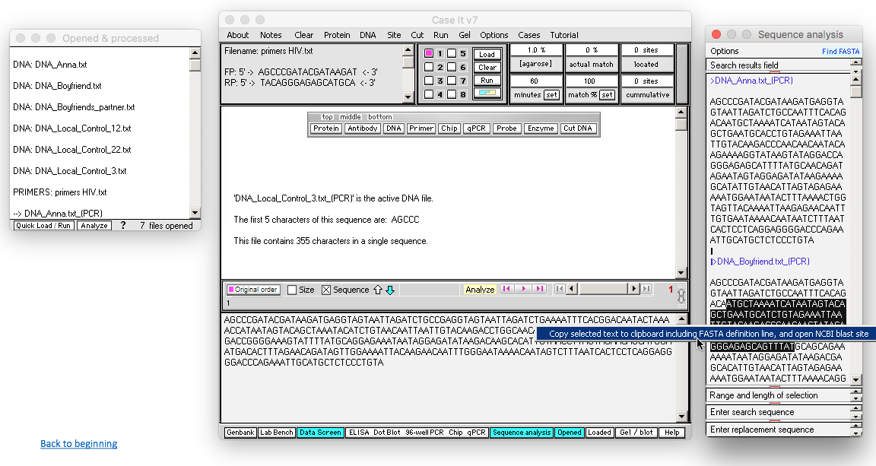
You can also highlight and BLAST highlighted contents of the Export field, by right-clicking on the highlighted sequence. We won’t show the BLAST results for this particular example, but it would be similar to those shown previously.
Back to beginning

Slide 39
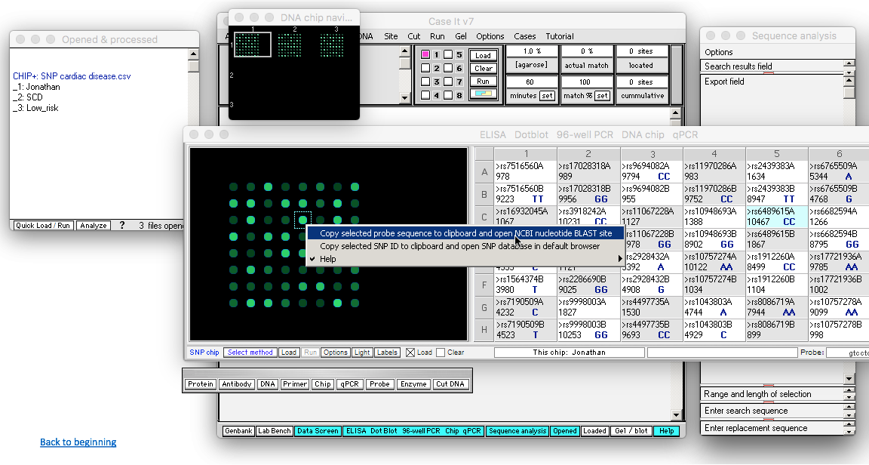
BLASTing can also be done on features of a microarray, by right-clicking on a selected feature. The procedure for setting up a SNP or expression microarray can be found in a separate tutorial. This concludes the tutorial on BLASTing sequences via Case It.
Back to beginning

